Slide 1


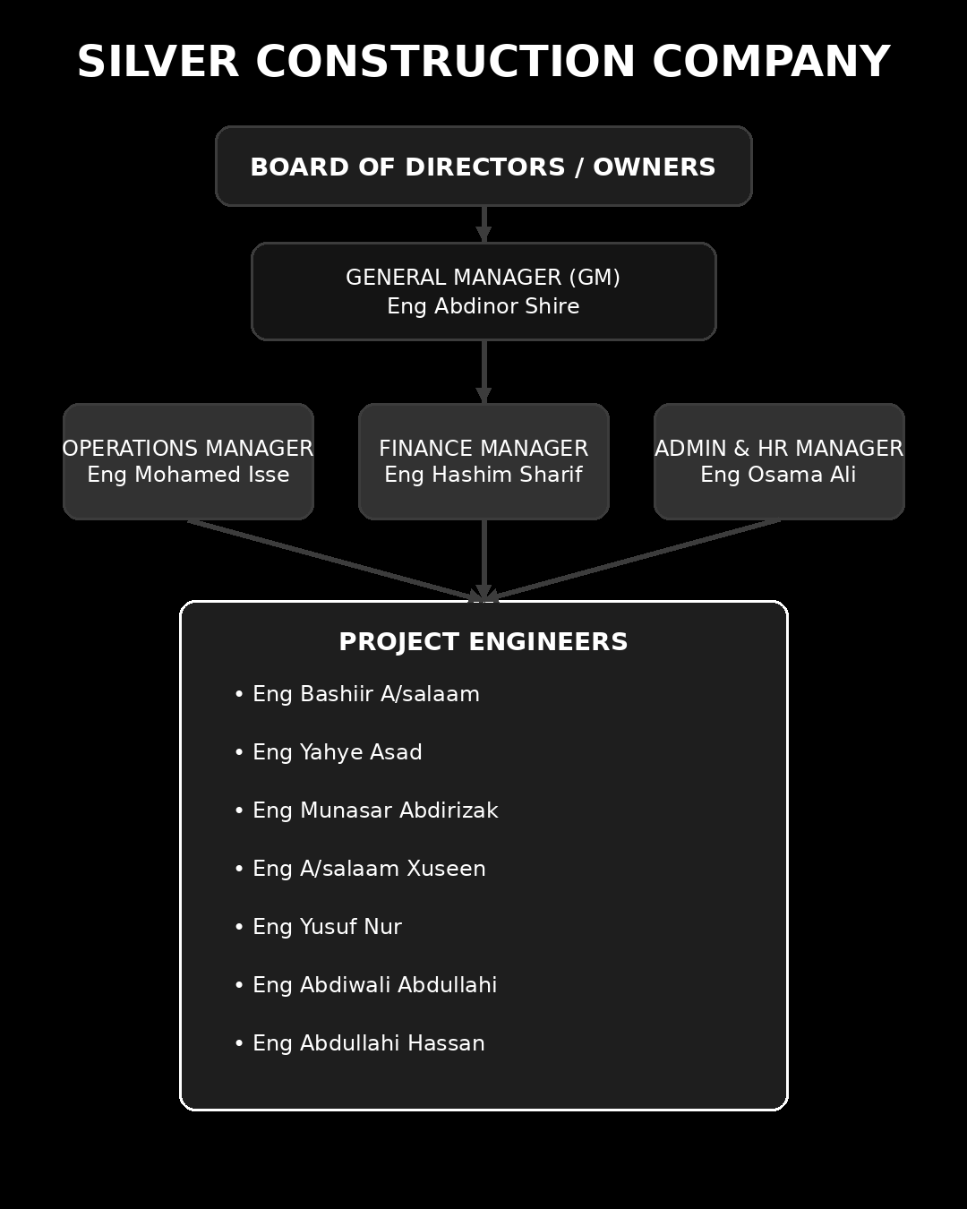
Silver Construction Company

Slide 2
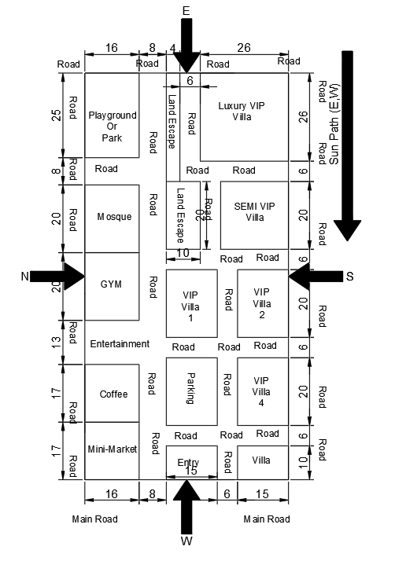
Luxury VIP Villa
Ground Floor
Guest sitting
Kitchen
Store
Living room
Dining room
Maid room + Bathroom
G. Bathroom
Laundry
Gym
Garden / Landscape
Parking
Pool
First Floor
Master rooms
Bedrooms
Small kitchen
Reading room
Office
Bathroom
Living room

Slide 3
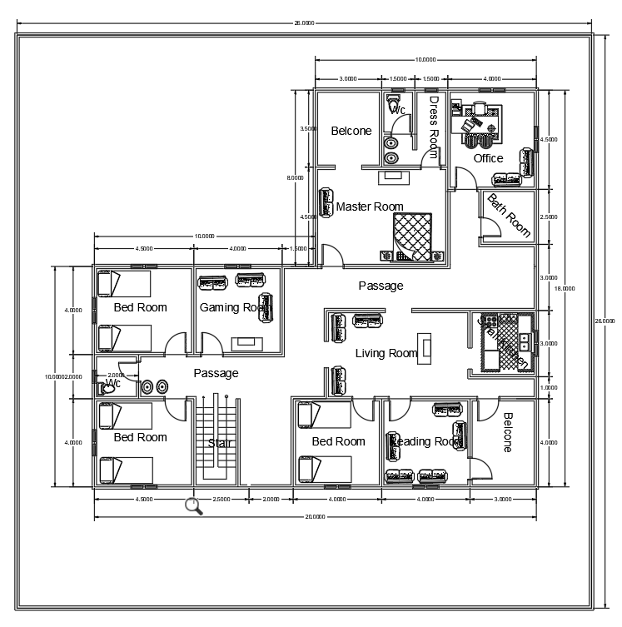
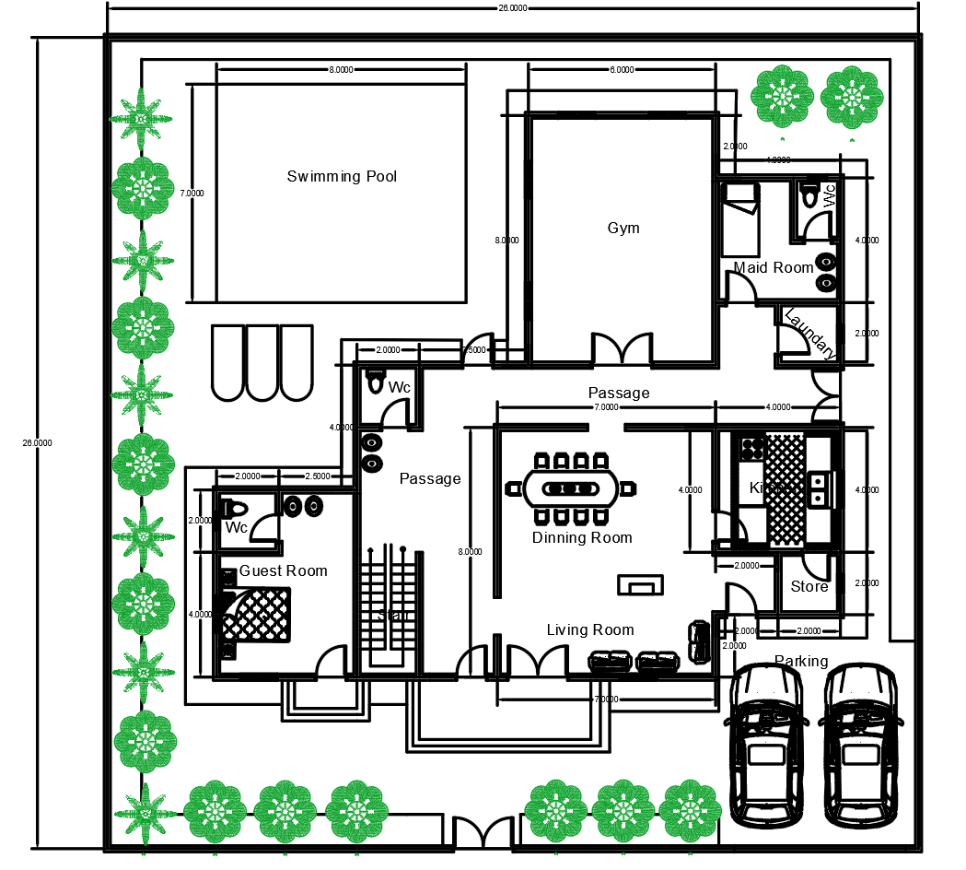
Sketch Diagram
FIRST - FLOOR
GROUND - FLOOR

Slide 4
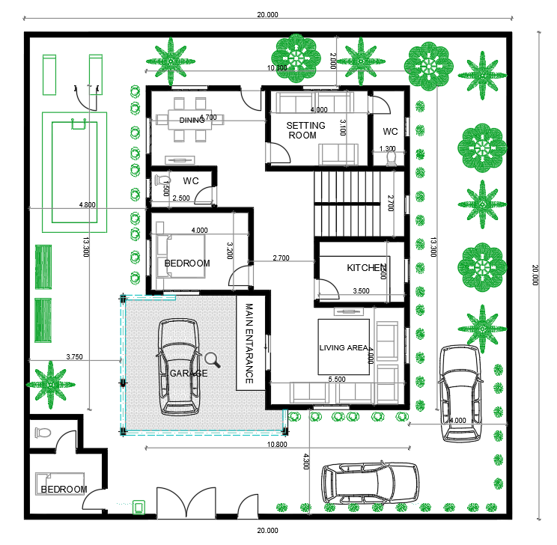
Semi VIP Villa
No
Kitchen
Living room
Dining room
Maid room + Bathroom
G. Bathroom
Garden / Landscape
Parking
Pool
Master rooms
Bedrooms

Slide 5
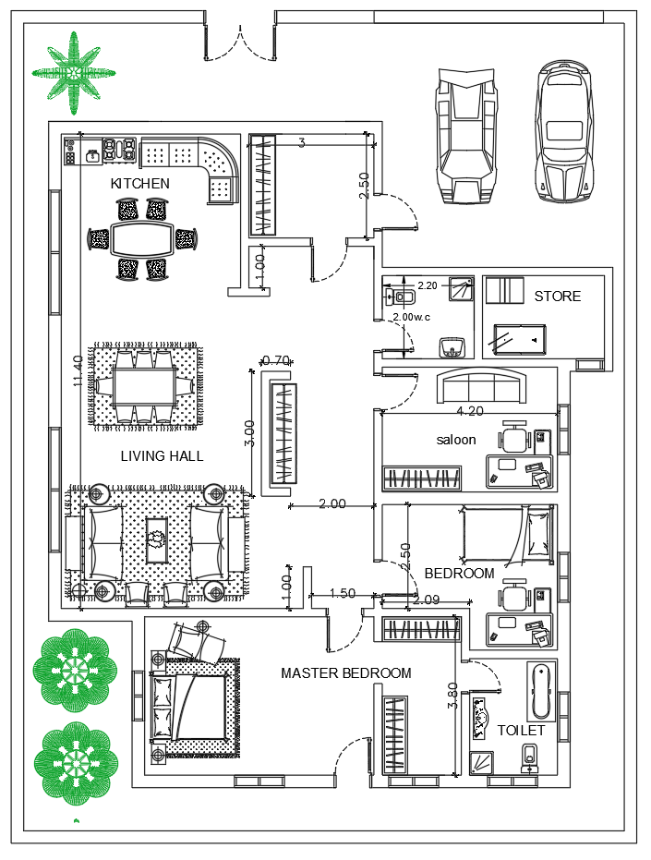
VIP Villa
No
Kitchen
Living room
Dining room
Store
G. Bathroom
Garden / Landscape
Parking
Master rooms
Bedrooms

Slide 6
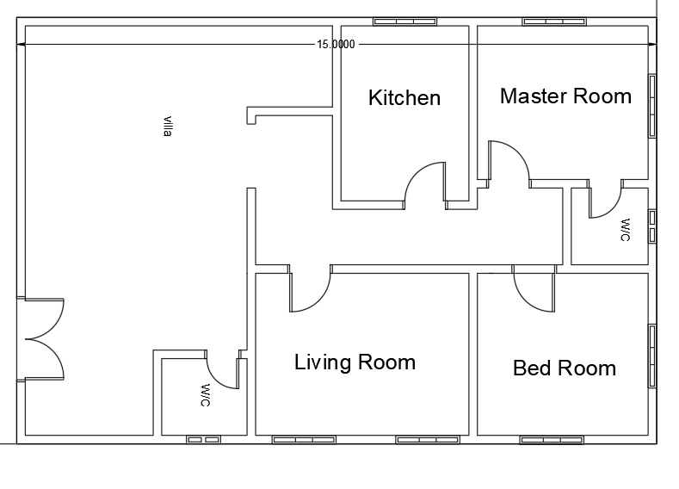
Villa
No
Kitchen
Living room
G. Bathroom
Master rooms
Bedrooms

Slide 7
