Slide 1


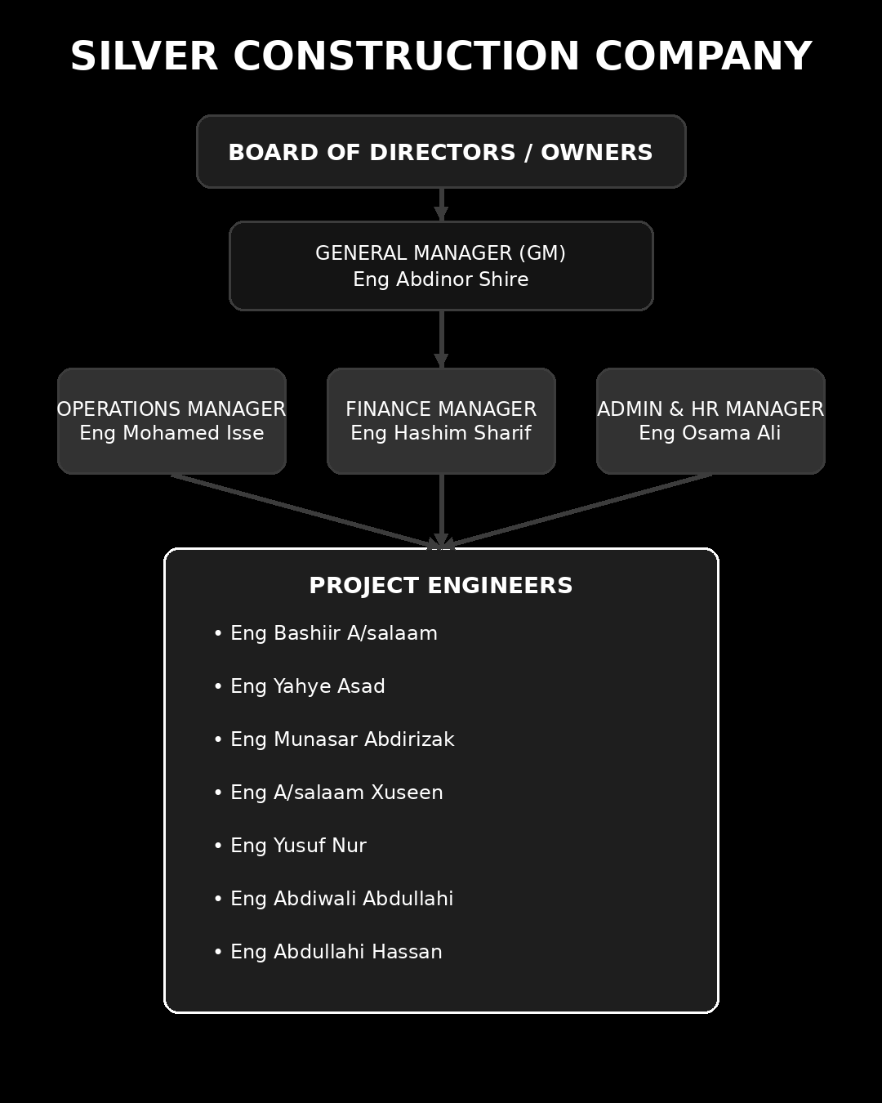
Silver Construction Company

Slide 2
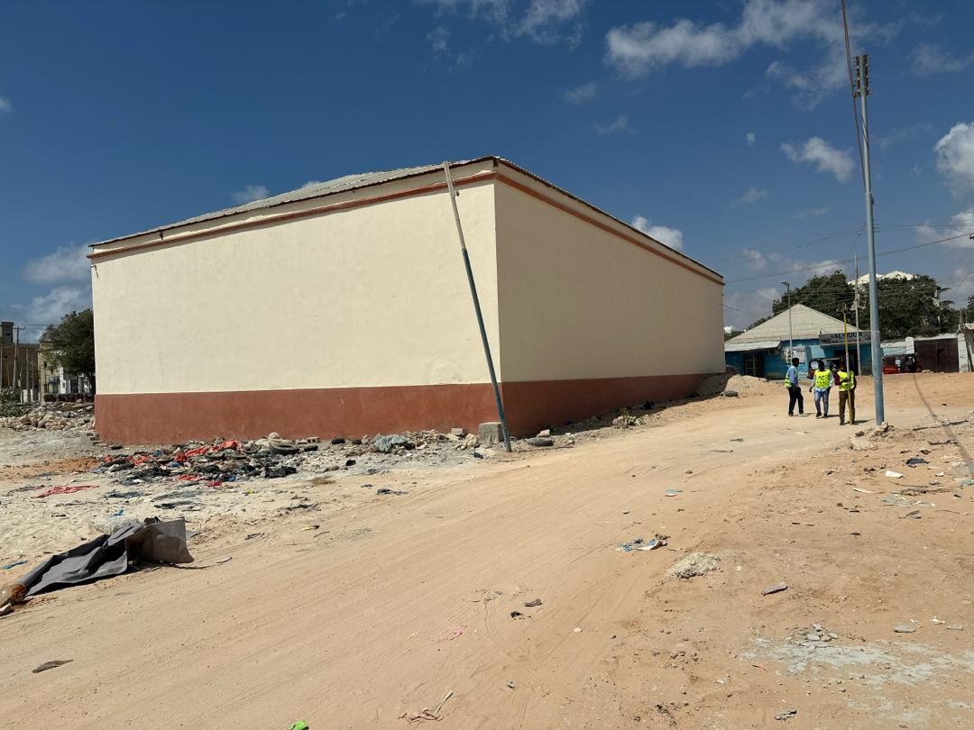
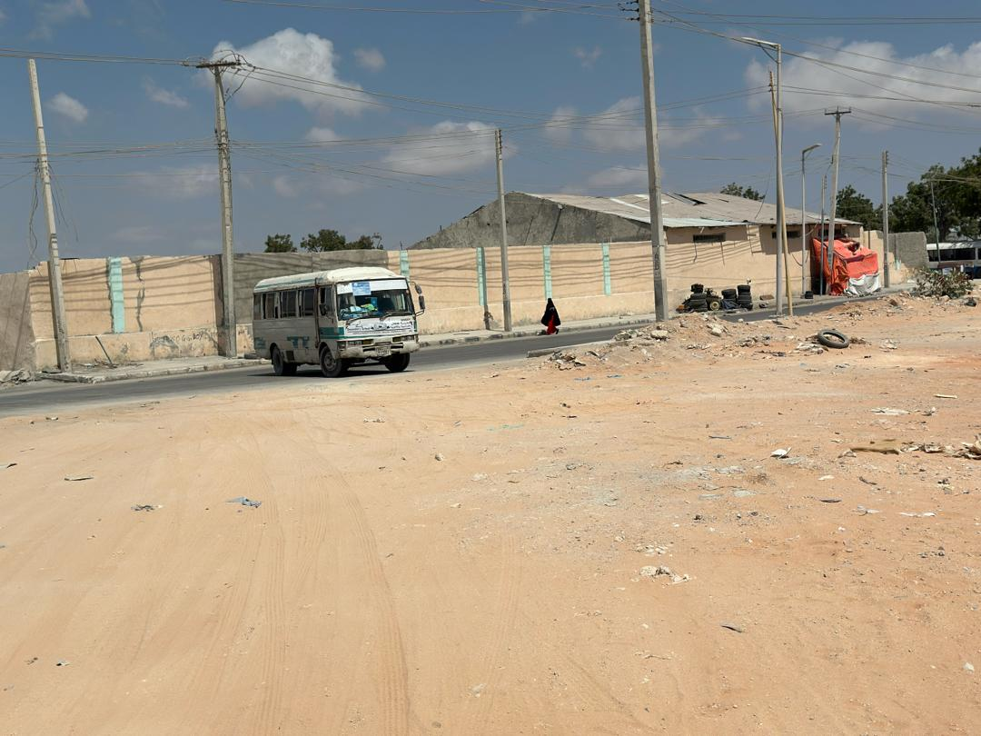
PROJECT DEFINITION
Project Title
Proposed Planned Residential Community Development at Carwo Taleex, Mogadishu
Deg; Hodan
Laanta; October
Xafada; Carwo Taleex

Slide 3
Problem Statement
Mogadishu is experiencing rapid urban growth, which has increased the demand for organized residential housing and community services. Many areas are developing without proper urban planning, leading to:
    Congested residential areas
    Lack of organized road networks
    Limited access to community facilities
The vacant land located in Carwo Taleex requires a planned residential layout that integrates housing, roads, and social services in an organized and efficient manner.

Slide 4
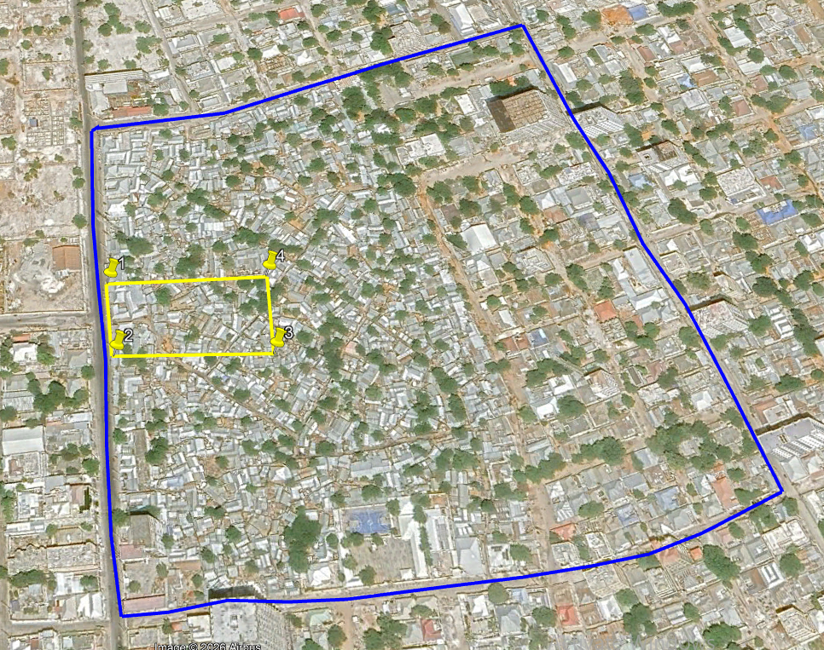

Slide 5
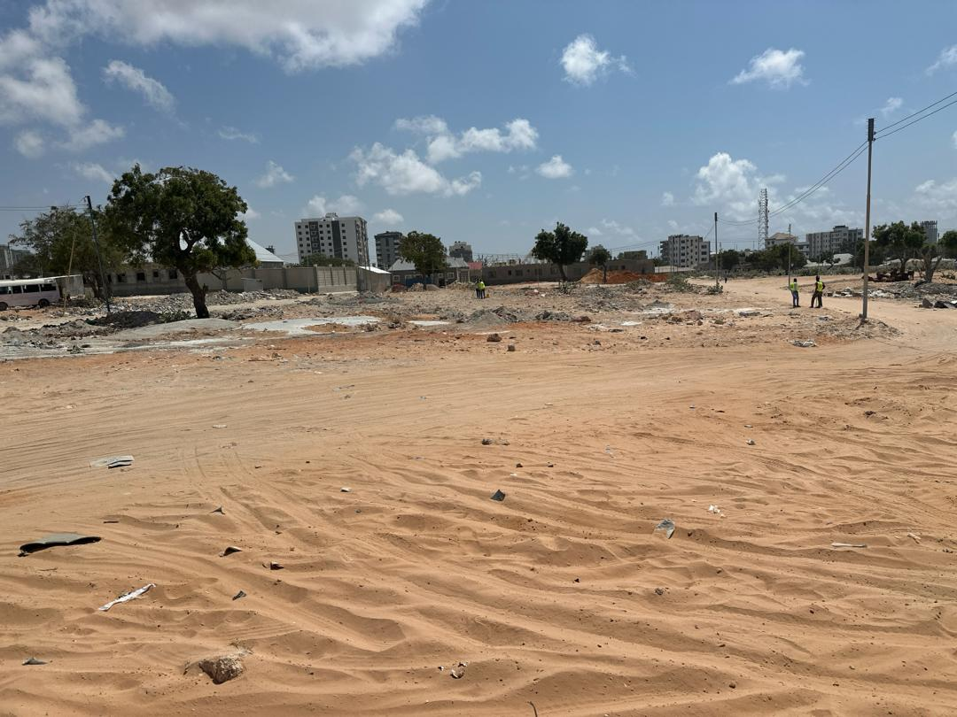

Slide 6
Project Justification
This project is proposed in order to:
  Provide modern residential villas in a planned environment
  Improve land use efficiency within the site
  Create community facilities such as a mosque, park, gym, coffee area, and mini-market
  Enhance urban organization and living standards
The project contributes to the sustainable urban development of Mogadishu.

Slide 7
Objectives
General Objective
To design a planned residential community within Carwo Taleex that provides organized housing, accessible roads, and essential community services.
Specific Objectives
To develop a 120 m × 60 m site plan containing different villa types.
To design internal roads and a main entrance for proper circulation.
To allocate land for community facilities including a park, mosque, gym, coffee area, and mini-market.
To ensure efficient land distribution and functional layout.
To create a safe, accessible, and attractive residential environment.

Slide 8
Project Scope
The project focuses on the planning and design of a 120 m × 60 m residential block located in Carwo Taleex. The scope includes:
  Development of VIP Villas and Semi-VIP Villas
  Planning of internal road networks and access points
  Allocation of land for community facilities such as playground/park, mosque, gym, coffee area, and mini-market
  Provision of parking areas and circulation routes
  Preparation of 2D and 3D site layouts showing the building arrangement and site organization.

Slide 9
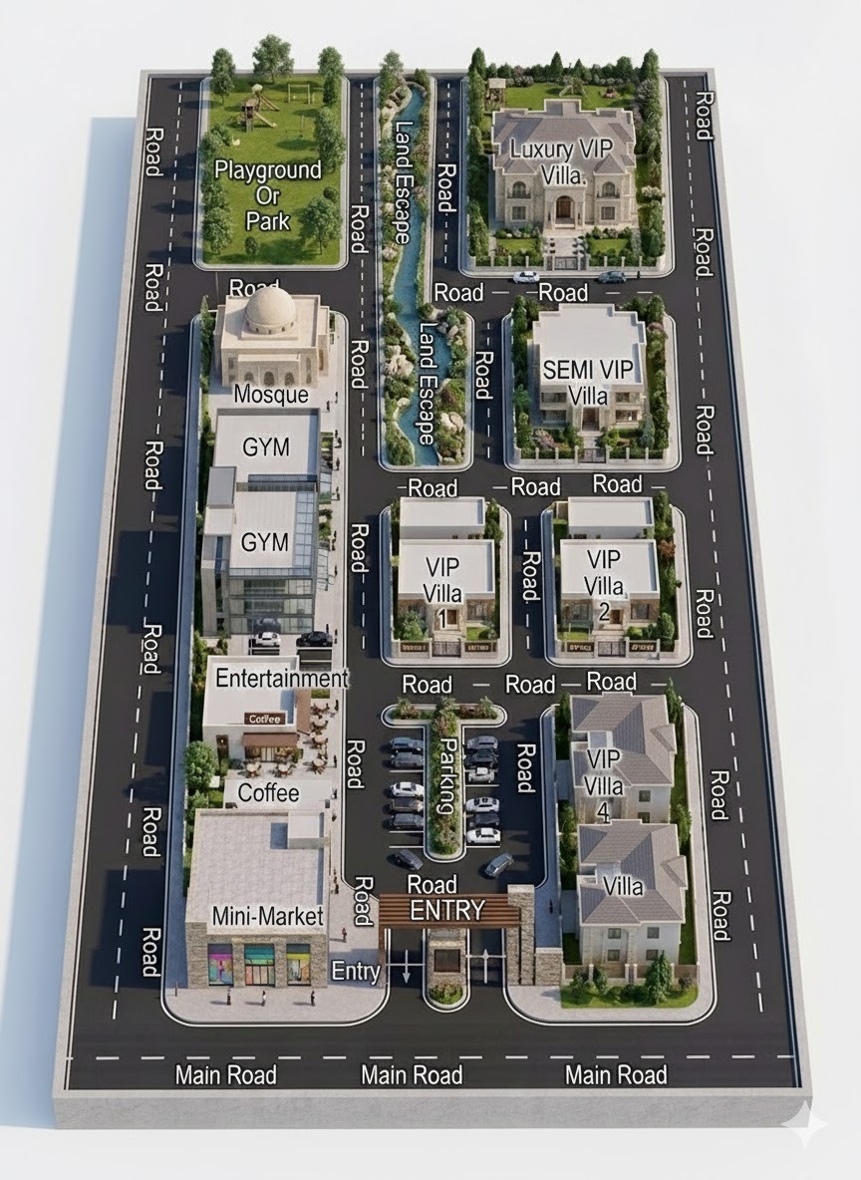
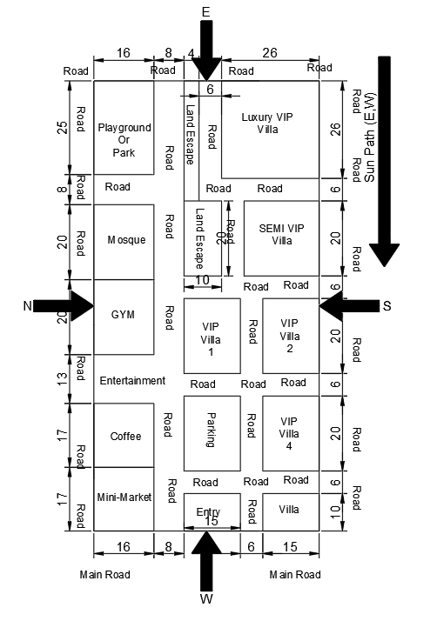

Slide 10
Presentation 2

Slide 11
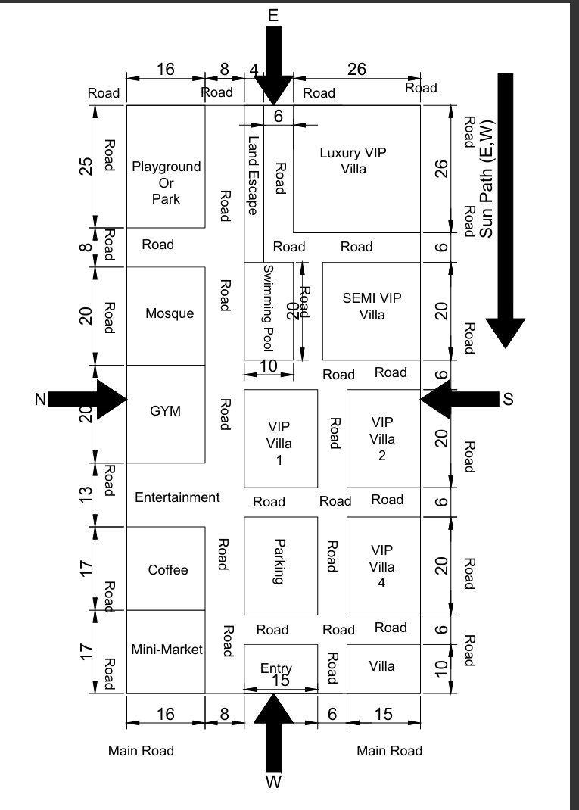
Site Sketch Diagram

Slide 12
SITE ANALYSIS REPORT
  Site Location and Size
The project is located in Mogadishu, specifically Carwo Taleex.
The site measures approximately 120 m × 60 m and is planned as a Residential Luxury Villa Compound with amenities such as a mosque, park, gym, and small commercial area.
  Site Boundary
The site is surrounded by roads on all sides.
  North: Inside the compound, there is a park/playground and villas
  South: Main road and entrance
  East: Major road with sun path exposure
  West: Main road and commercial facilities

Slide 13
SITE ANALYSIS REPORT
  Road Access and Circulation
Internal roads connect all areas:
Main Road is on the West sides
Internal Roads lead to:
  Luxury VIP Villa
  Semi VIP Villa
  VIP Villas
  Parking
  Entertainment area
  Mini Market
The internal circulation facilitates vehicle movement and pedestrian flow
  Site Orientation
The site has 4 main directions:
  North (N) – Gym and park side
  South (S) – Villas side
  East (E) – Sun-facing side (sun path)
  West (W) – Main entrance side
This orientation helps with ventilation and sunlight distribution within the compound.

Slide 14
SITE ANALYSIS REPORT
  Surrounding Land Use
The site includes various functions:
  Residential: Luxury VIP Villa, Semi VIP Villa, VIP Villas
  Religious: Mosque
  Recreational: Playground / Park, Swimming Pool, Gym
  Commercial: Coffee shop, Mini-Market
  Entertainment: Entertainment area
  Parking: For residents and visitors
This creates a mixed-use residential community.

Slide 15
SITE ANALYSIS REPORT
  Environmental Considerations
Key environmental factors considered include:
  Sun Path (East → West) for solar exposure
  Green Area / Park to improve air quality
  Swimming Pool for recreation
  Road spacing to ensure proper ventilation

Slide 17
ACCESS ANALYSIS
  Main Entrance (Primary Access)
  The main gate is located on the West side with a 15 m entrance road, connected to the main road.
  Secondary / Service Entrance
  There is a secondary access from the North / East internal road, which can be used for service vehicles or emergency access.
  Traffic Direction
  Vehicle circulation inside the compound follows:
    West → into the compound
    Internal roads branching to villas and facilities
    Easy loop for smooth traffic circulation
  Nearby Junctions
  There are road junctions within the compound connecting:
    Central road
    Villa roads
    Commercial area roads
  These junctions facilitate movement and accessibility.

Slide 18
SITE ELEVATION
1. Highest Elevation
The highest point of the site is approximately 2.20 m, located near the north-east corner of the plot.
2. Lowest Elevation
The lowest point is approximately 0.98 m, located at the south-west corner of the plot.
3. General Slope Direction
Based on the contour pattern and elevation values, the land slopes from North-East to South-West.
Slope Direction:
2.20 m → 0.98 m
This indicates that rainwater will naturally drain toward the south-west side of the site.
4. Contour Lines
The curved lines represent contour lines, which connect points with the same elevation.
They show that the terrain has a smooth and gradual slope, suitable for residential development.

Slide 19
SITE ELEVATION
5. Elevation at Key Points
Approximate elevations around the site:
North-West: 2.20 m
North-East: 1.65 m
Center: 2.04 m
South-West: 1.75 m
South-East: 0.98 m
6. Planning Implications
Due to this elevation pattern:
Drainage systems should be directed toward the south-east side.
Buildings may require minor grading or leveling.
The lowest area can be used for storm water drainage or landscape features.
✅ Conclusion:
The site has a moderate natural slope, descending from north-west to south-east, which is beneficial for natural drainage and effective site planning.

Slide 20
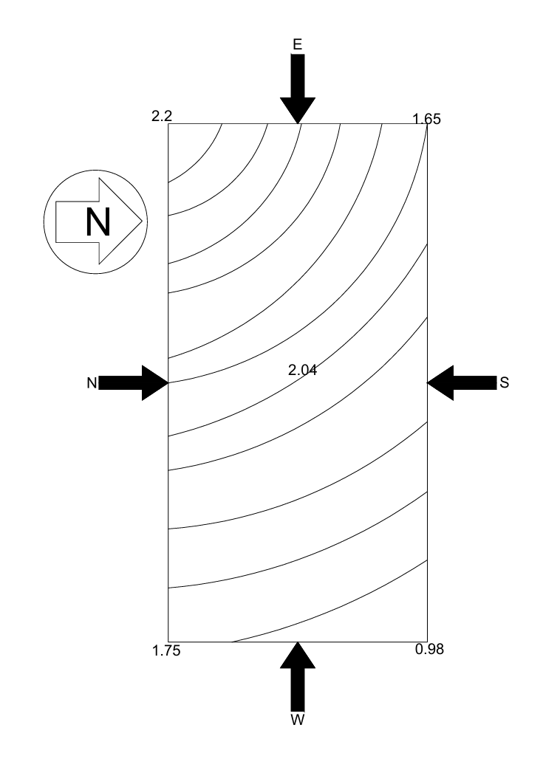
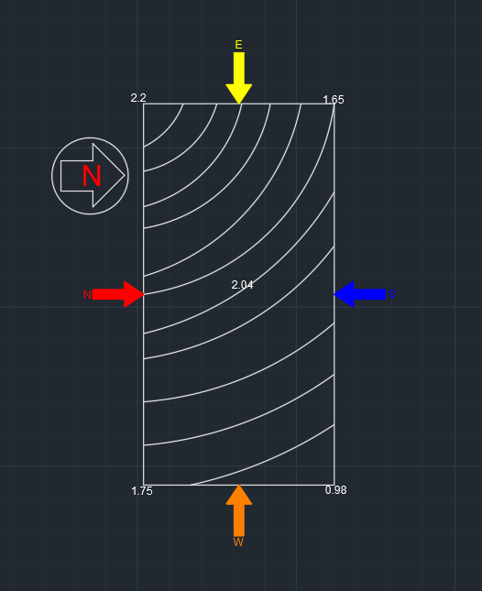

Slide 21
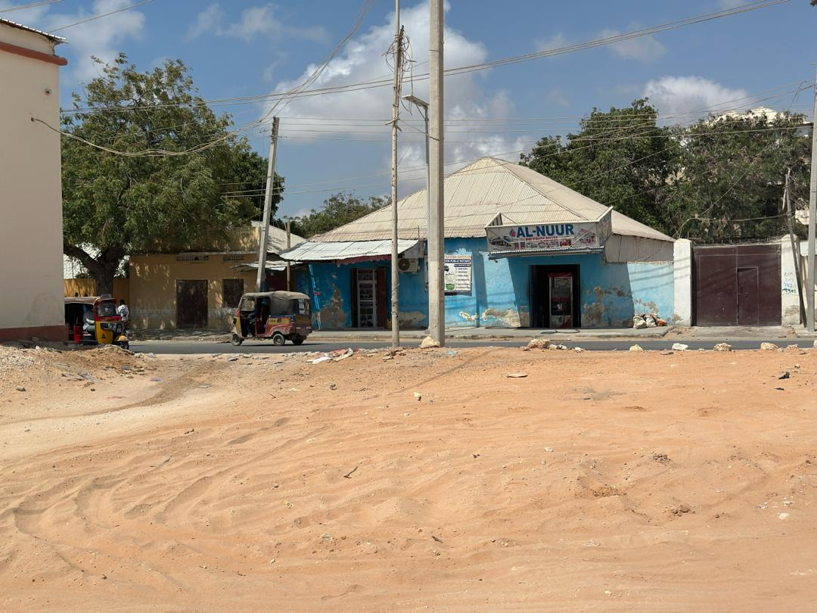
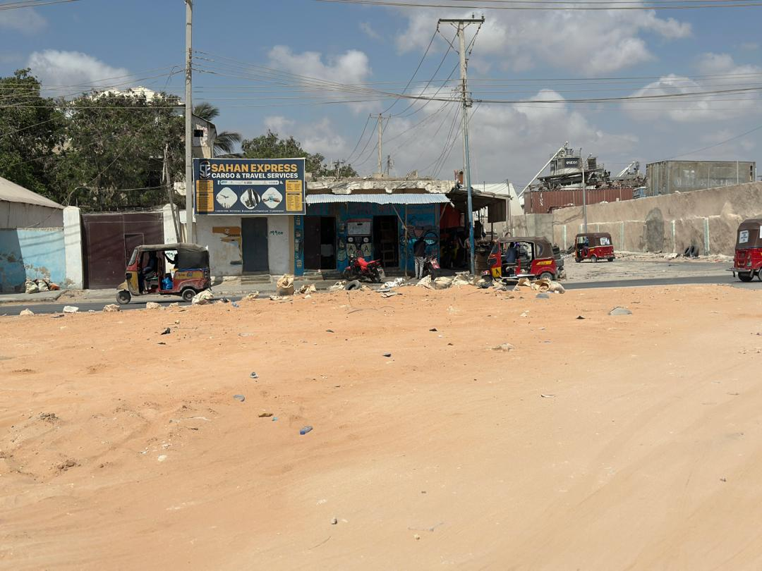

Slide 22
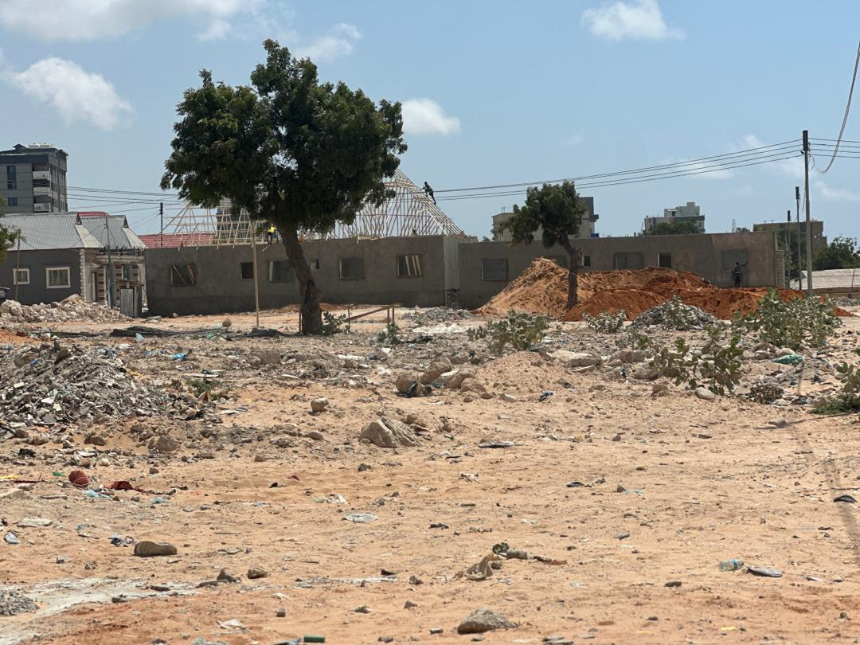
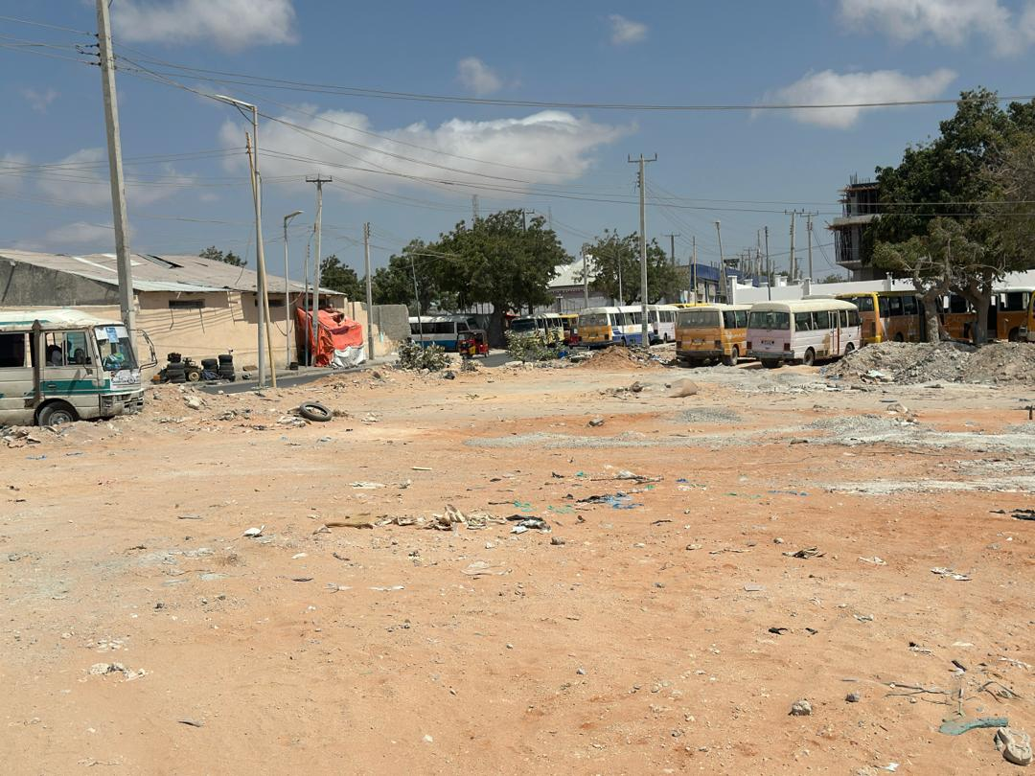

Slide 23
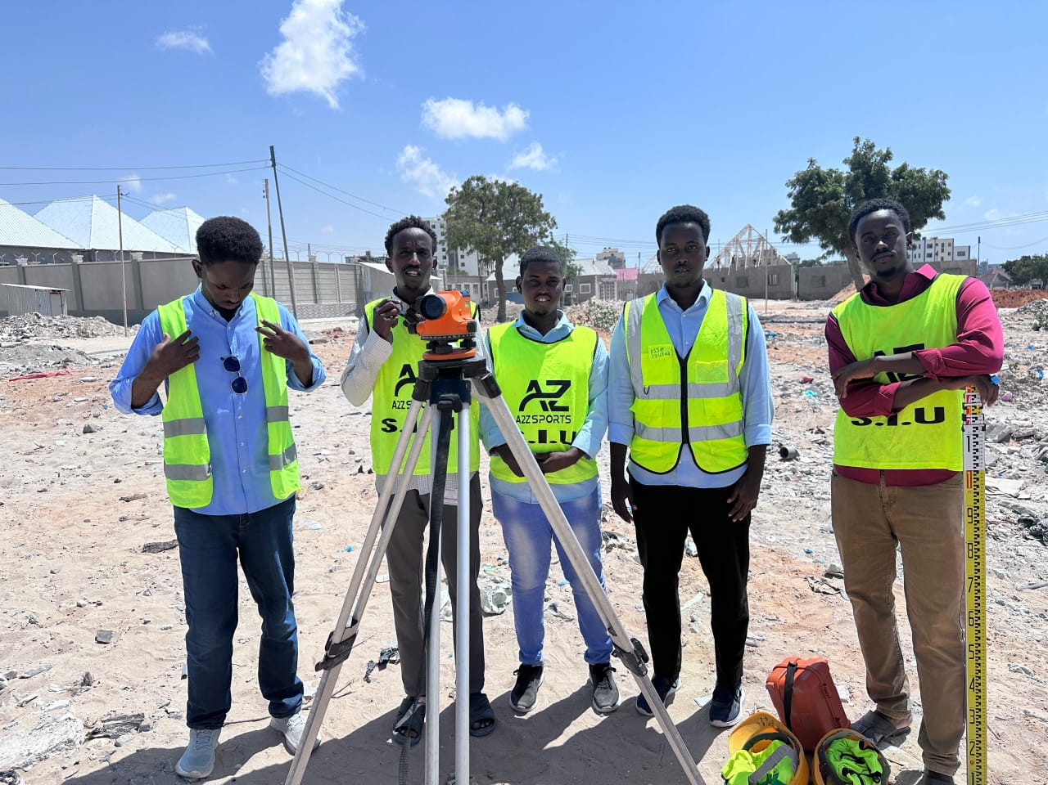
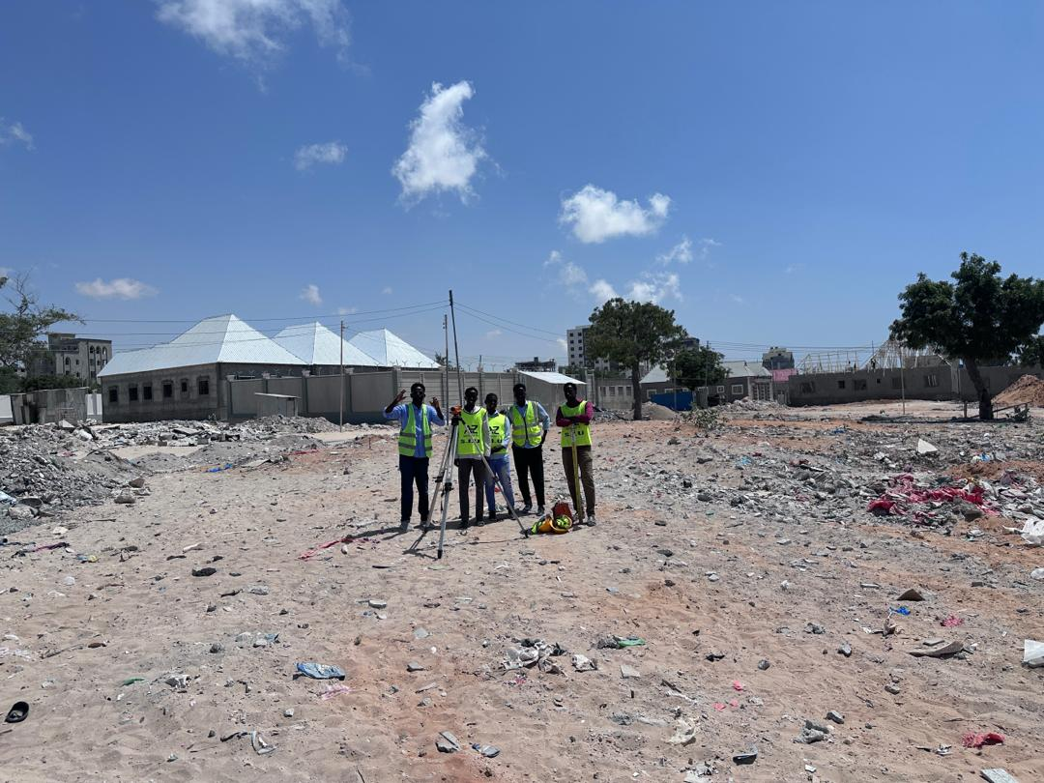

Slide 24
