Slide 1
Structural Drawing
Design of Mosque Building
Hodon District

Slide 2
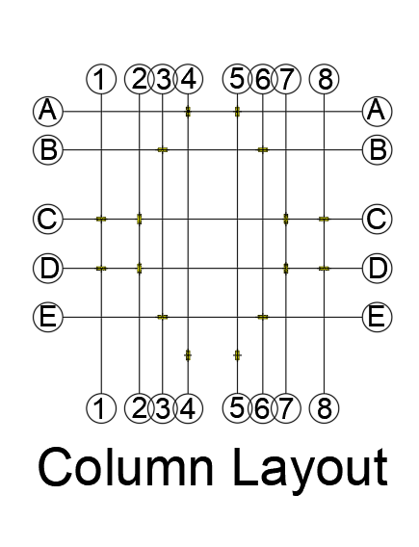

Slide 3
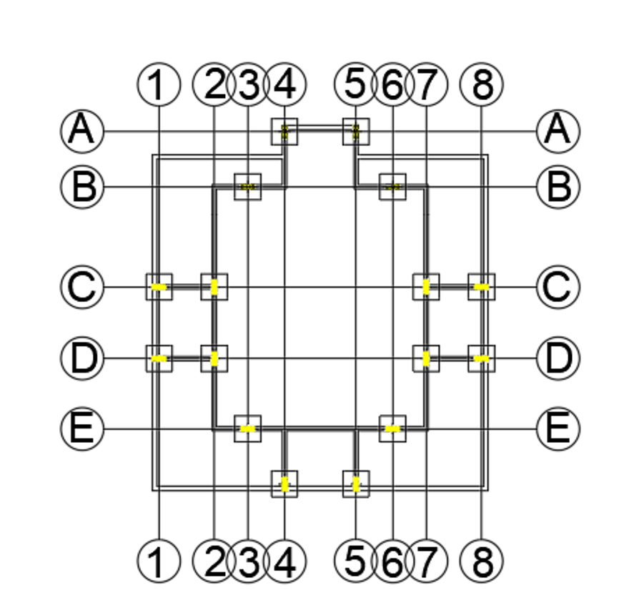

Slide 4
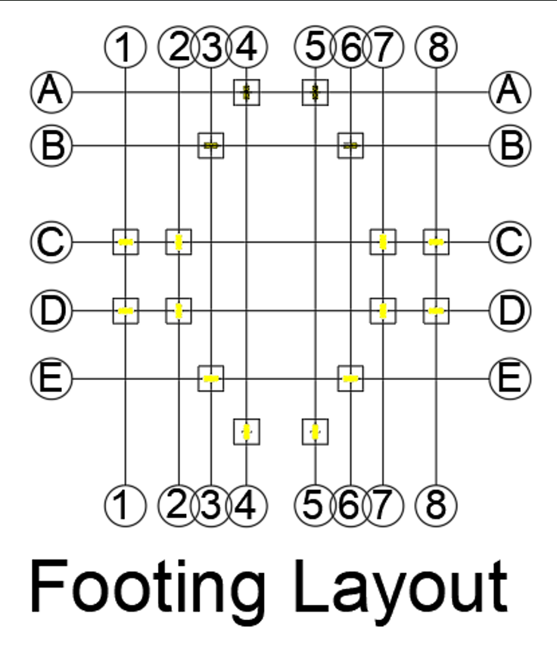
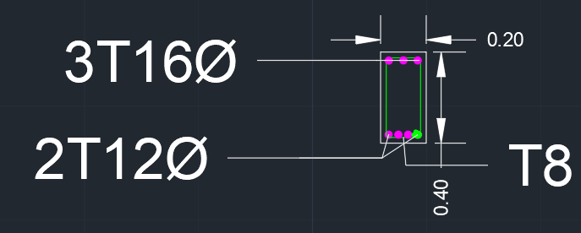
T6Ø @140mm c/c
16T14∅

Slide 5
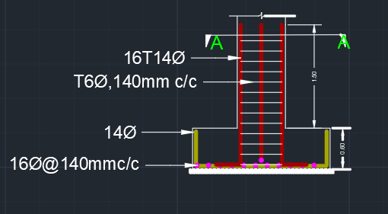
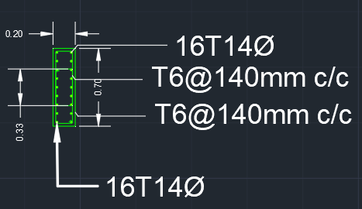
T6Ø @140mm c/c
16T14∅

Slide 6
