Slide 1

Drainage Design for Flood Control on Daalo road
in Mogadishu, Somalia

Slide 2
ALLAMAGAN CONSTRUCTION COMPANY
GROUP NAMES ID
1. SHARIFA NOR MUDEY 135702
2. ILYAAS MOHAMUD ABUUKAR 134408
3.SHARIF AHMED MANDEY 133256
4. MOHAMED ABDULAHI XAAJI 130776
5. ABDIRAHIIM MOHAMED OSMAN 136168
6. ZAKARIYE A. QAADIR ALI 133555
7. SUMAYO ABDI SAMAD DIRIYE 132418
8. ABDI HAKIIN ABDIRIZAK YUSUF 134028
9. ABDIMAHAD DAHIR OSMAN 134554
10. ZAKARIYE ABDULLE MOHAMED 134380
11. BISHAAR DAHIR MOHAMUD 134279
12. MOHAMED HASSAN MOHAMUD 135800
13, Abdihakiin Ali Abdirahman 134528

Slide 3
1.0 Introduction
Drainage design for flood control is an important part of urban infrastructure development, especially in rapidly growing cities such as Banaadir Region. Flooding has become one of the major environmental and engineering challenges affecting roads, settlements, businesses, and public services in the region. During the rainy seasons, many roads in Mogadishu experience severe water accumulation due to inadequate drainage systems, poor stormwater management, rapid urbanization, and blocked drainage channels. As a result, transportation is disrupted, road pavements are damaged, and nearby communities face risks to health, safety, and property.

Slide 4
Flooding is a major problem affecting Daalo Road in Banaadir Region, Somalia, due to poor drainage and heavy rainfall. Proper drainage design is important to control storm water, reduce road damage, improve safety, and prevent traffic disruption. This study focuses on designing an effective drainage system to minimize flood risks and improve the durability of the road.

Slide 5
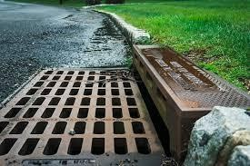
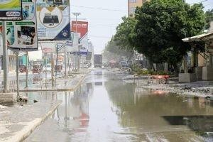
1.1 Definition of Drainage Design For Flood Control in Daalo, Mogadishu, Somalia
▶ Drainage design for flood control refers to the engineering planning and development of systems that collect, convey, manage, and safely discharge storm water and surface runoff to prevent flooding.
▶ In Daalo area of Mogadishu, drainage design involves the analysis of rainfall patterns, topography, soil conditions, and existing infrastructure to create channels, culverts, storm sewers, retention basins, and other hydraulic structures that reduce flood risks and protect lives, property, and roads.
▶ Flood control drainage systems are especially important in Mogadishu due to seasonal heavy rainfall and inadequate existing drainage infrastructure.

Slide 6
1.2. Title of the Project
▶Design of an Integrated Drainage System for Flood Control in Daalo Area, Mogadishu, Somalia.”

Slide 7
1.3. Statement of the Problem
▶ Daalo area in Mogadishu experiences frequent flooding during the rainy seasons. The main problems include:
▶ Lack of properly designed storm water drainage systems
▶ Blocked or undersized drainage channels
▶ Poor waste management causing drain blockage
▶ Low-lying topography in some sections
▶ These issues lead to:
▶ Road damage and transportation disruption
▶ Property destruction
▶ Health risks due to stagnant water
▶ Economic losses to residents and businesses
Therefore, a proper drainage design is required to control and manage floodwater effectively.

Slide 8
1.4. Justification of the Drainage Design (Flood Control)
The project is justified for the following reasons:
▶ Protection of Lives and Property – Reduces flood-related accidents and structural damage.
▶ Infrastructure Protection – Prevents deterioration of roads and buildings.
▶ Public Health Improvement – Minimizes water-borne diseases caused by stagnant water.
▶ Economic Stability – Reduces business interruptions and repair costs.
▶ Urban Development Support – Supports sustainable planning and
organized expansion of Daalo area.
▶ Given the growing population of Mogadishu, proper drainage infrastructure is essential for long-term development.

Slide 9
1.5. Objectives of the Drainage Design (Flood Control)
A. General Objective
▶ To design an effective and sustainable drainage system that controls flooding in Daalo area, Mogadishu.
▶ B. Specific Objectives
To analyze rainfall intensity and runoff characteristics in Daalo area.
To determine peak discharge using hydrological methods.
To design appropriate drainage structures (channels, culverts, storm drains).
To ensure safe disposal of storm water to natural water bodies or designated outlets.
To reduce flood risk and improve road accessibility during rainy seasons.
To propose maintenance guidelines for long-term system performance.

Slide 10
1.6. Scope of the Drainage Design (Flood Control)
▶ The scope of this project includes:
Site survey and topographic analysis of Daalo area
Rainfall data collection and hydrological analysis
Hydraulic design of open and closed drainage systems
Design of culverts, manholes, and discharge outlets
Preparation of 2D drawings and design calculations
Cost estimation of the drainage system
Environmental and social impact considerations
▶ The project focuses on designing a complete drainage system to control
flooding in Daalo area, Mogadishu.

Slide 11
1.7. Type & Users of the Drainage Design (Flood Control)
▶ Type of Drainage System
Surface drainage system (open channels)
Subsurface drainage system (storm water pipes)
Combined drainage structures (culverts, retention basins)
▶ Users of the Drainage System
Residents of Daalo area
Business owners
Road users and transport operators
Local government authorities
Urban planners and engineers
Emergency services
▶ The drainage design will serve both residential and commercial areas and improve overall urban resilience in Mogadishu.

Slide 12
Conclusion
▶ Expected Outcomes
▶ ✔ Reduced flooding
▶ ✔ Improved road durability
▶ ✔ Safer transportation
▶ ✔ Better urban infrastructure

Slide 13
2.0 Introduction
Over all Topography information
Today we will explain the work we carried out, which was surveying For road.
Through this survey, we identified the differences in ground elevation, the areas where water accumulates the most, the causes of the problem, and the possible solutions.
The total length of the stations we covered was 220 meters on each side, making it 440 meters in total.
Therefore, we took measurements at 20-meter intervals
for each station.

Slide 14
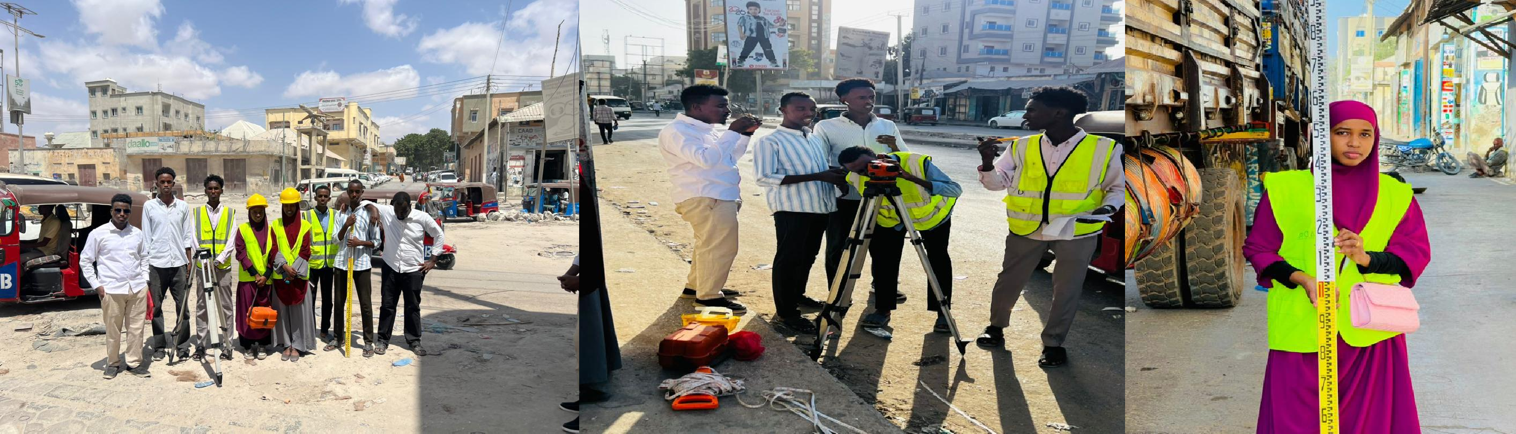

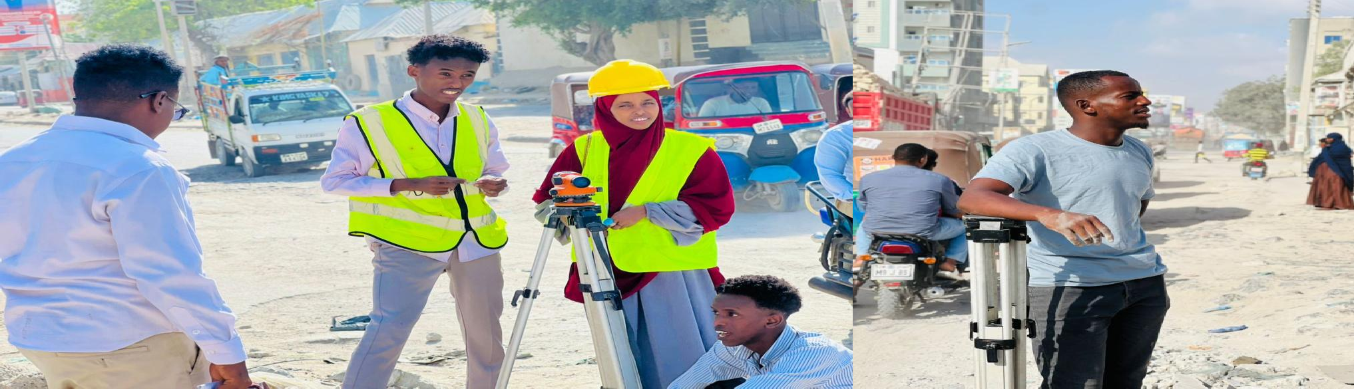
Topography information

Slide 15
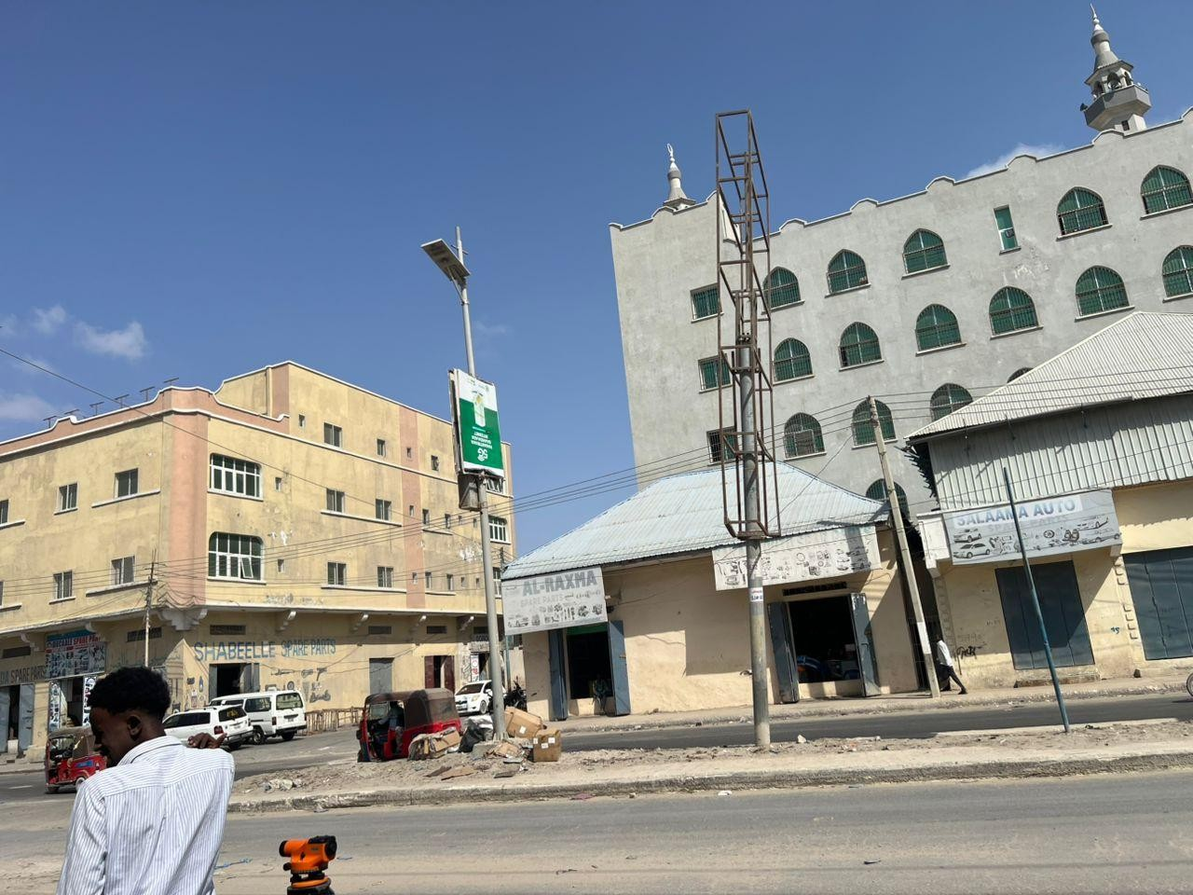
We started the survey from the Bar Ubax Side and concluded at the Balagsii area.

Slide 16
Topography information
From the topographic survey, we found that the main problem was variation in ground elevation, which caused water to collect in low lying areas. This indicates that the natural slope of the land is not sufficient for proper surface runoff.
The recommended solution is to design a drainage system that follows the natural slope direction to allow water to flow away from the road area and prevent stagnation.

Slide 17
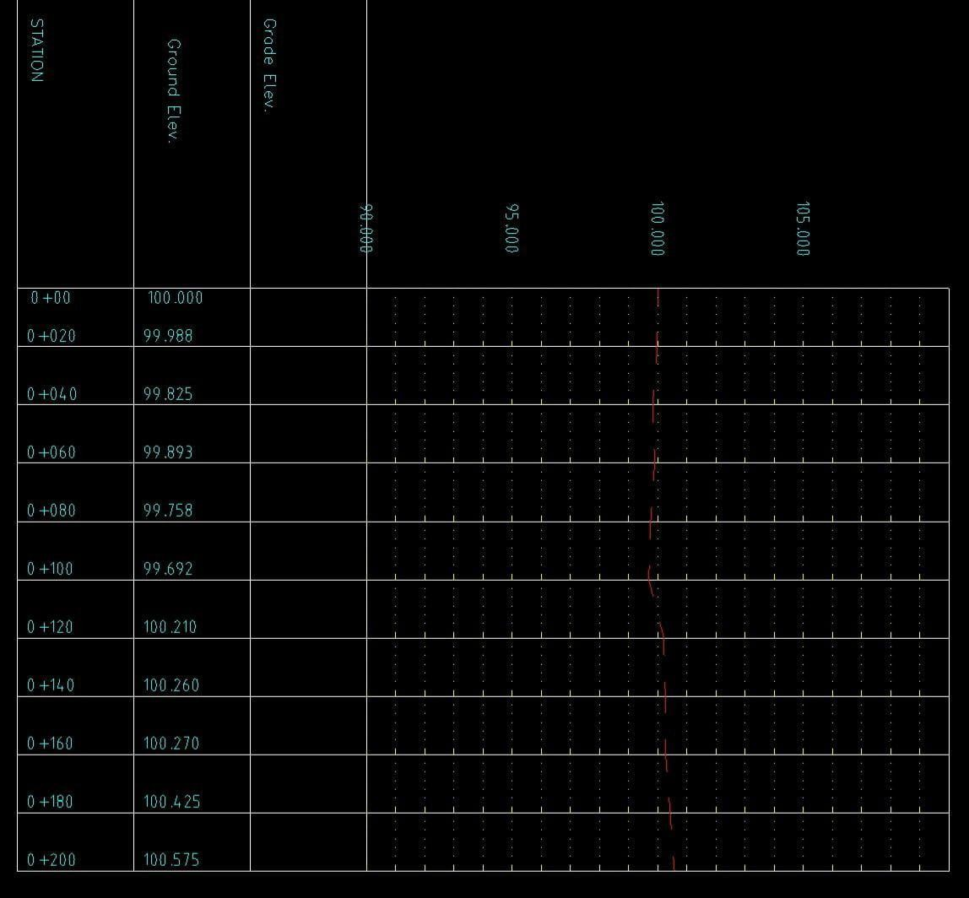
The problem We Found

Slide 18
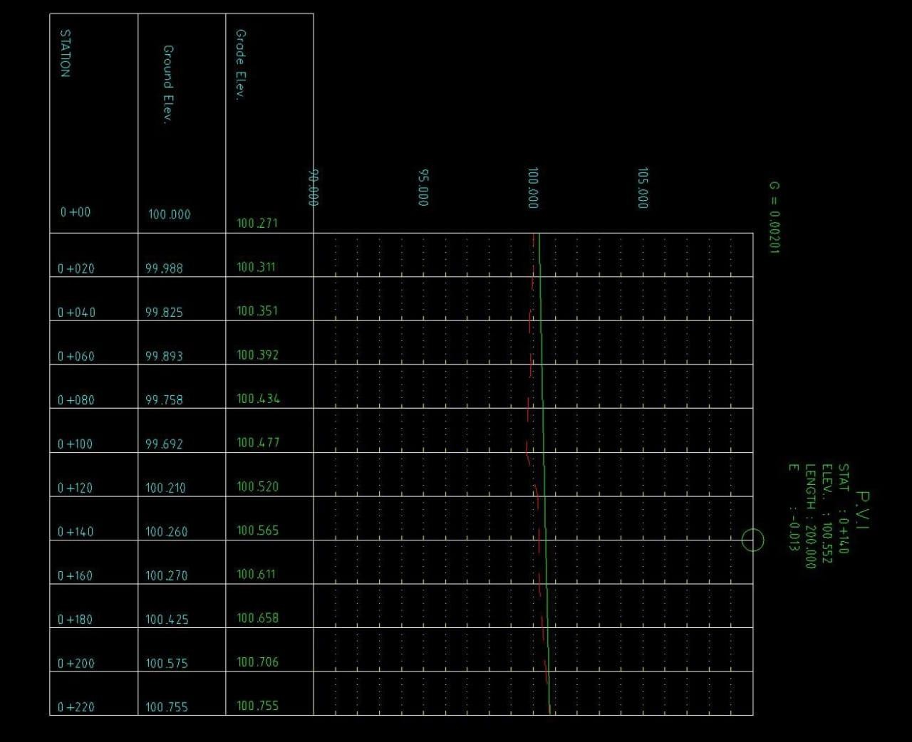
The Solution

Slide 19
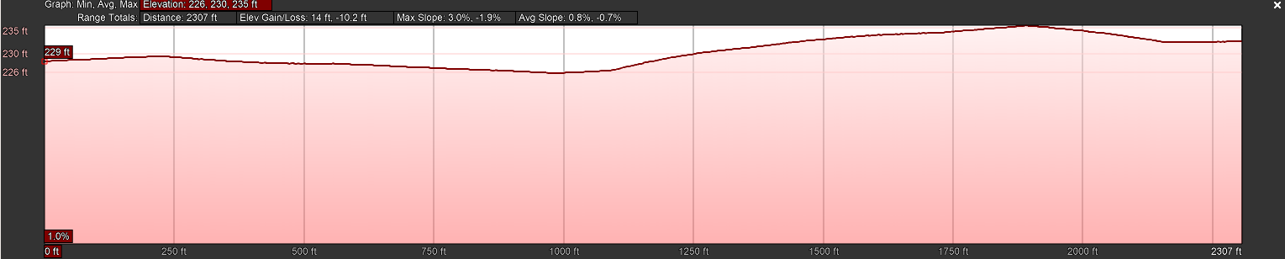
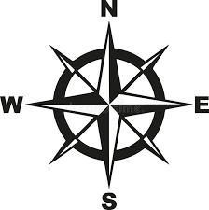
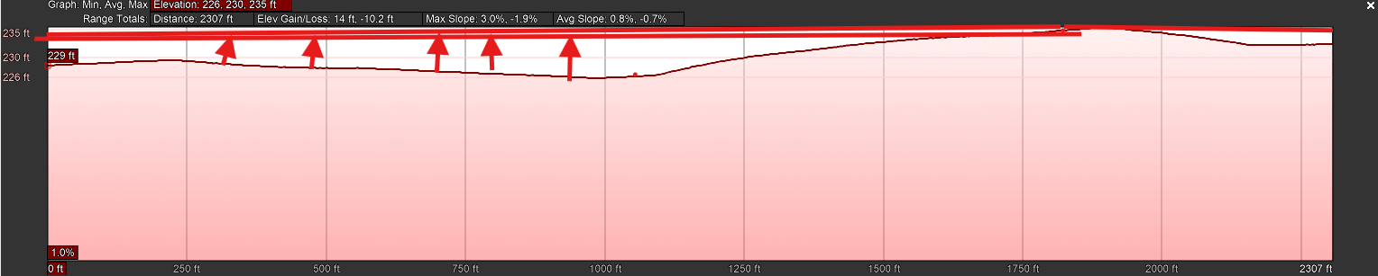
2.1 CUT AND FILL

Slide 20
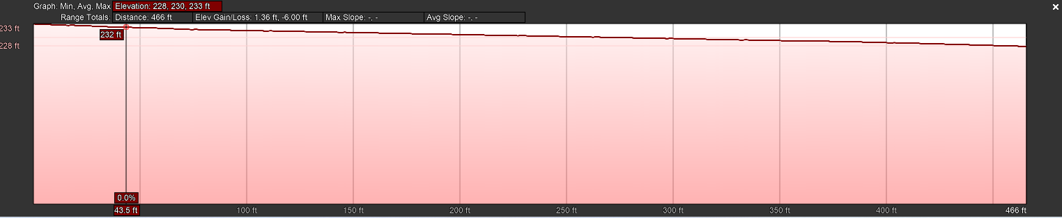
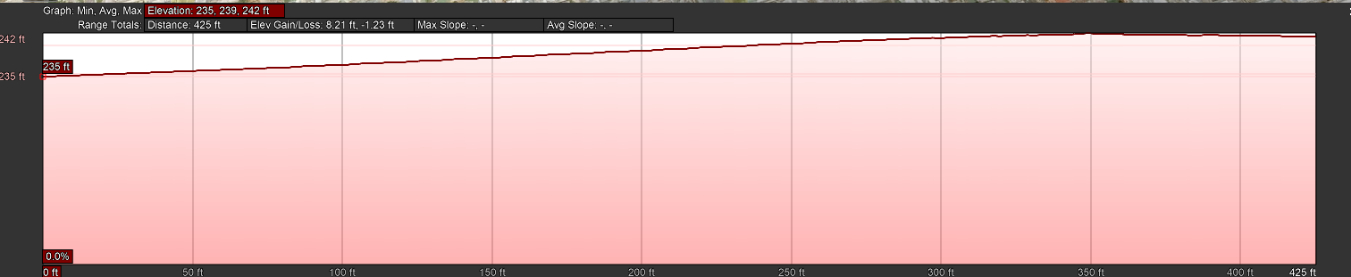
Street 1 Balagsi to Bar uwax
South and North
South
North

Slide 21
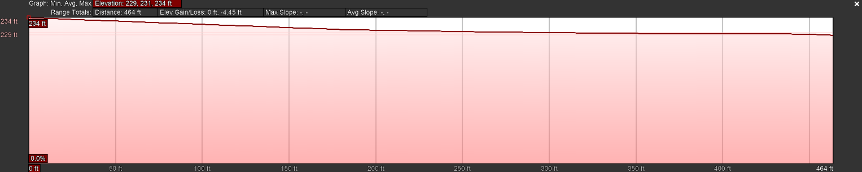
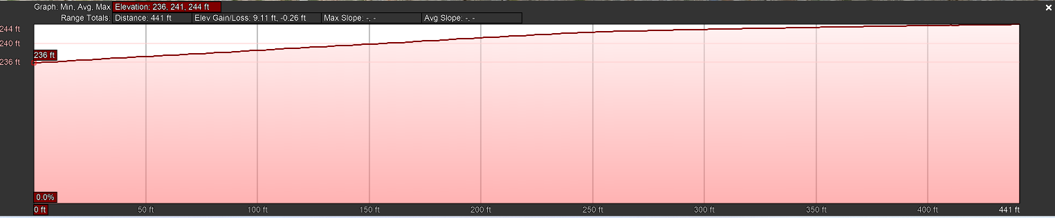
Street 2 Balagsi to Bar uwax
South and North
South
North

Slide 22
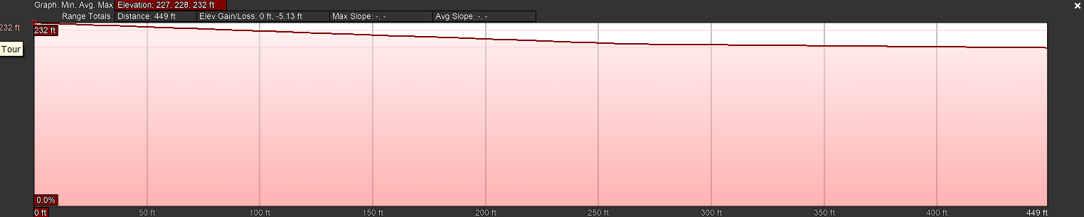
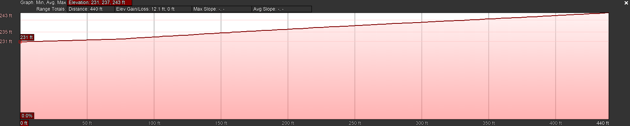
Street 3 Balagsi to Bar uwax
South and North
South
North

Slide 23
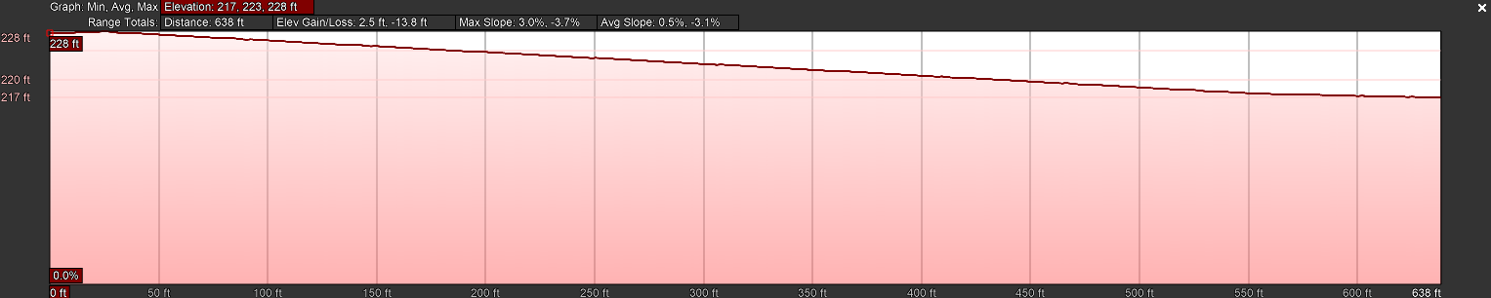
Street 4 Balagsi to Bar uwax
South and North
South
North

Slide 24
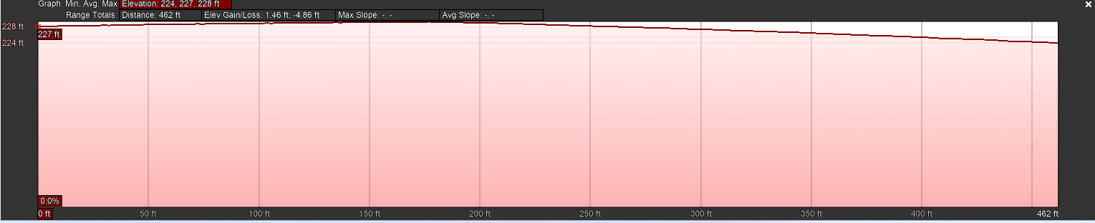
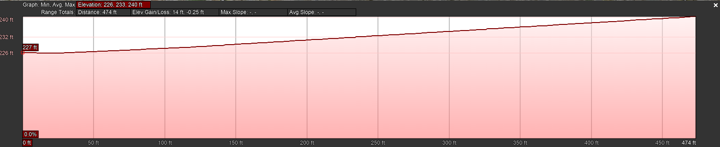
Street 5 Balagsi to Bar uwax
South and North
South
North

Slide 25
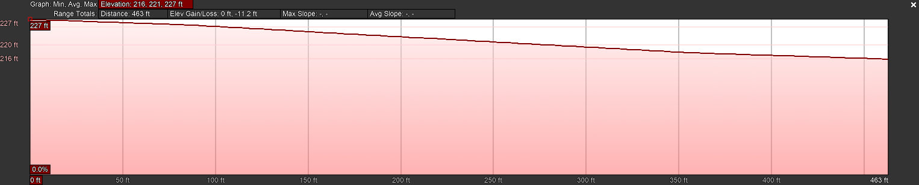
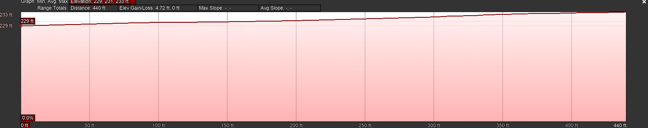
Street 6 Balagsi to Bar uwax
South and North
South
North

Slide 26
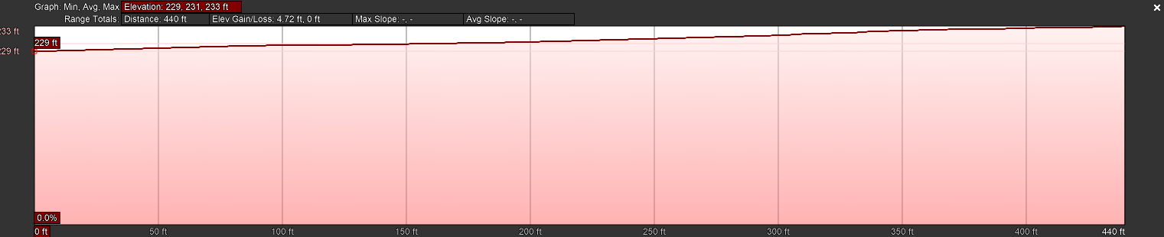
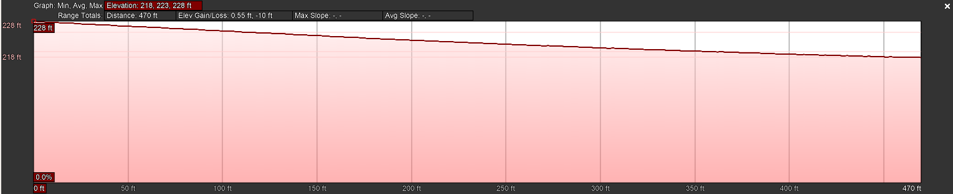
Street 7 Balagsi to Bar uwax
Sough and North
South
North

Slide 27
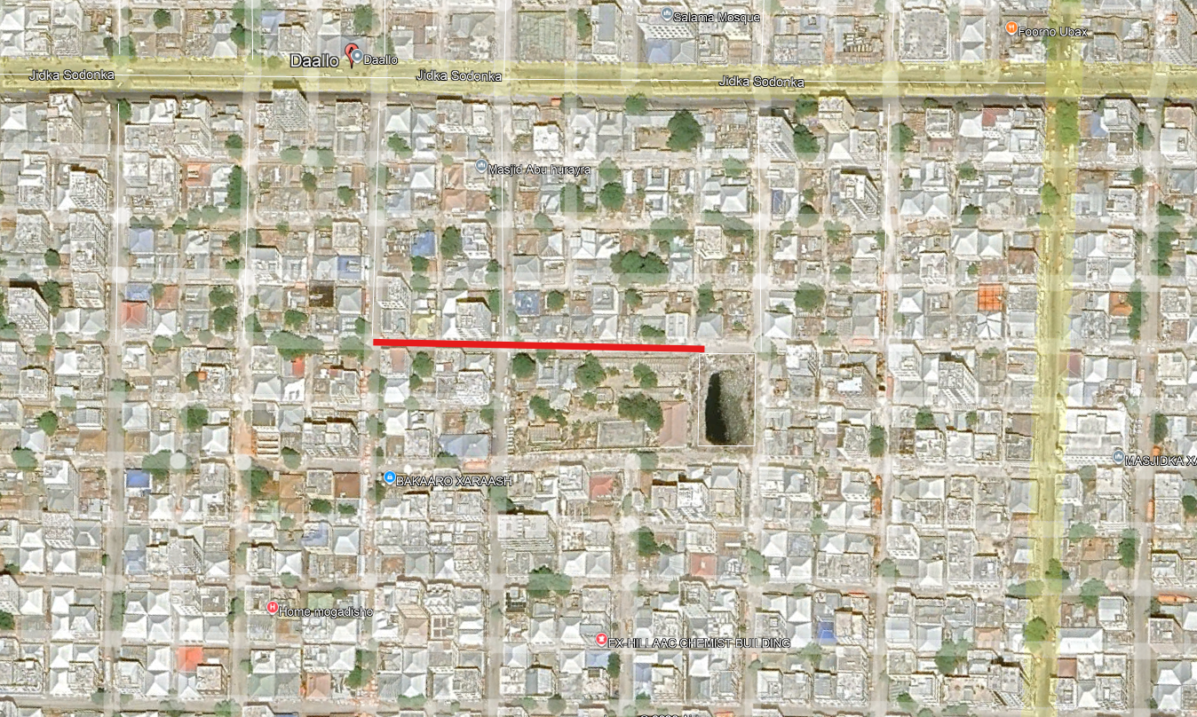
Street of drainage system

Slide 28

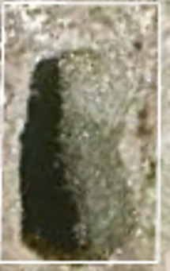
Drainage system design
Area : 35X55 = 1925m2

Slide 29
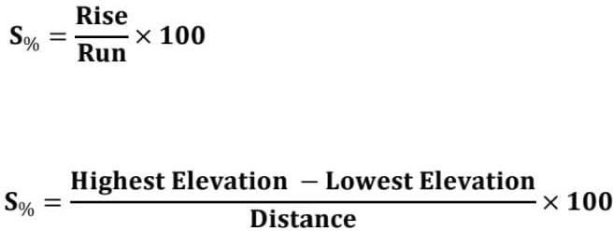
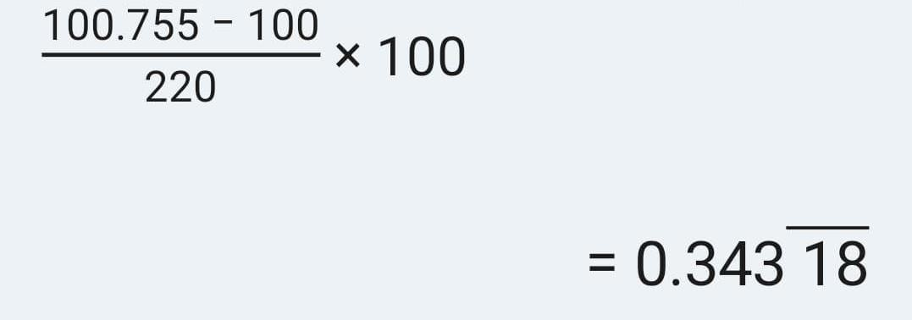
The Following is the Formula we Used:

Slide 30
Conclusion
The Highest Point H is 100.755 and the
Lowest Point L is 100
And the Drainage Follow direction is East Side or Bar Ubah side due to the topography of the land.

Slide 31
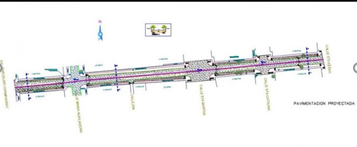
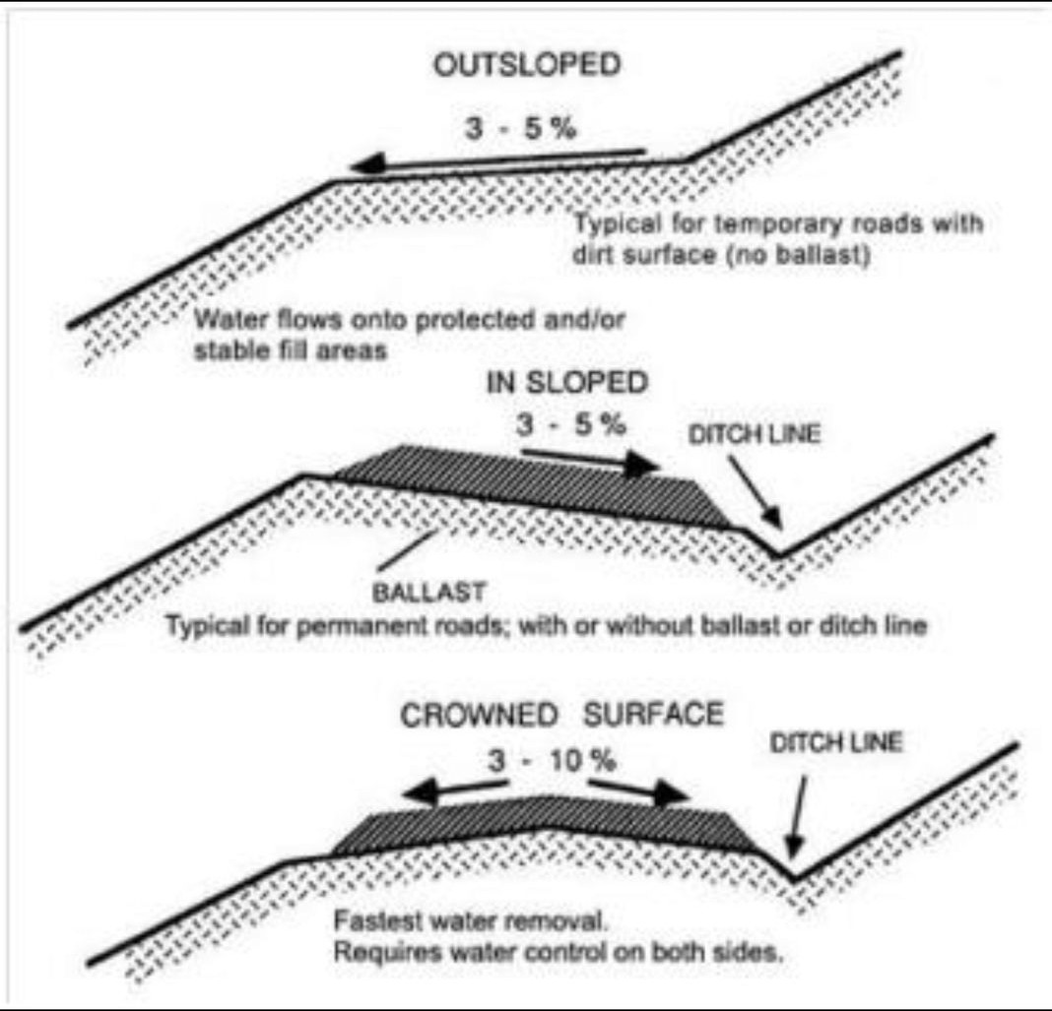
3.0 -Road reconstruction layout sketch
Total Width: 30m (15m from the centerline to each side)
Carriageway: Two lanes, each approximately 3.5m wide.
Road Shoulders: Providing lateral support and safety.
Side Drains: Positioned along the edges to collect runoff.
Outlet Points: Connected to low-lying discharge areas. Flood Prevention Mechanism:
The road features a slight slope (cross-fall) of 2–3%, ensuring water flows from the center toward the edges.
Runoff is channeled directly into the drainage network to prevent accumulation.

Slide 32
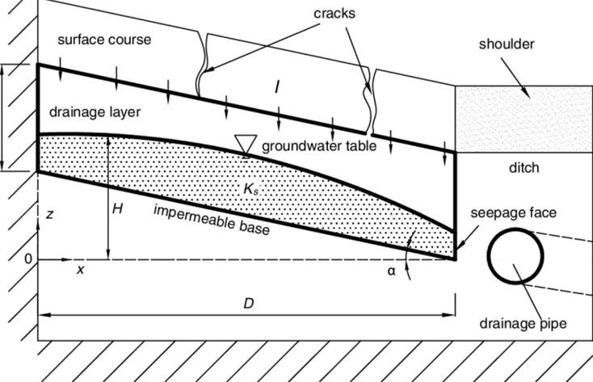
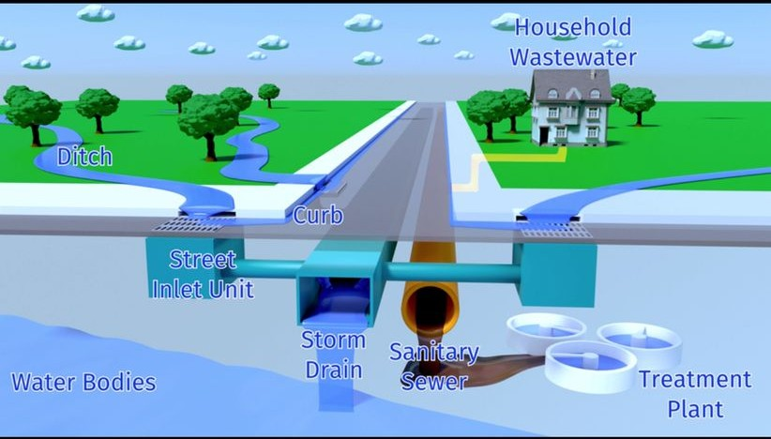
3.1 - Drainage system concept diagram
Side Drains: Open channels for surface water.
Culverts: Transverse pipes allowing water to cross under the road.
Underground Perforated Pipes: For subsurface drainage and groundwater control.
Outlet Channel: The final discharge point.
Operational Flow:
Rainfall → Road Surface → Side Drains → Culverts → Discharge into low-lying areas or reservoirs.

Slide 33
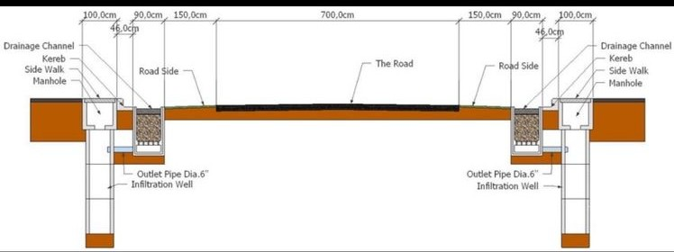
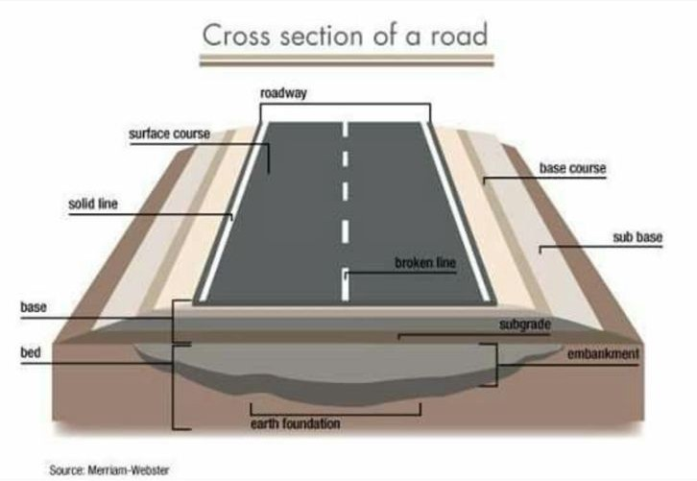
3.2 Road cross-section drawing
Asphalt Layer: The durable wearing course.
Base Course: The primary structural layer.
Subgrade: The prepared natural soil foundation.
Camber: The subtle convex curvature of the road surface.
Side Drains: Situated at the base of the embankment.
Benefit:
The Camber forces water away from the center of the road, while the side channels capture and transport it, protecting the road's structural integrity.

Slide 34
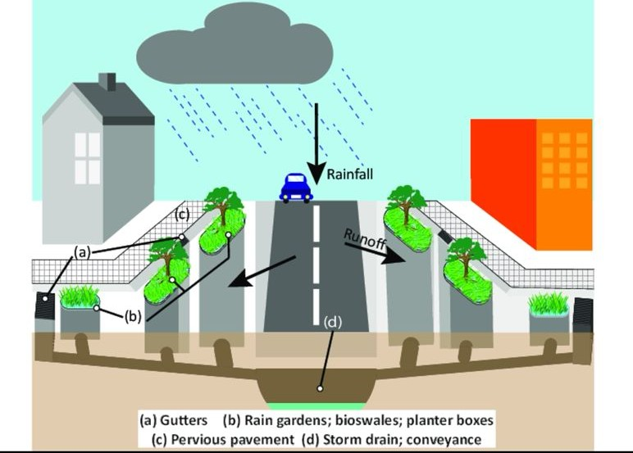
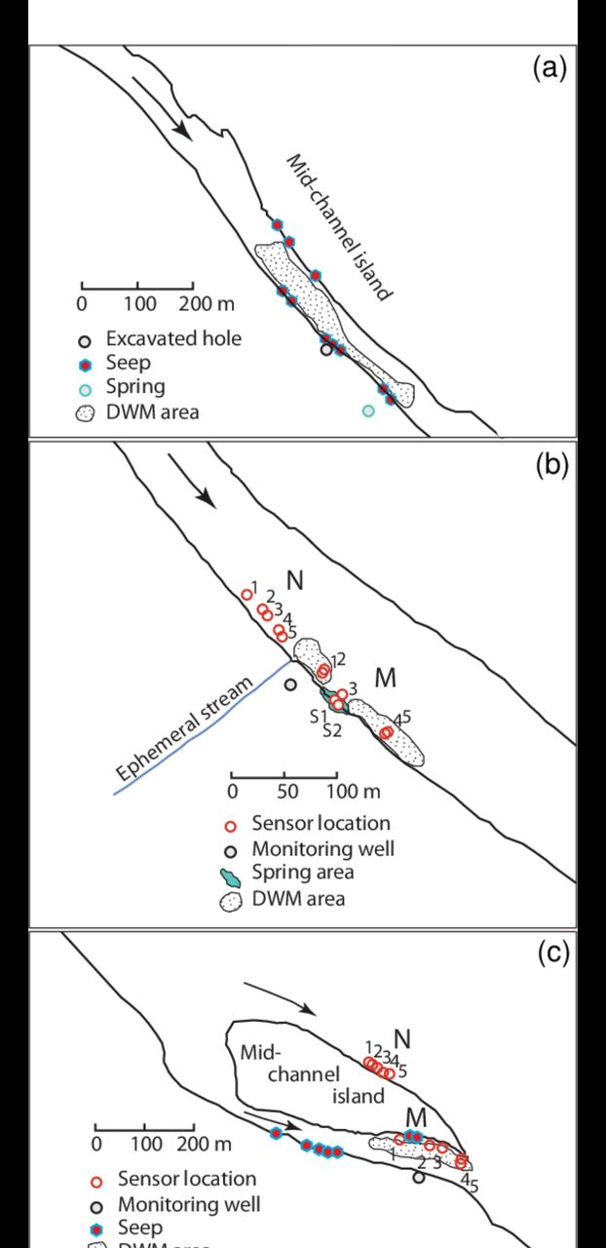
3.3 Water Flow Direction SketchDescription:
Flow Arrows: Visual indicators showing the path of runoff.
Gradient: A slope moving from high-elevation points to lower discharge zones.
Final Outlet: The designated end-point for all collected water.
Objective: To ensure "positive drainage" and eliminate ponding (standing water) on the road surface.

Slide 35
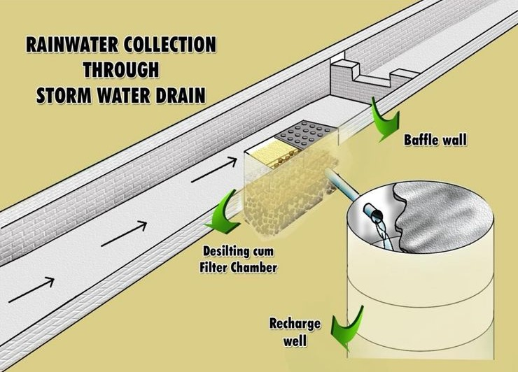
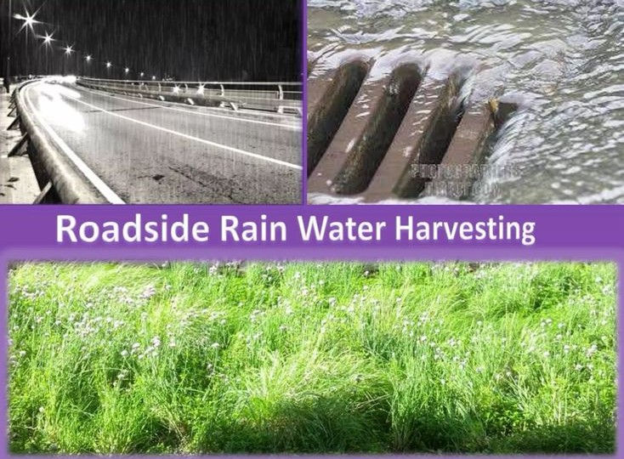
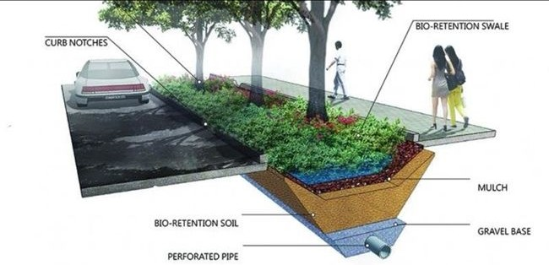
3.4 - Sustainable Drainage Features (SUDS)Sustainability Elements:
Bioswales: Vegetated channels that naturally filter and slow down runoff.
Permeable Pavement: Pedestrian areas designed to allow water to infiltrate the ground.
Rainwater Harvesting: Systems to capture and store rain for reuse.
Roadside Trees: Strategic planting to absorb water and stabilize soil.
Benefits: Reduced flood risk and peak flow.
Improved water quality through natural filtration.
Enhanced environmental protection and urban aesthetics.

Slide 36
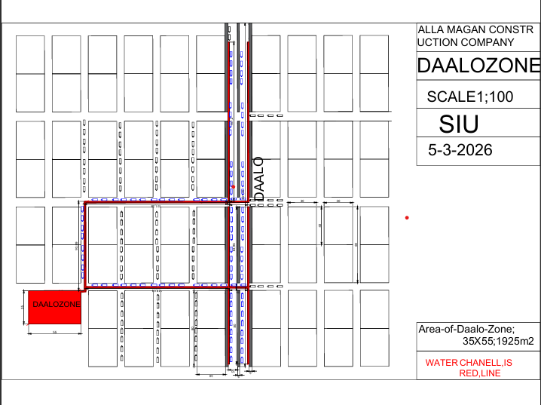
4.0- 2D Plan Road

Slide 37
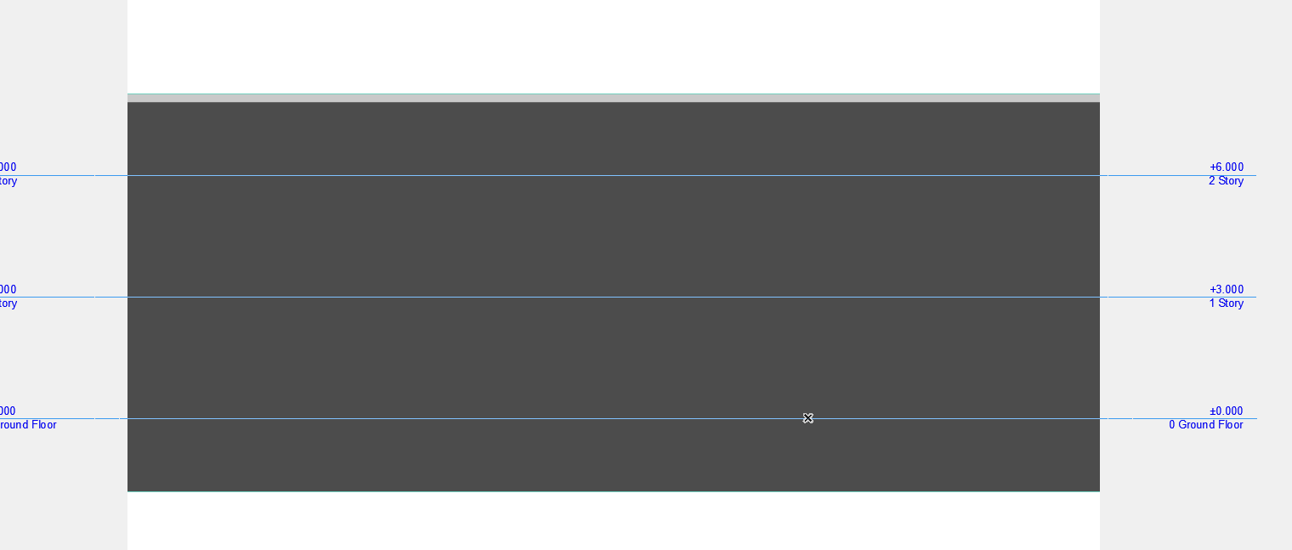
4.1 ELEVATION OF DRAINAGE SYSTEM

Slide 38
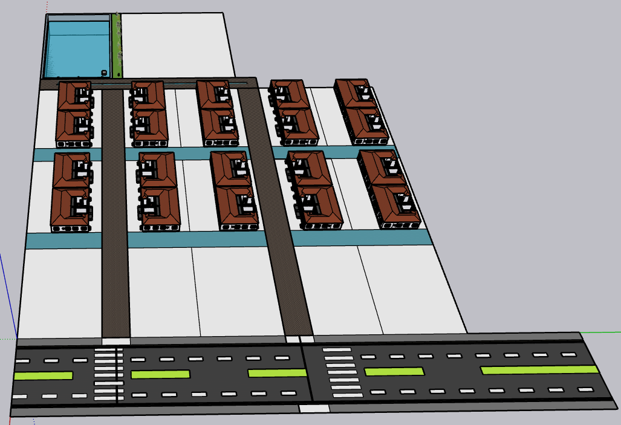
4.2- 3D Road

Slide 39
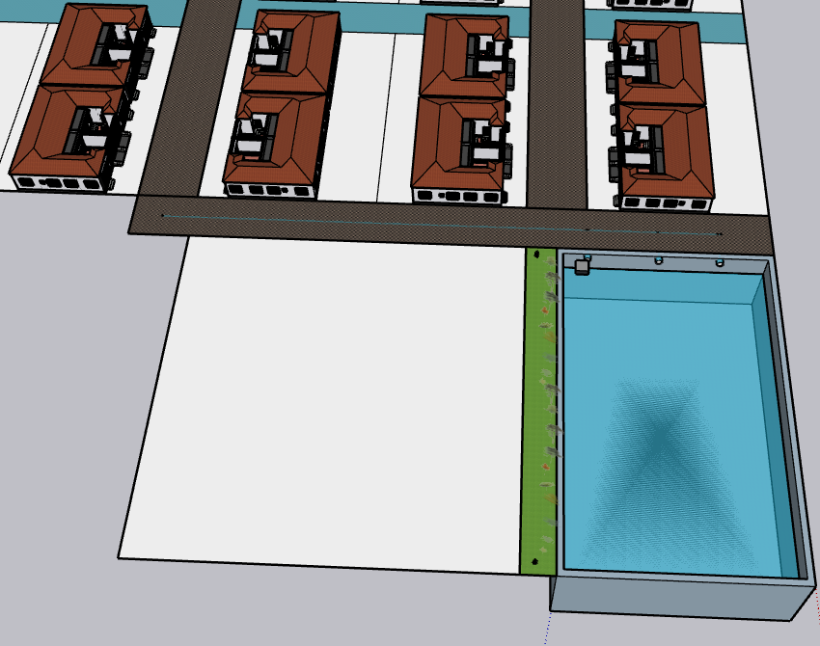
4.2- 3D Road

Slide 40
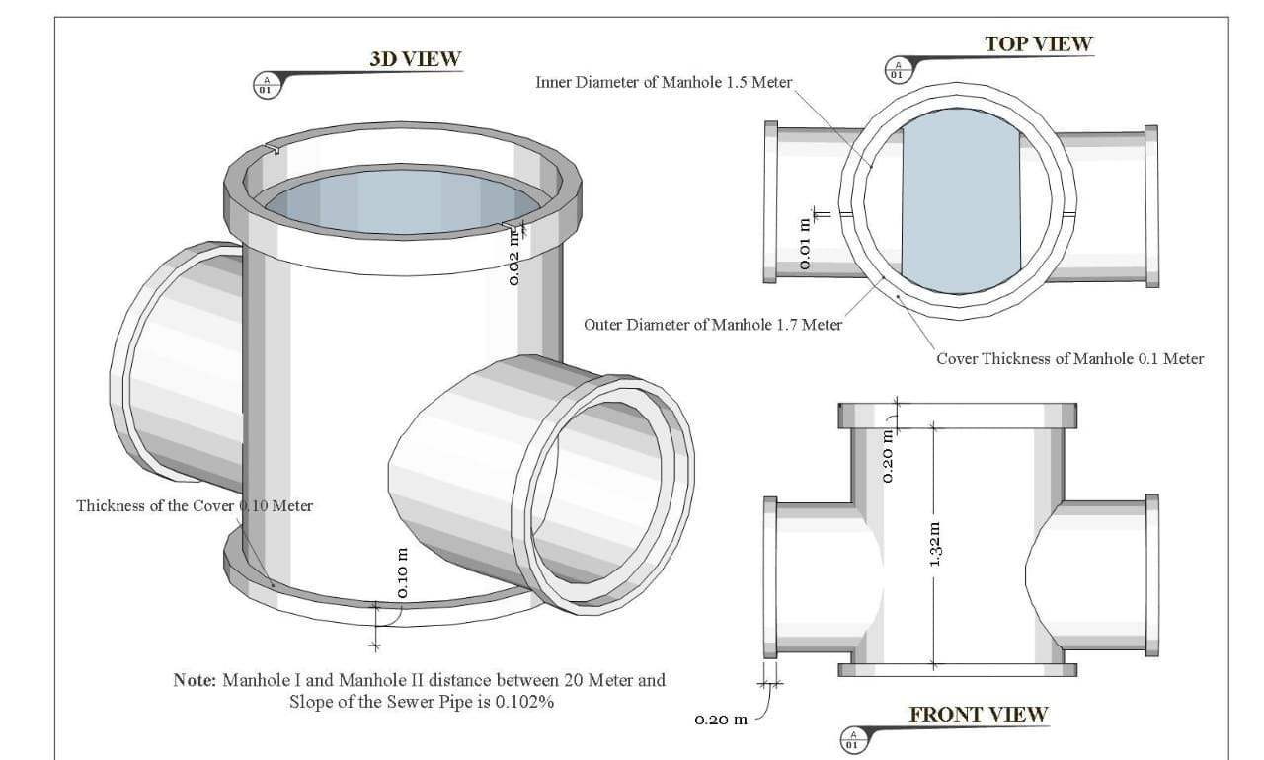
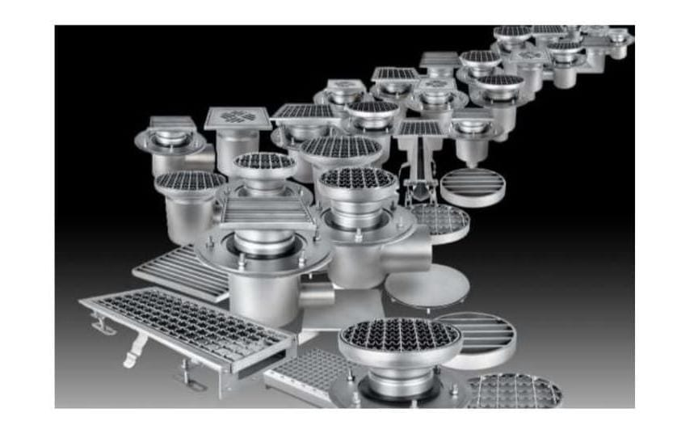
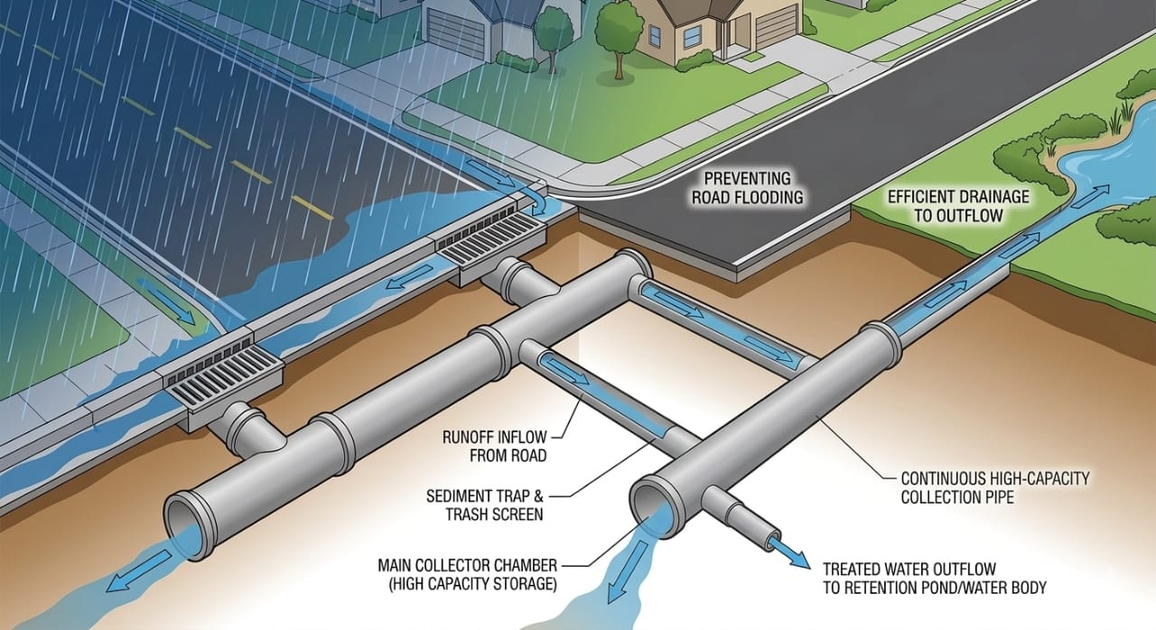
5.0 Planning , Design of Road side Drainage system

Slide 41
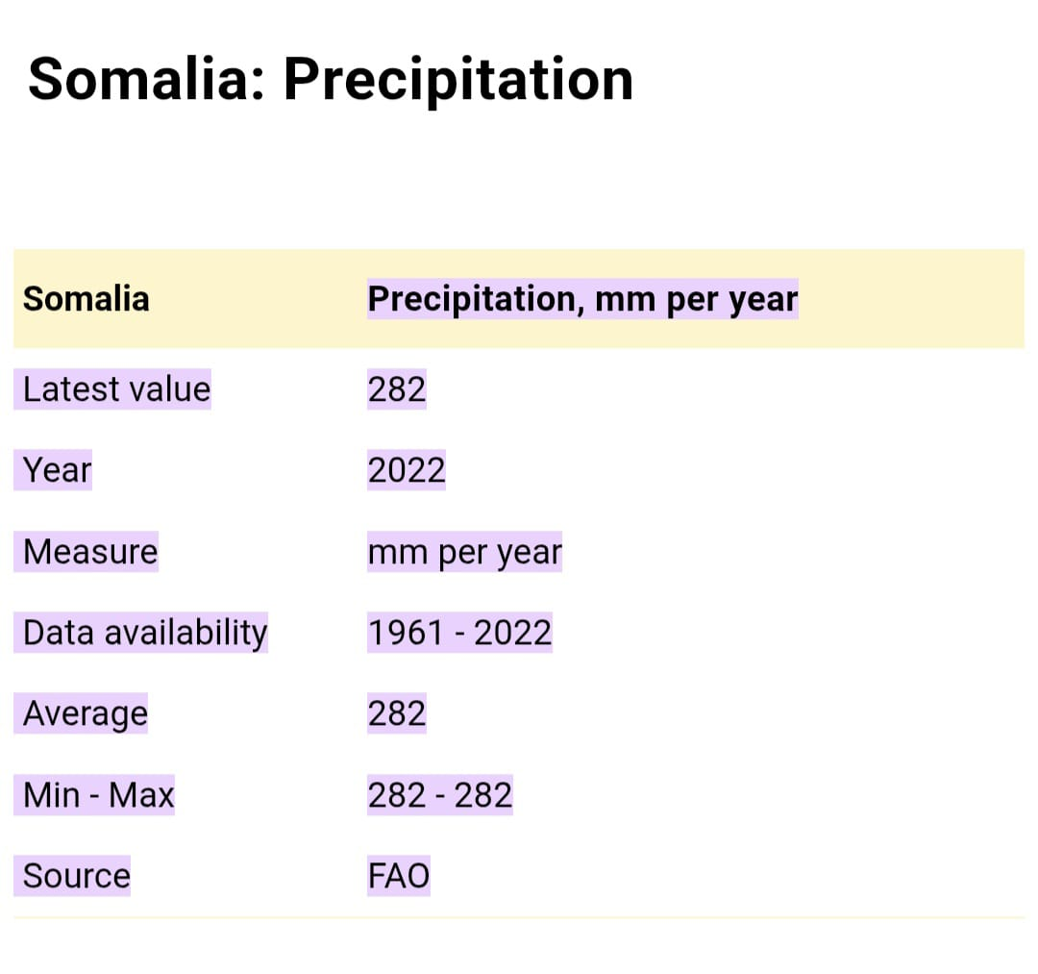
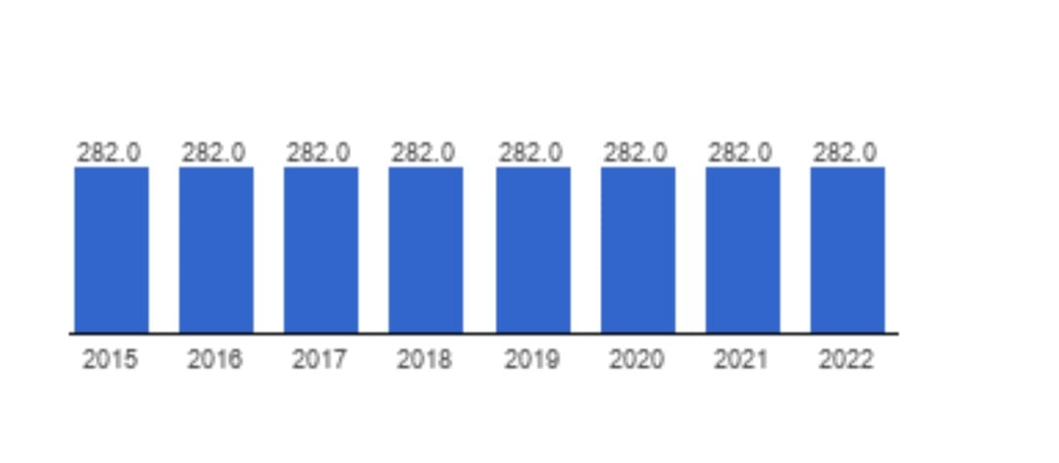
5.1 Somalia Precipitation Average

Slide 42
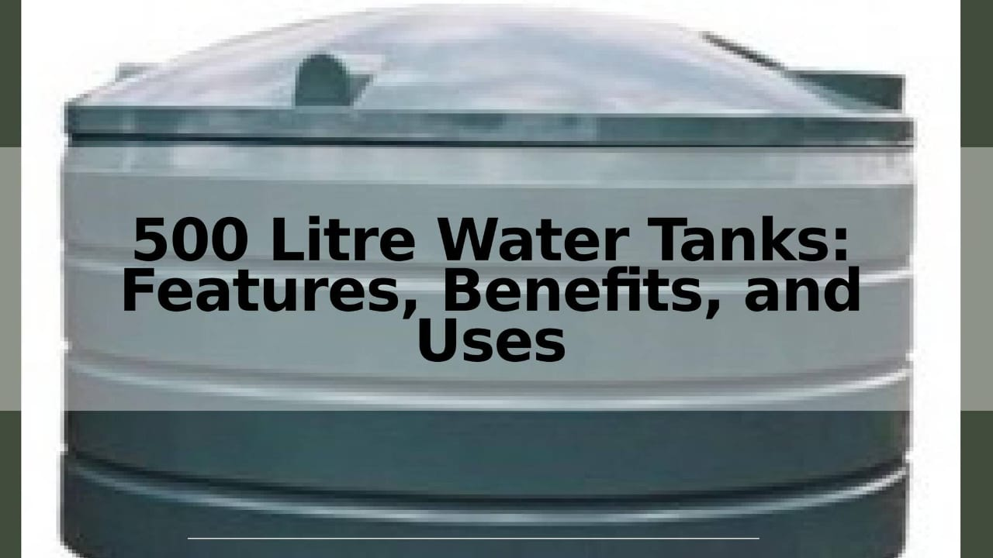
Specially Banadir Region
The Banaadir region, which includes the capital city of Mogadishu, receives an average of approximately 399 mm (15.7 in) of rainfall per year. This is significantly higher than the national Somalia average of 282 mm.
Somalia Precipitation - data, chart | TheGlobalEconomy.com https://share.google/vMfKAtN7E1sW9T2fN

Slide 43
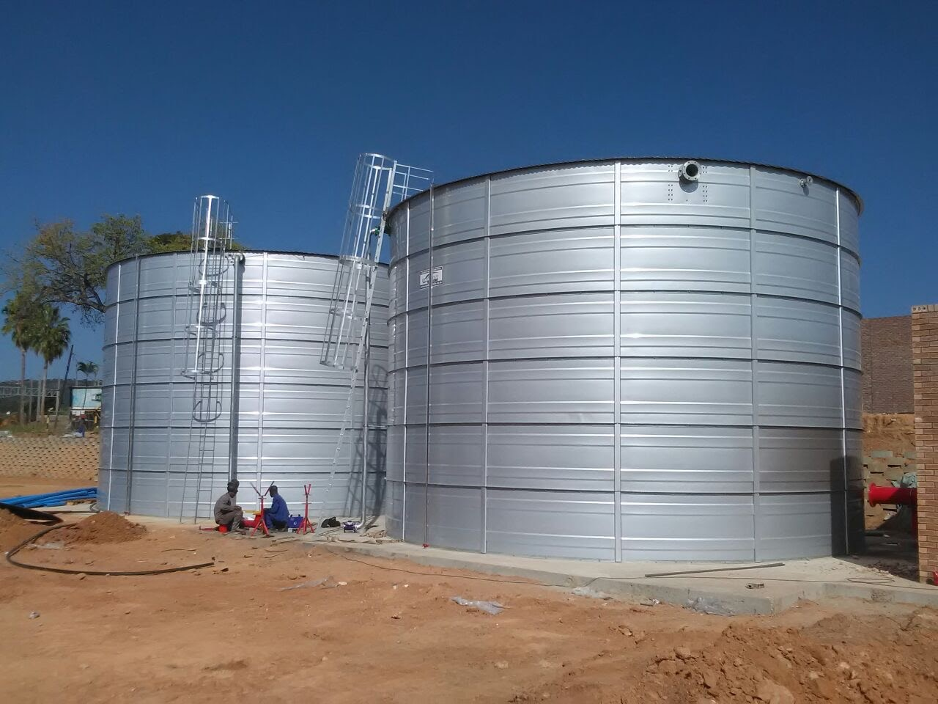
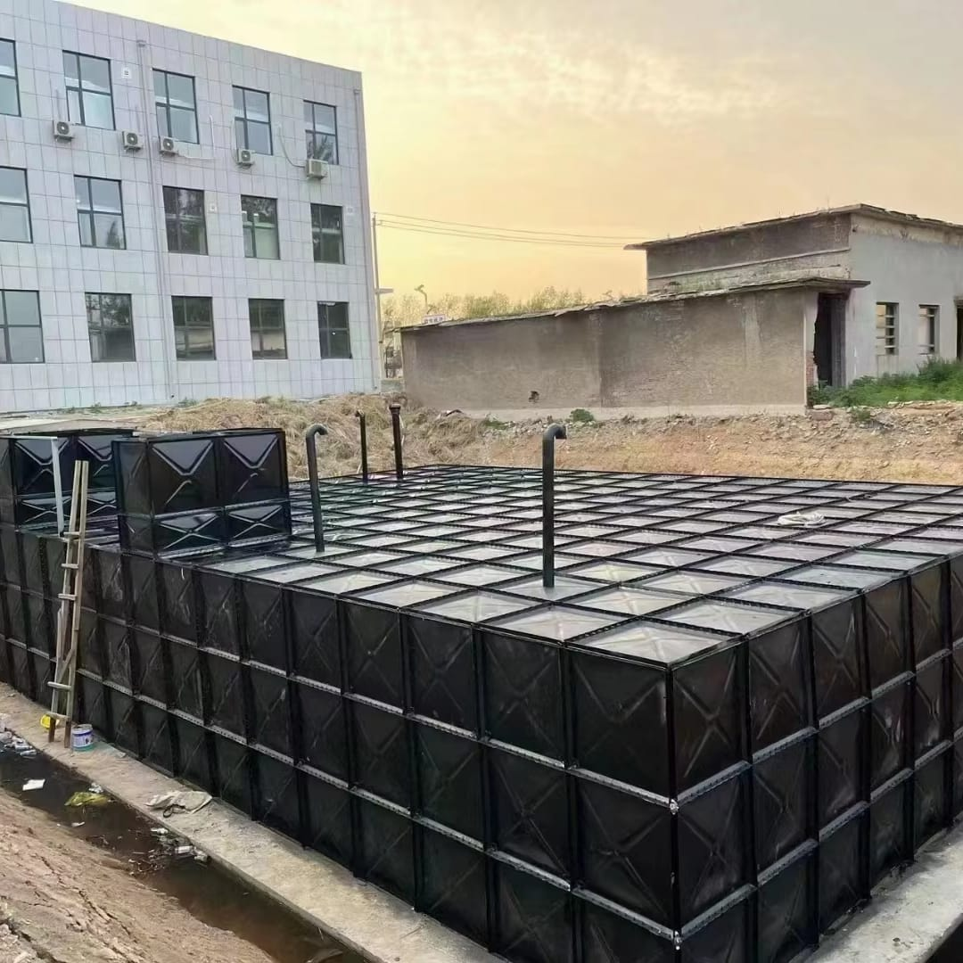
5.2 Storm water Storage Tanks
Reliable Water Tanks in Ethiopia: Rainbow Reservoirs’ Sustainable Storage Solutions

Slide 44
Conclusion
This integrated design provides a comprehensive solution that:
Prevents water stagnation on the carriageway.
Optimizes storm water runoff management.
Extends the lifespan of the road infrastructure.
Minimizes flood-related damages and maintenance costs.

Slide 45
5.3 Water Storage & Road Design
Rectangle Storage Calculation and Pavement Layout

Slide 46

5.4.0 Pavement Layout
Total Width = 30 m
Two lanes Each Side
Median (waist) = 3 m
Other section = 10 m

Slide 47
5.4.1 Road Dimensions
Total Width = 30 m
Left Walkway = 3.5 m
Left Carriageway = 10 m
Median = 3 m
Right Carriageway = 10 m
Right Walkway = 3.5 m

Slide 48

5.4.2 Drainage Pipe System Calculations

Slide 49


Drainage Pipe System Calculations

Slide 50



Slide 51


Slide 52

5.4.3 Water Storage Calculation
Rectangle
Width = 34 m
Length = 54 m
Depth=2m
Step 1: Area
Area = 34 × 54 = 1836 m²
Step 2: Volume
Volume =1836 ×2= 3672 MC

Slide 53
Storage Examples
100 mm = 367,200 liters
1000 mm (1 m) = 3,672,000 liters
2000 mm (2 m) = 7,344,000 liters

Slide 54
6.0 Geotechnical Investigation
A. Drainage & Flood Risk
1.Site drainage at Daalo Road, Bakaro Market, Mogadishu is moderate to poor.
Some signs of water accumulation are observed during rainfall due to limited drainage systems.
The area appears potentially prone to flooding, especially during rainy seasons.
2. General Geotechnical Interpretation
B.0 Preliminary Subsurface Interpretation
Based on visual assessment of Daalo Road (Bakaro Market area):
Subsoil is likely composed of:
Silty sand with sandy clay layers
Soil conditions suggest:
Moderate bearing capacity

Slide 55
Settlement risk: low to medium
The subsurface conditions are preliminarily interpreted as cohesive to semi-cohesive soils, suitable for light to medium structures with proper design.
3. Preliminary Engineering Assessment
C.0 Foundation Considerations
Based on assumed soil conditions:
Shallow foundations (strip or pad footings) are likely suitable
Ground compaction may be required in weaker zones
Estimated allowable bearing capacity:
100 – 200 kPa (ASSUMED)
These values are indicative and based on typical soil behavior observed at the site.

Slide 56
D. Limitations & Disclaimer
E.0 Limitations of Study
This assessment is based only on visual inspection of Daalo Road.
No boreholes, in-situ testing, or laboratory analysis were conducted.
Therefore, subsurface conditions may vary and cannot be fully confirmed.
A detailed geotechnical investigation is recommended before construction.

Slide 57

6.1 Structure of Pavement

Slide 58

6.2 Cost estimation of Pavement

Slide 59
Conclusion
A proper drainage design is essential for controlling floods on Daalo Road in Banaadir Region, Somalia. An effective drainage system helps manage stormwater runoff, reduce road damage, improve transportation safety, and minimize flooding impacts on nearby communities. Therefore, implementing a well-planned drainage system will improve the durability and sustainability of the road infrastructure while supporting urban development in the area.

