Slide 1
Geotechnical Investigation
A. Drainage & Flood Risk
1.Site drainage at Daalo Road, Bakaro Market, Mogadishu is moderate to poor.
Some signs of water accumulation are observed during rainfall due to limited drainage systems.
The area appears potentially prone to flooding, especially during rainy seasons.
2. General Geotechnical Interpretation
B.0 Preliminary Subsurface Interpretation
Based on visual assessment of Daalo Road (Bakaro Market area):
Subsoil is likely composed of:
Silty sand with sandy clay layers
Soil conditions suggest:
Moderate bearing capacity

Slide 2
Settlement risk: low to medium
The subsurface conditions are preliminarily interpreted as cohesive to semi-cohesive soils, suitable for light to medium structures with proper design.
3. Preliminary Engineering Assessment
C.0 Foundation Considerations
Based on assumed soil conditions:
Shallow foundations (strip or pad footings) are likely suitable
Ground compaction may be required in weaker zones
Estimated allowable bearing capacity:
100 – 200 kPa (ASSUMED)
These values are indicative and based on typical soil behavior observed at the site.

Slide 3
D. Limitations & Disclaimer
E.0 Limitations of Study
This assessment is based only on visual inspection of Daalo Road.
No boreholes, in-situ testing, or laboratory analysis were conducted.
Therefore, subsurface conditions may vary and cannot be fully confirmed.
A detailed geotechnical investigation is recommended before construction.

Slide 4
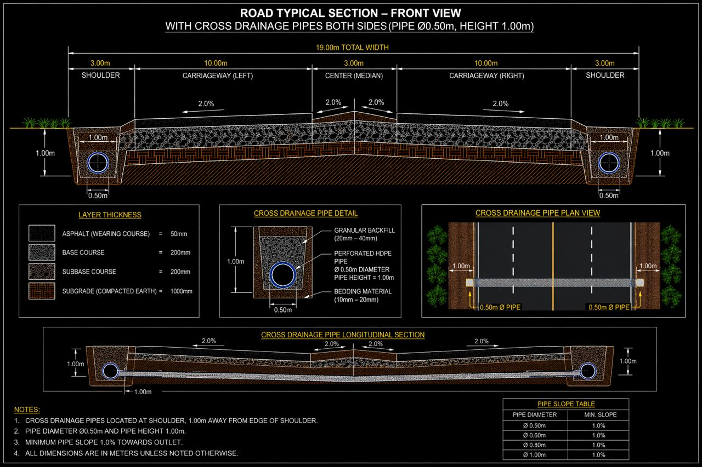
Structure of Pavement

