Slide 1
Project planning and managment

Slide 2

INTRODUCTION
The project covers building planning, architectural layout, structural design, and cost estimation to develop a safe and economical structure.
It includes site analysis, foundation, column, beam, slab, and staircase design, along with plans, sections, and elevations.
Overall, the project applies civil engineering principles to achieve a durable, functional, and efficient building.

Slide 3
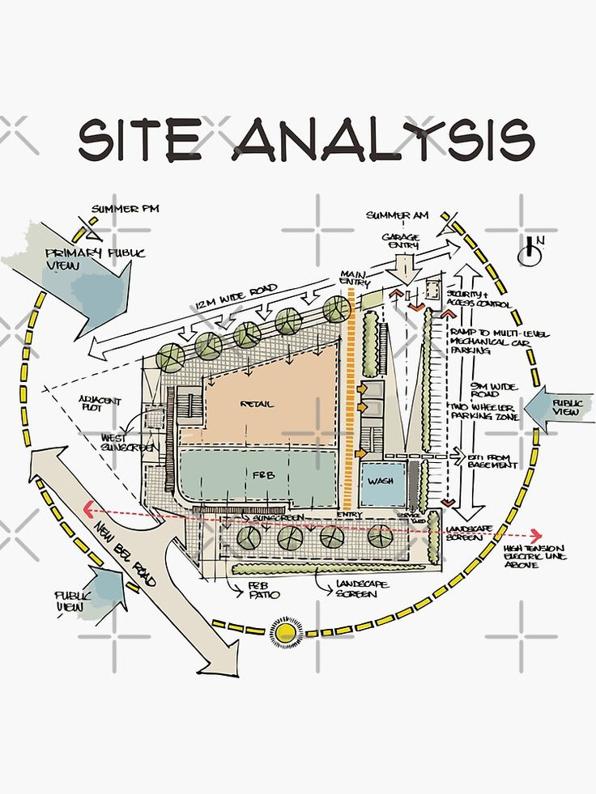
Site Analysis
The project site is a 20m × 35m rectangular plot suitable for construction, parking, and circulation.
The north-facing orientation provides good natural lighting, ventilation, and indoor comfort.
The site is accessible by a 35m main road and an 8m side road, with residential and commercial buildings nearby.

Slide 4
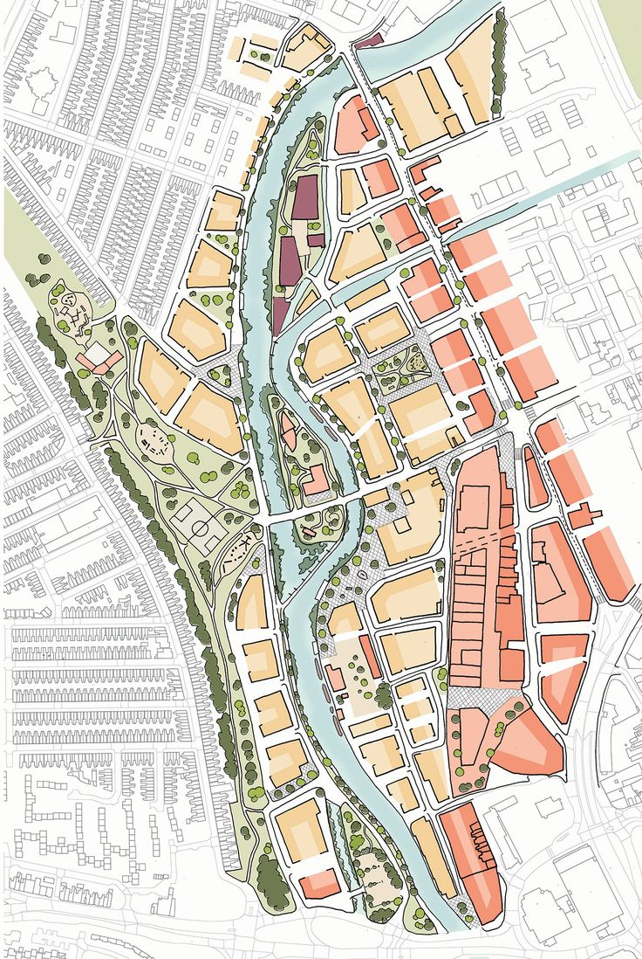
Access and Traffic Analysis
The site has a main entrance on the north side connected to the 35m Main Road, with a secondary entrance on the east side.
The entrances provide easy vehicle and pedestrian access while ensuring smooth traffic circulation and reducing congestion.
The site is surrounded by key junctions, including Taraqa, Sigaarka, Shiirkole, and Shiirkole Ofiyaale.

Slide 5
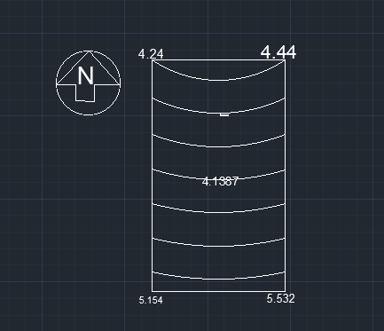
Site Elevation
The site slopes from north to south, with higher ground levels in the north and lower levels in the south.
Proper drainage is required to control rainwater flow and prevent water accumulation.
Foundation planning should consider the elevation differences to ensure stability and safety.

Slide 6
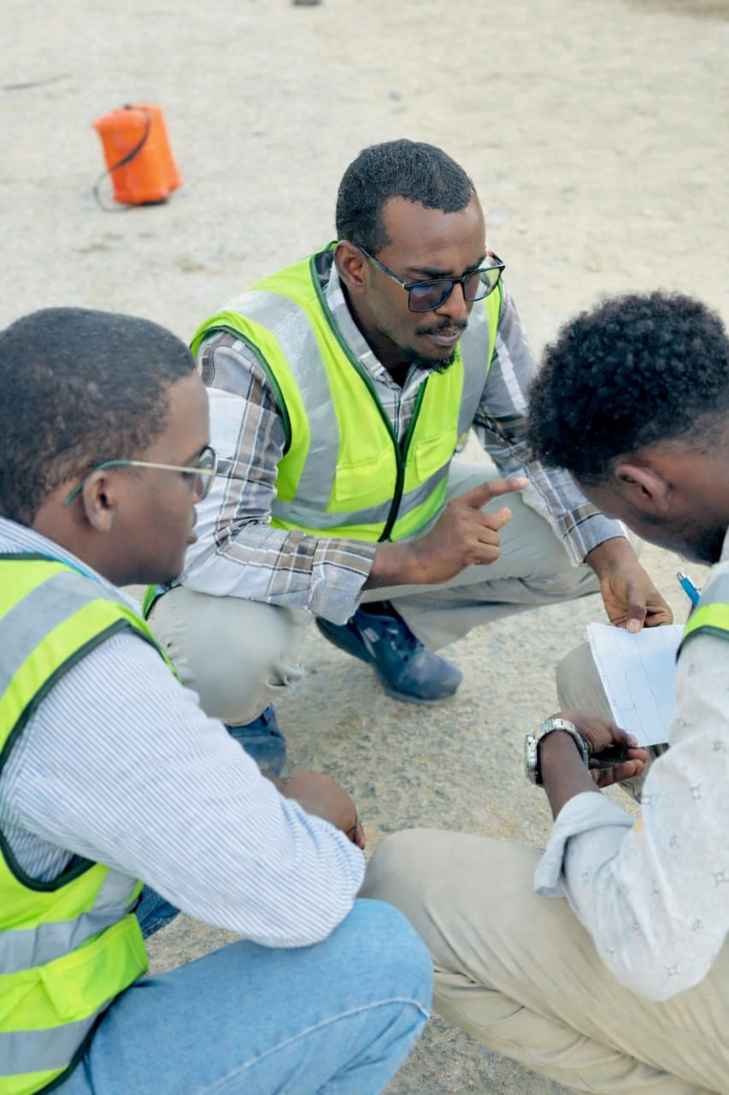
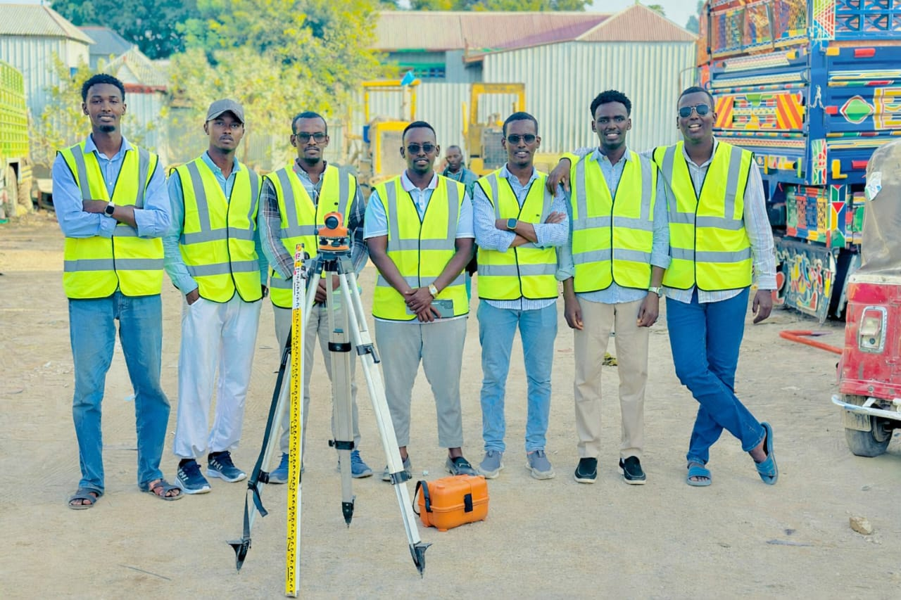
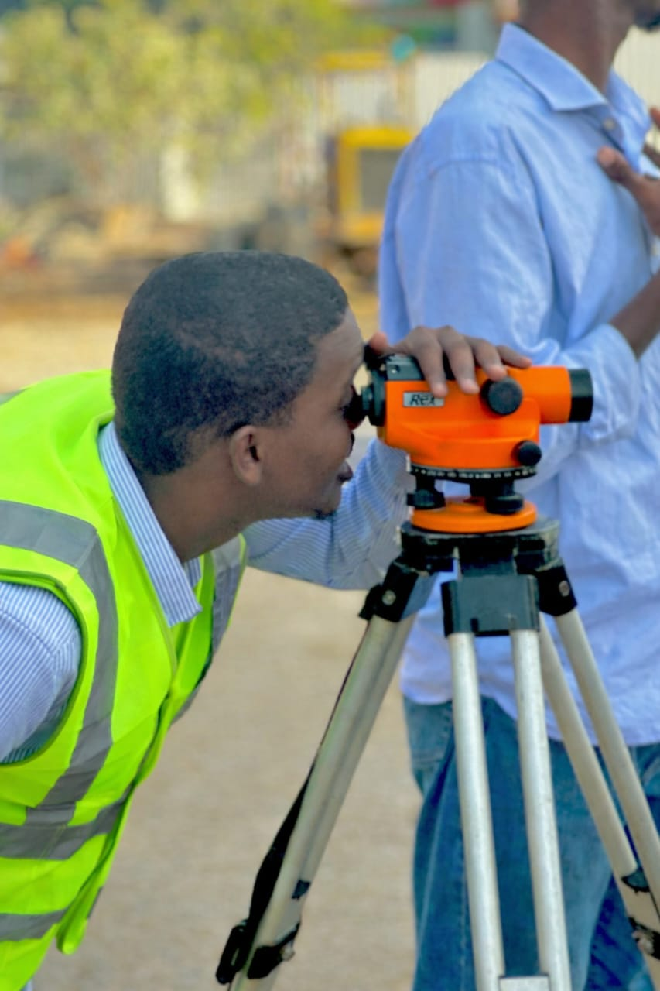
THE SITE WHERE WE CONDUCTED THE PROJECT

Slide 7
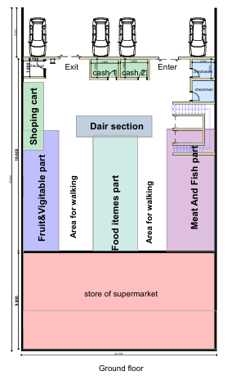
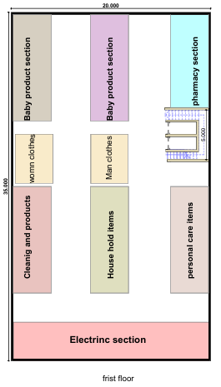
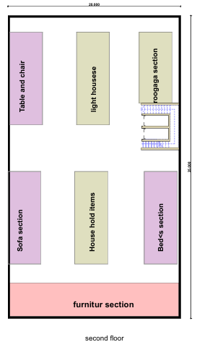
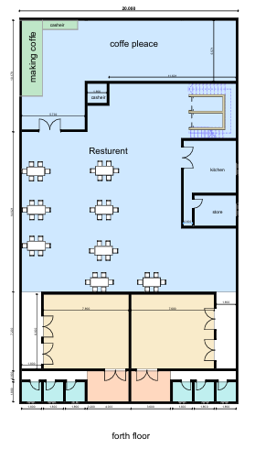
2D PLANE

Slide 8

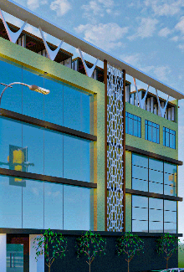
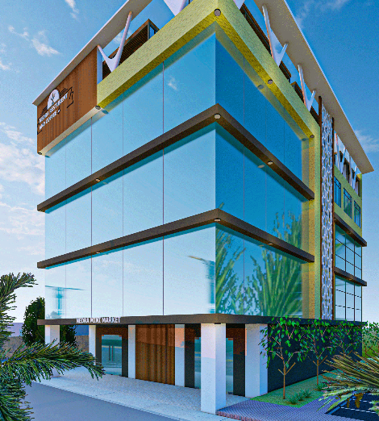
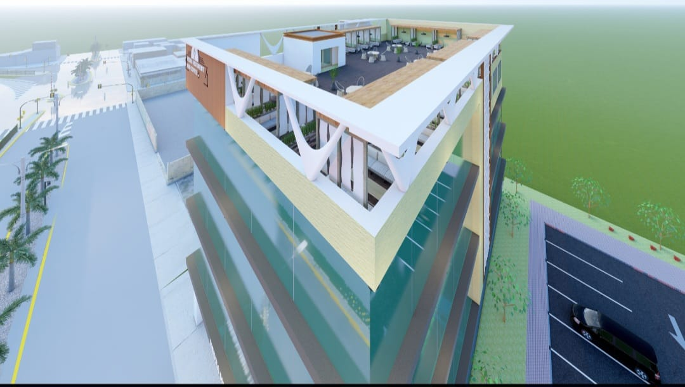
ELAVATION VEIW
TOP VEIW
FRONT VEIW
SIDE VEIW
BACK SIDE VEIW

Slide 9
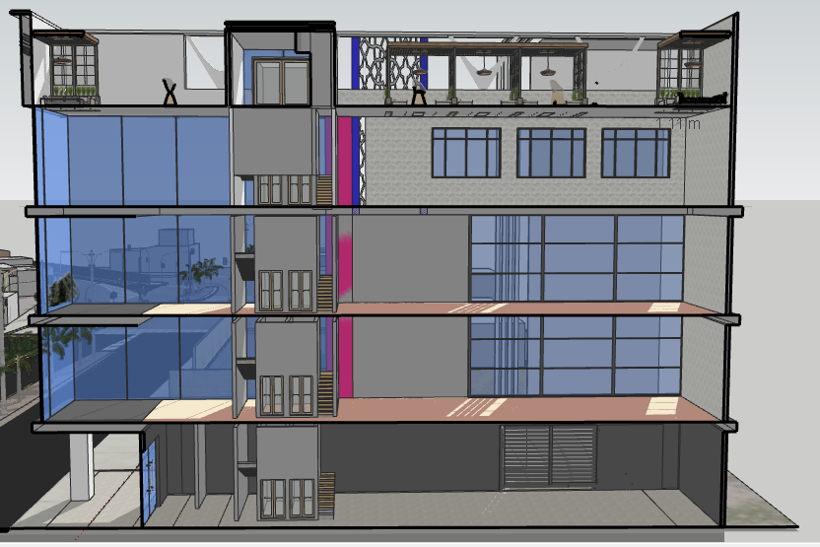
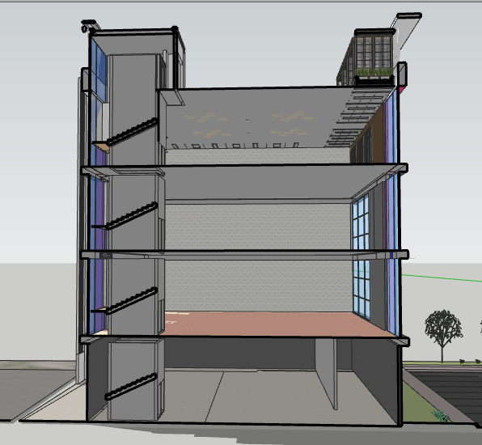
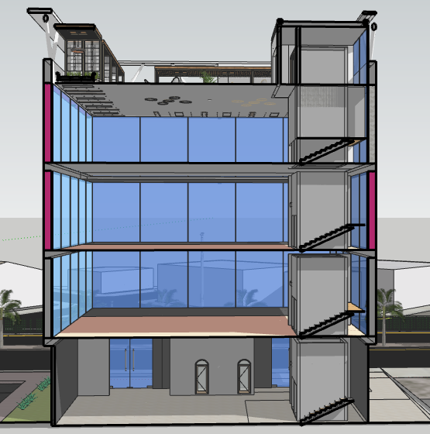
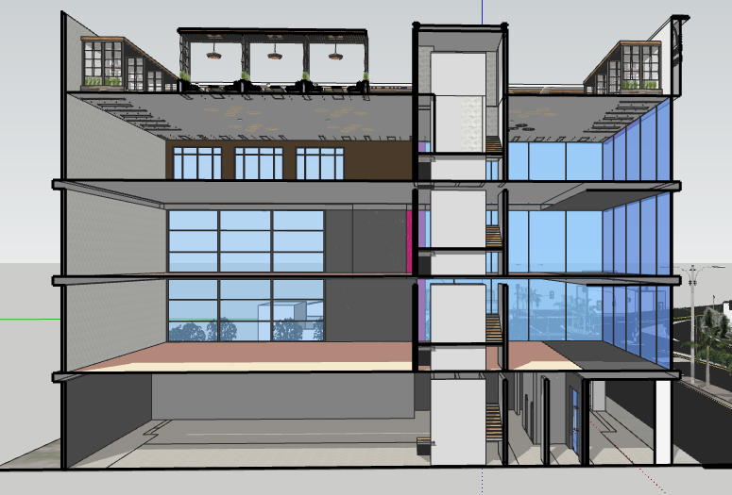
SECTIONS
SECTION 1
SECTION 2
SECTION 3
SECTION 4

Slide 10
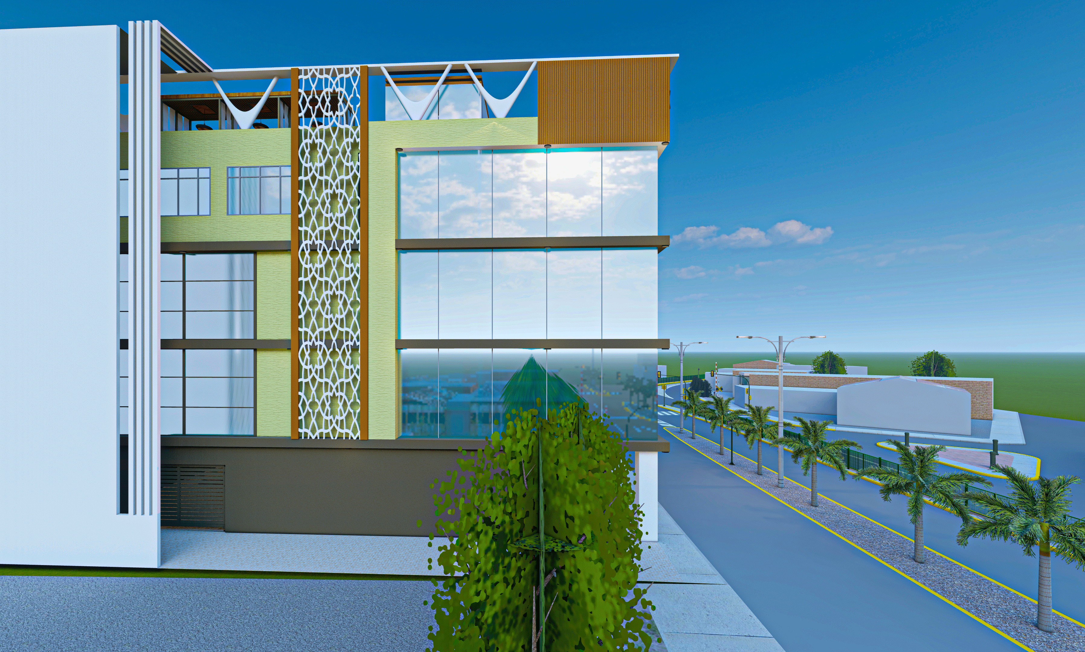
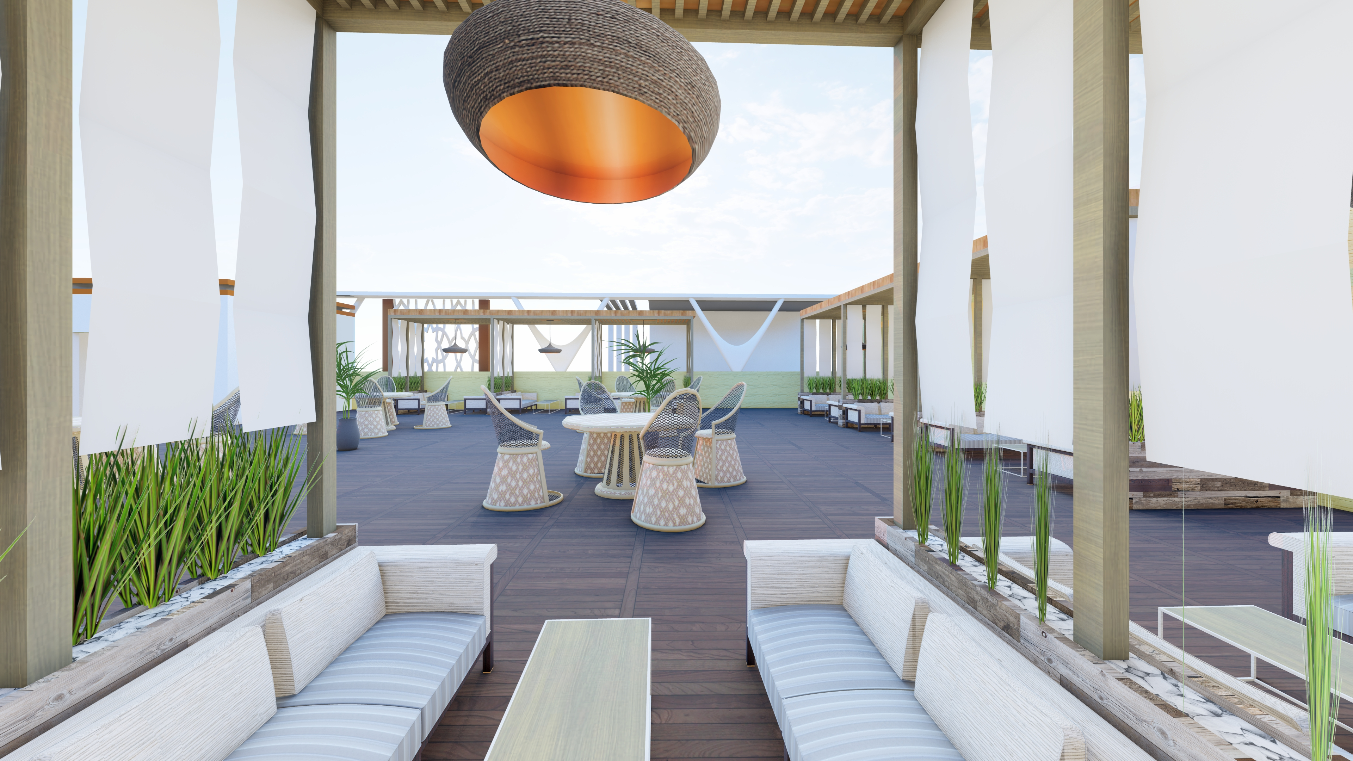
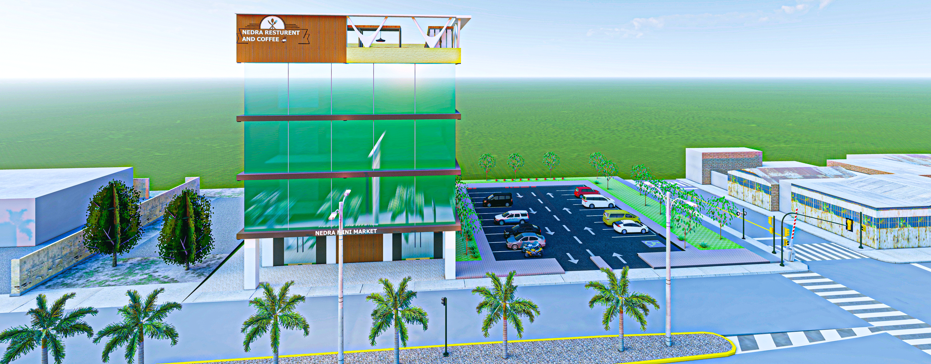
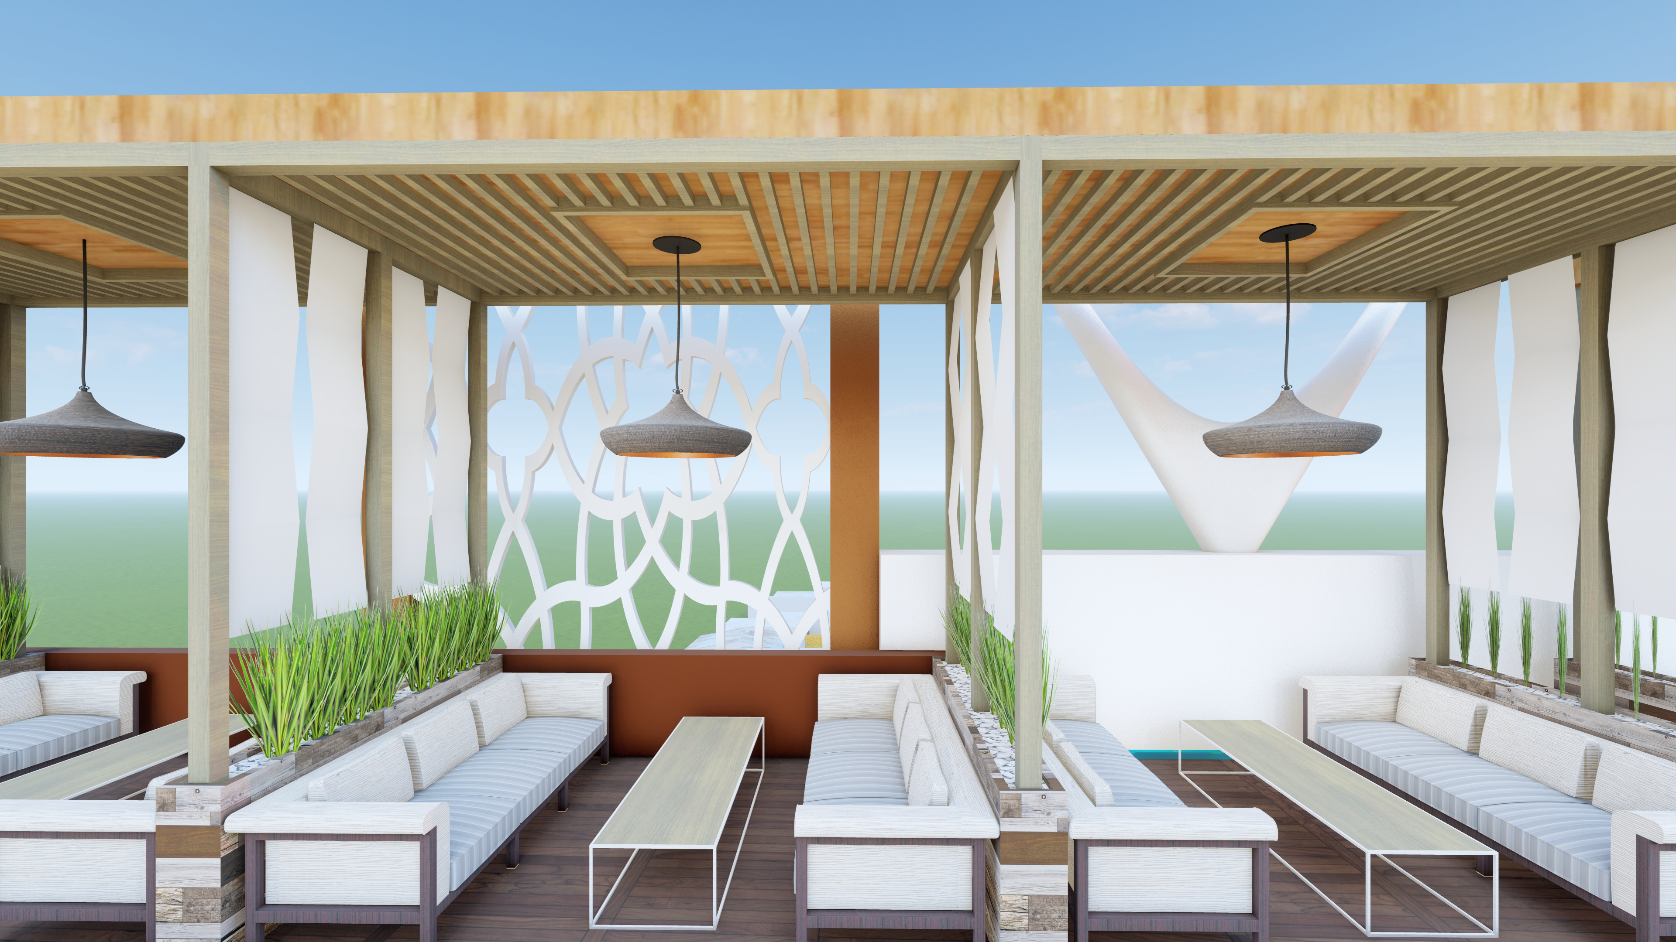
3D PLANE

Slide 11
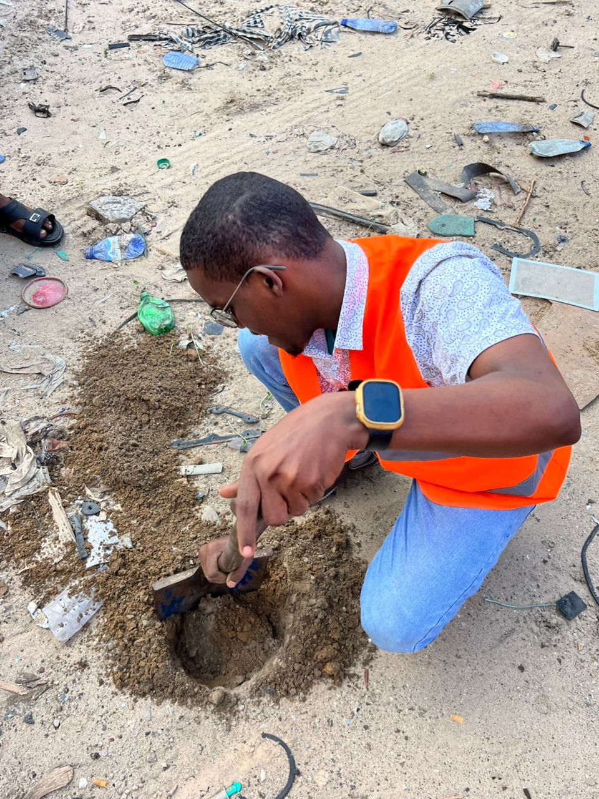
GEOTECHNICAL REPORT
The geotechnical assessment found the site soil to be brown, gravelly, firm, and moderately compacted, with good drainage and low plasticity.
The site has a gentle slope, mostly dry ground, minimal vegetation, and no groundwater observed during the inspection.
Overall, the site is stable and suitable for construction, with no major geotechnical problems or flooding risks identified.

Slide 12
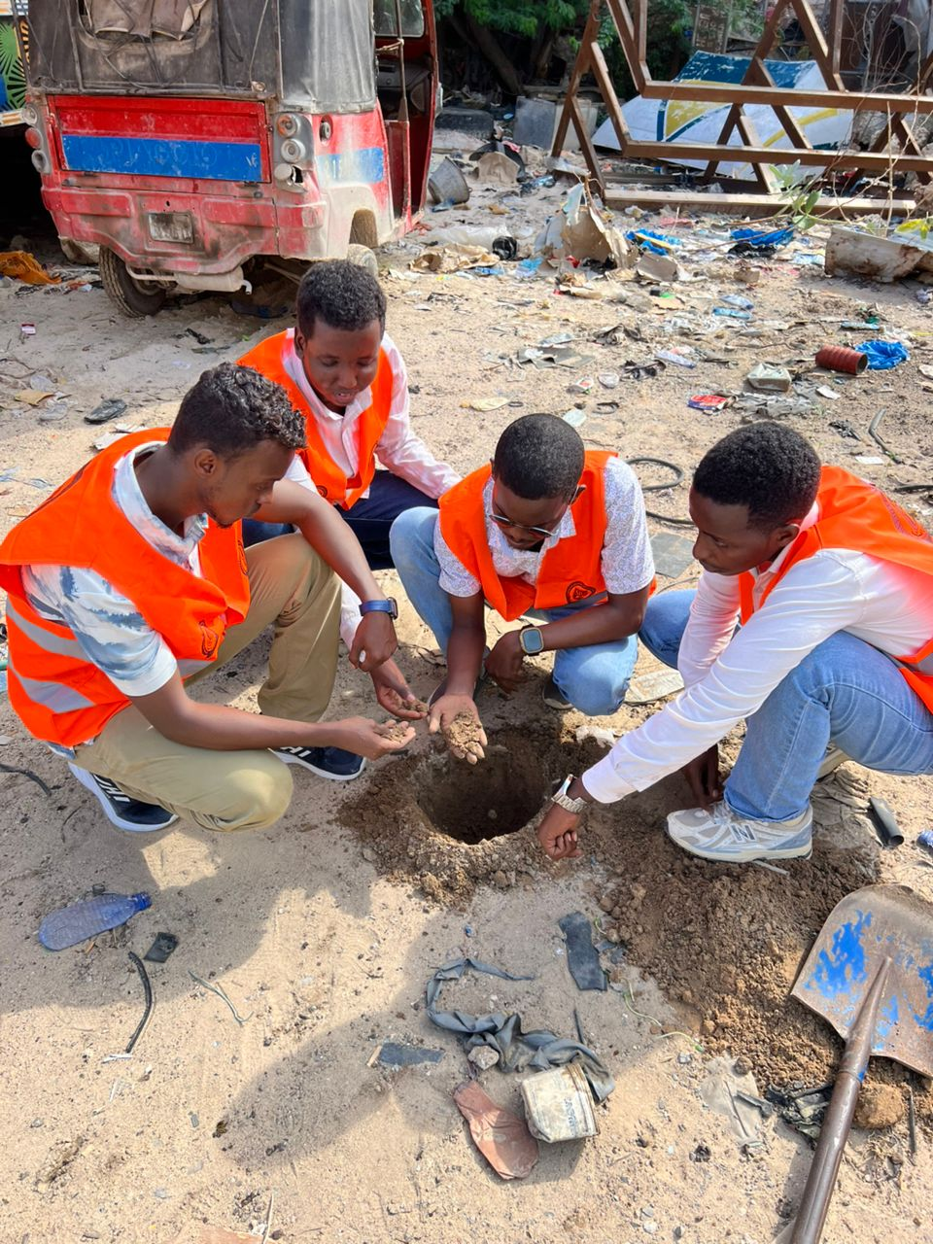
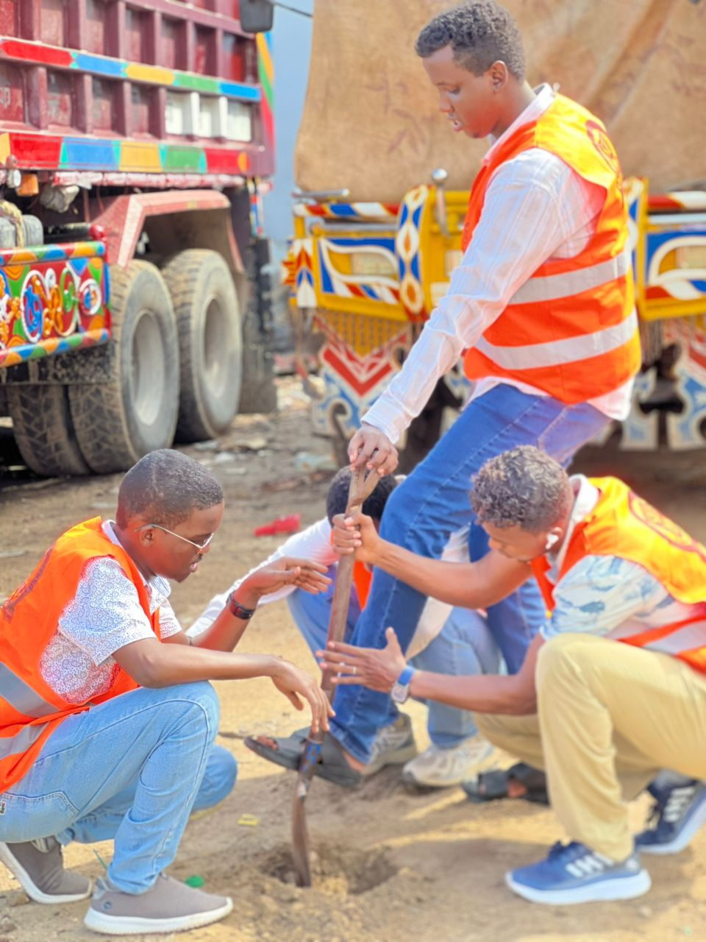
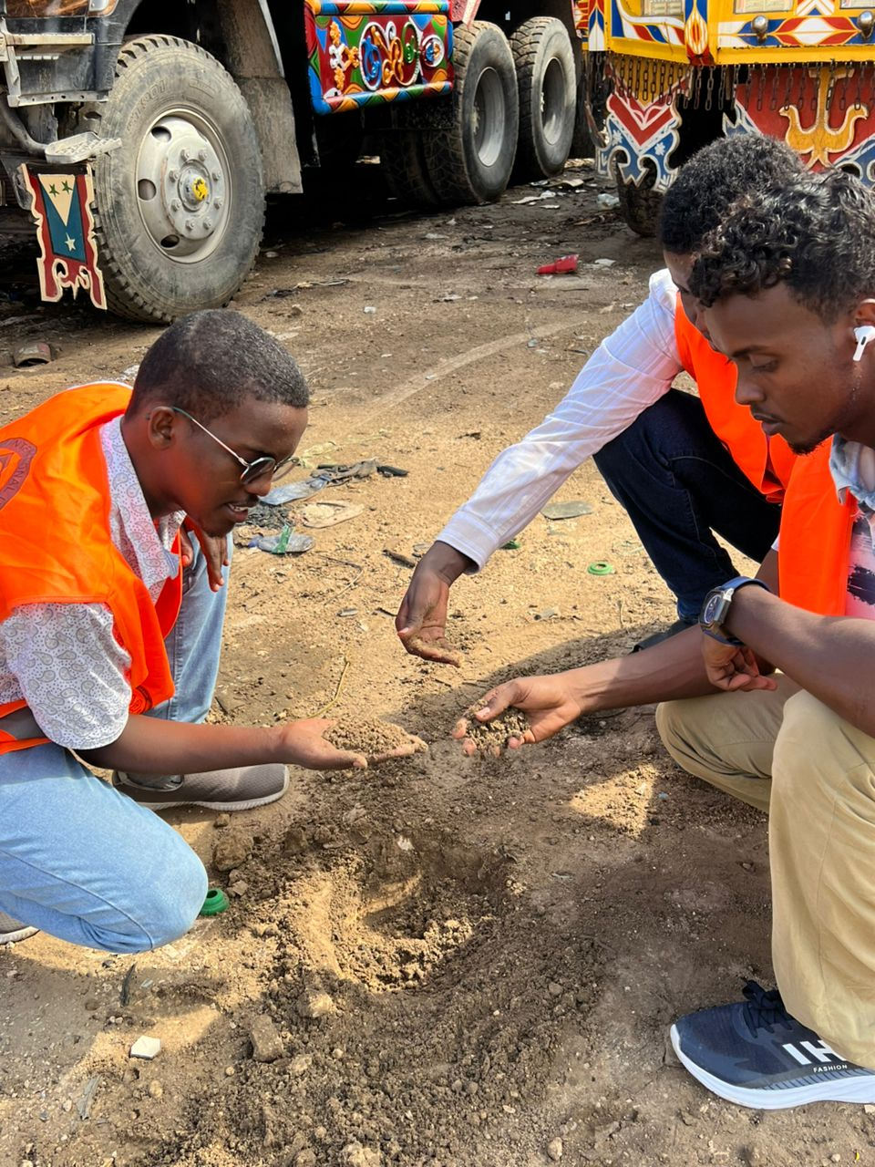
SITE WORK

Slide 13
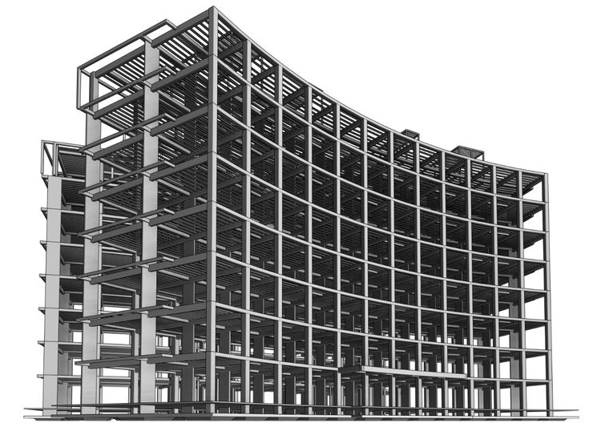
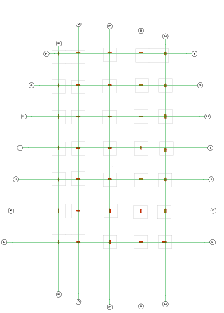
STRUCTURAL DESIGN
INTODUCTION
Structural design is a branch of civil engineering that deals with planning and designing safe and strong buildings. It helps structures carry loads like people, furniture, and wind safely. The main goal is to make buildings stable, durable, and safe for use.
Foundation Design
Foundation design is the process of planning and designing the base of a building. It helps transfer the building load safely to the ground and keeps the structure stable and strong.

Slide 14
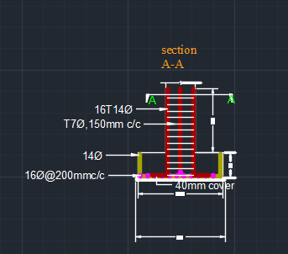
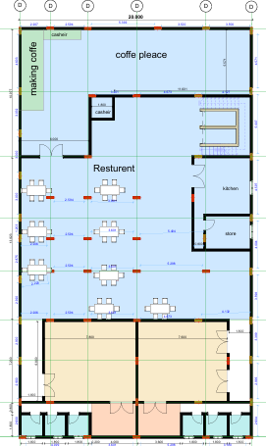
Column Design
is the process of determining the size, shape, and reinforcement of a structural column to safely support and transfer loads from the building to the foundation without failure.

Slide 15
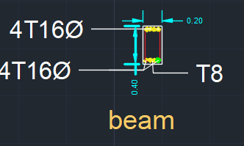
Beam Designs
the process of designing a structural beam to safely support loads and transfer them to columns or walls without bending or failure.

Slide 16
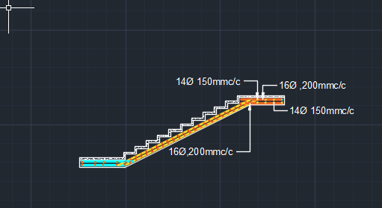
Staircase Design
is the process of planning and designing stairs to provide safe, comfortable, and efficient movement between different floor levels.

Slide 17
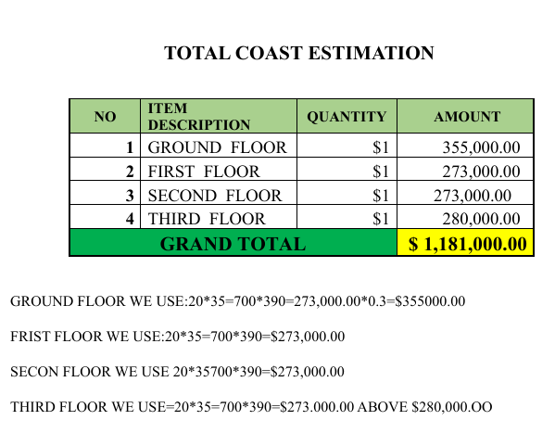
Cost Estimation
is the process of calculating the expected cost of materials, labor, and construction work required to complete a project.

Slide 18

Conclusion
The project focused on planning, analysis, and structural design, including site investigation, architectural planning, and cost estimation.
The site was found suitable for construction, and the proposed design provides safety, strength, durability, and efficient space utilization.
Overall, the project improved practical civil engineering knowledge and highlighted the importance of proper planning and structural analysis.
.

