Slide 1
Proposed Planned Residential Community Development at Carwo Taleex, Mogadishu
PROJECT NAME
SUBJECT
PLANNING AND MANAGEMENT
SUPERVISOR
ENG. OSMAAN ABDI KULANE
HEAD OF CIVIL ENGINEERING

Slide 2


Slide 3
Chapter Content
Introduction
Site Analysis
Access and Traffic Analysis
Site Elevation
Site Location
2D Plan
Elevation Views
Front View
Back Side Vie
Side View
Top View
Sections
3D Plan
Geotechnical Report
Site Work
Structural Design
Foundation Design
Column Design
Beam Design
Staircase Design
Cost Estimation
Conclusion

Slide 4

INTRODUCTION
The proposed Carwo Village Development is a planned residential community designed to provide a comfortable, secure, and well-organized living environment.
The development combines residential buildings with essential community facilities, recreational spaces, commercial services, parking areas, landscaping, and internal roads.
The project involves site planning, architectural development, structural engineering, and preliminary cost assessment.
The overall design aims to achieve efficient land utilization while providing a functional and attractive environment for residents and visitors.

Slide 5
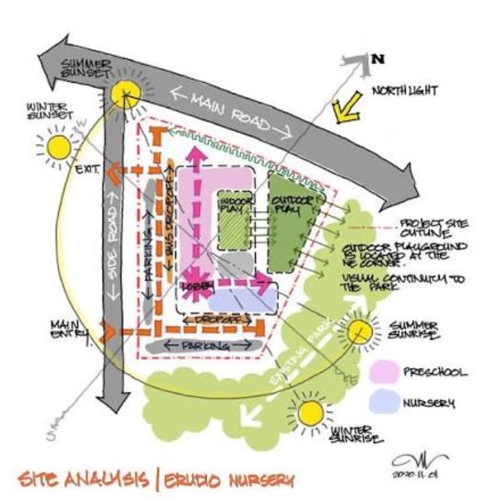
Site Analysis
The development occupies a rectangular site measuring approximately 120 m × 60 m, giving a total land area of 7,200 m². The site is located in Carwo Taleex within Hodan District of Mogadishu.
The proposed development makes use of the available land through a planned arrangement of residential units, community facilities, open spaces, access roads, and parking areas.
Building orientation is considered to improve daylight, ventilation, and general environmental comfort.

Slide 6
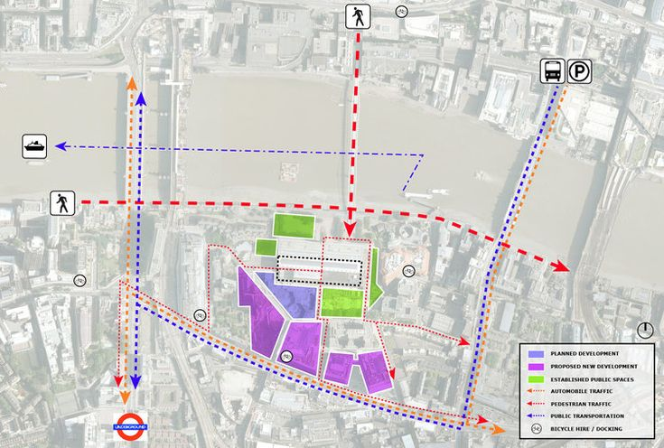
Access and Traffic Analysis
Access to the development is organized to provide convenient movement of vehicles and pedestrians. The principal entrance is positioned on the western side of the site and connects with a 15 m wide road.
Additional access is provided for service and emergency purposes from the northern/eastern side. Internal roads are arranged to connect the major facilities and residential areas while allowing vehicles to circulate efficiently throughout the development.

Slide 7
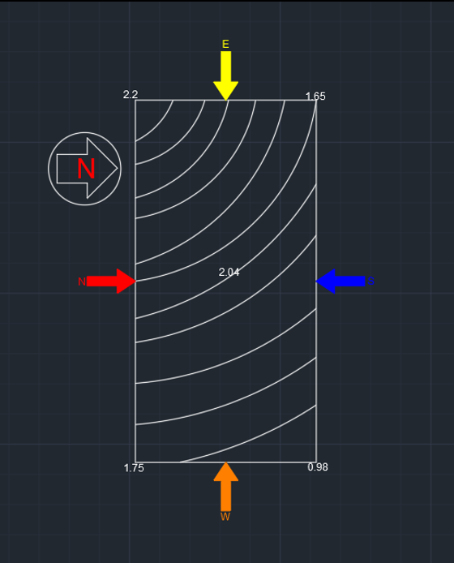
Site Elevation
The existing terrain has a gradual difference in elevation across the site.
The highest recorded level is approximately 2.20 m in the North-West, while the lowest level is approximately 0.98 m in the South-East.
This creates an overall elevation difference of about 1.22 m across the site.
The natural fall can be incorporated into the drainage strategy by directing surface runoff toward the lower portion of the site.
Appropriate grading and level adjustments will be required during construction.

Slide 8
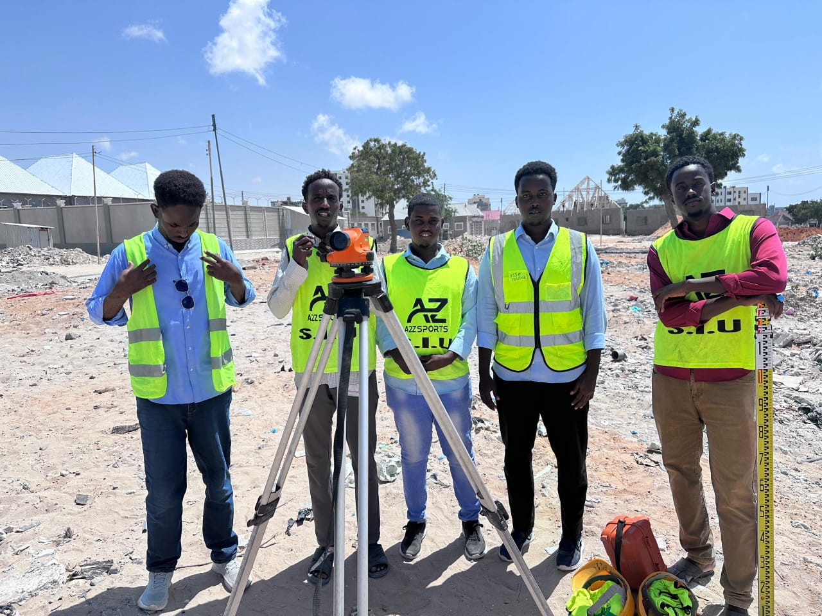
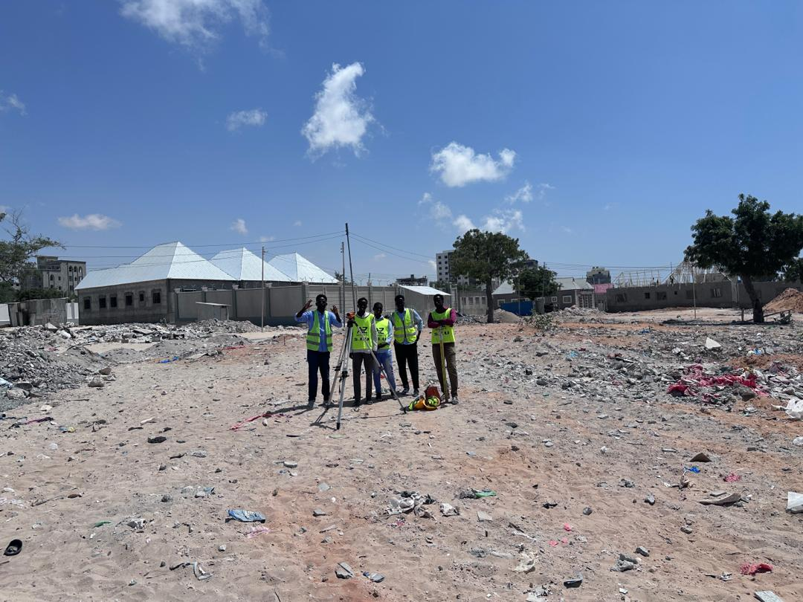
THE SITE WHERE THE PROJECT WAS IMPLEMENTED

Slide 9
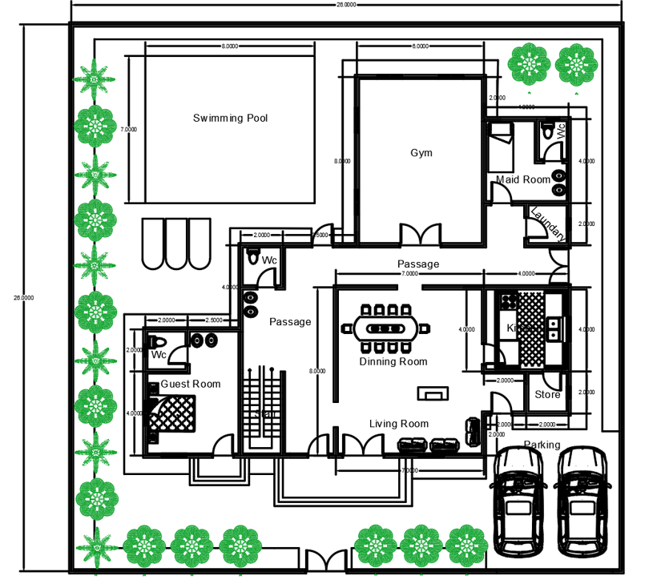
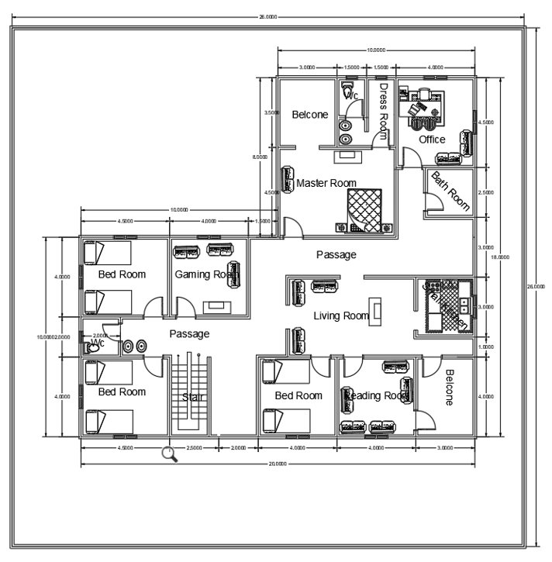
2D PLANES
Luxury VIP Villa
First Floor
Ground Floor

Slide 10
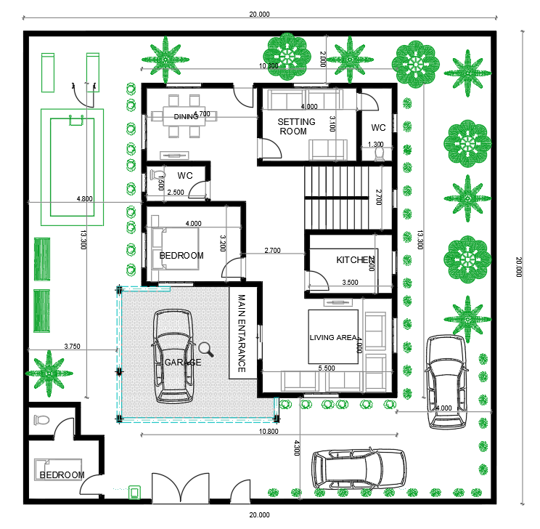
Semi VIP Villa
No
Kitchen
Living room
Dining room
Maid room + Bathroom
G. Bathroom
Garden / Landscape
Parking
Pool
Master rooms
Bedrooms

Slide 11
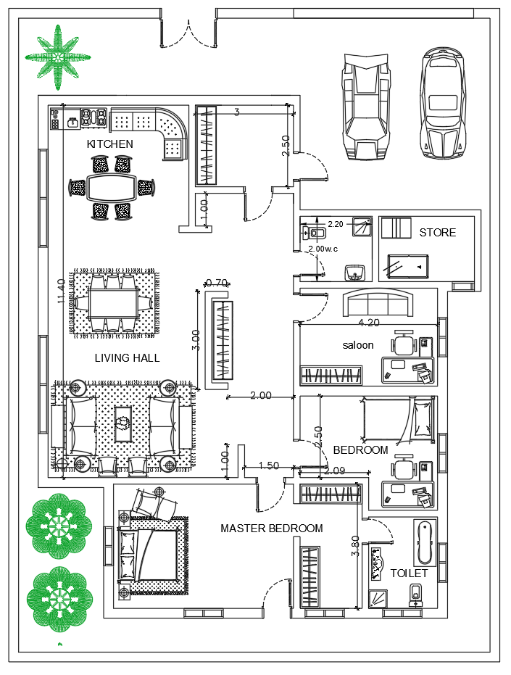
VIP Villa
No
Kitchen
Living room
Dining room
Store
G. Bathroom
Garden / Landscape
Parking
Master rooms
Bedrooms

Slide 12
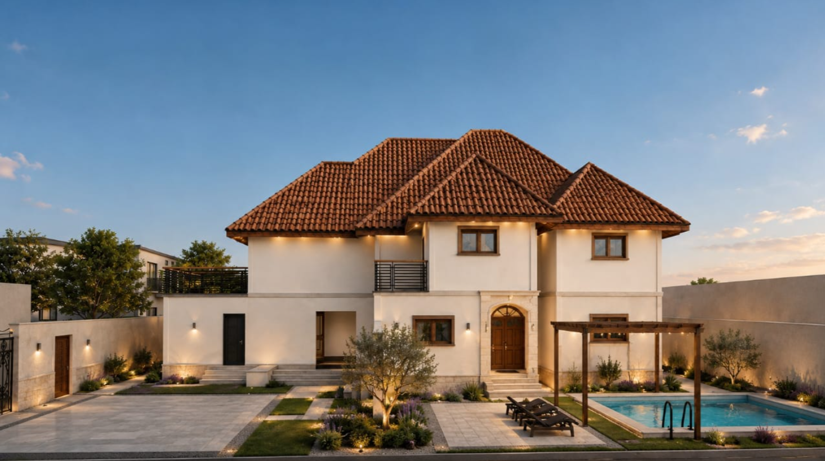
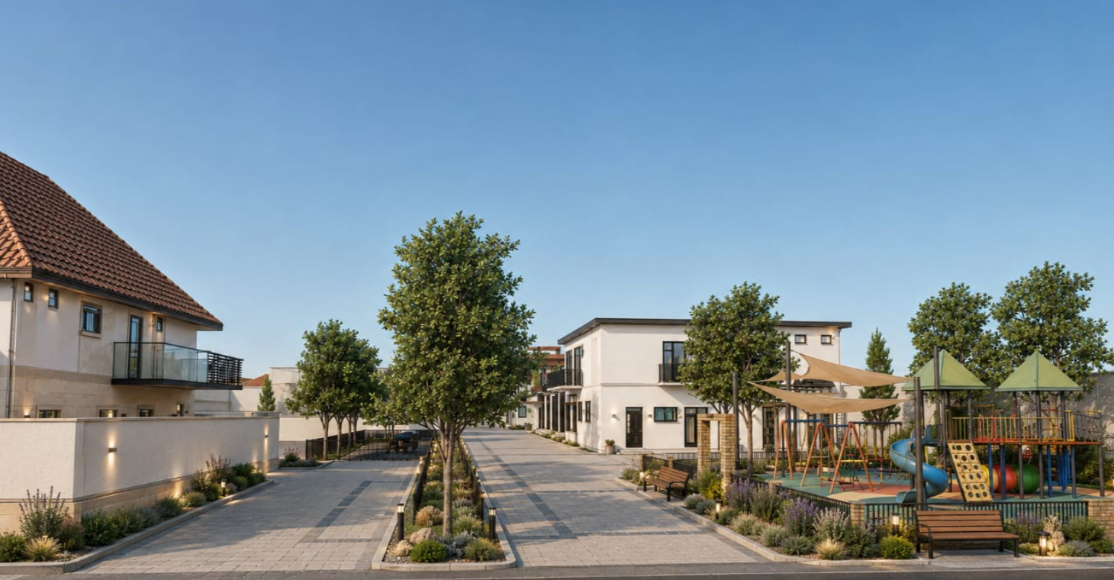
ELAVATION VEIW

Slide 13
SECTIONS

Slide 14
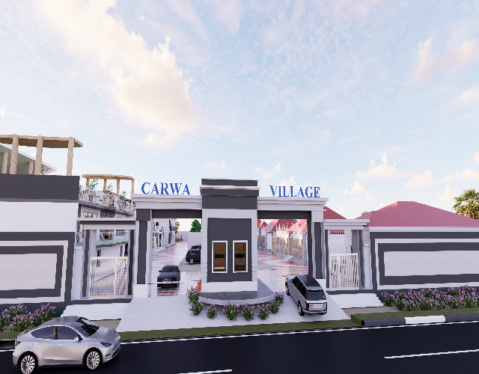
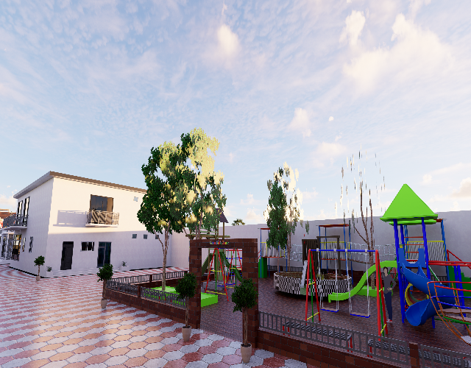
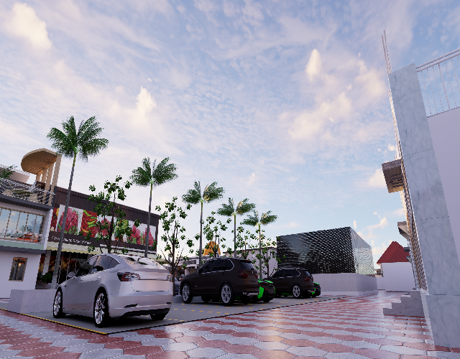
3D PLANES

Slide 15
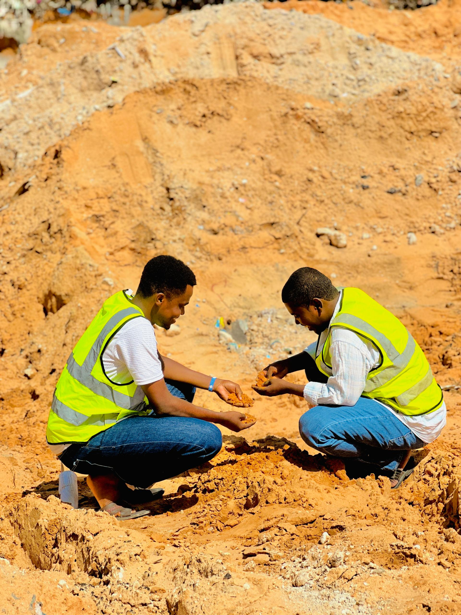
GEOTECHNICAL REPORT
The observed ground material consists mainly of brown, gravelly, coarse-grained soil.
The soil appears relatively firm and moderately compacted, with low plasticity and good natural drainage characteristics.
During the site observation, no surface groundwater was identified.
The existing ground conditions appear favorable for the proposed low-rise development;
however, detailed soil testing should be undertaken before construction to establish the design bearing capacity and appropriate foundation requirements.

Slide 16
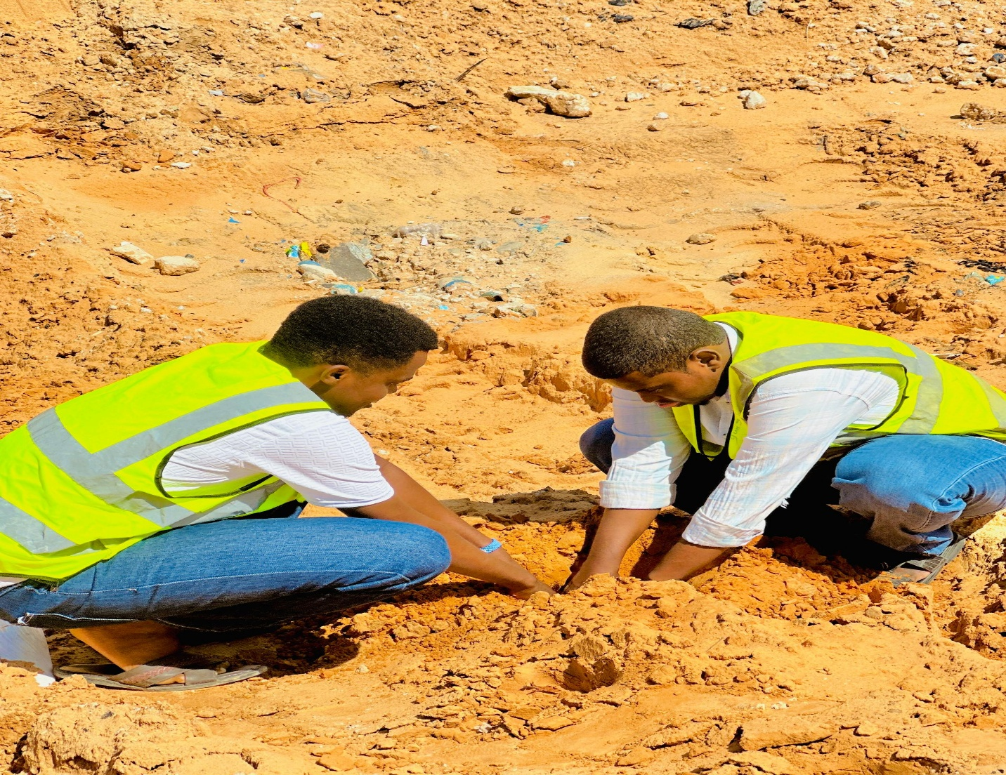

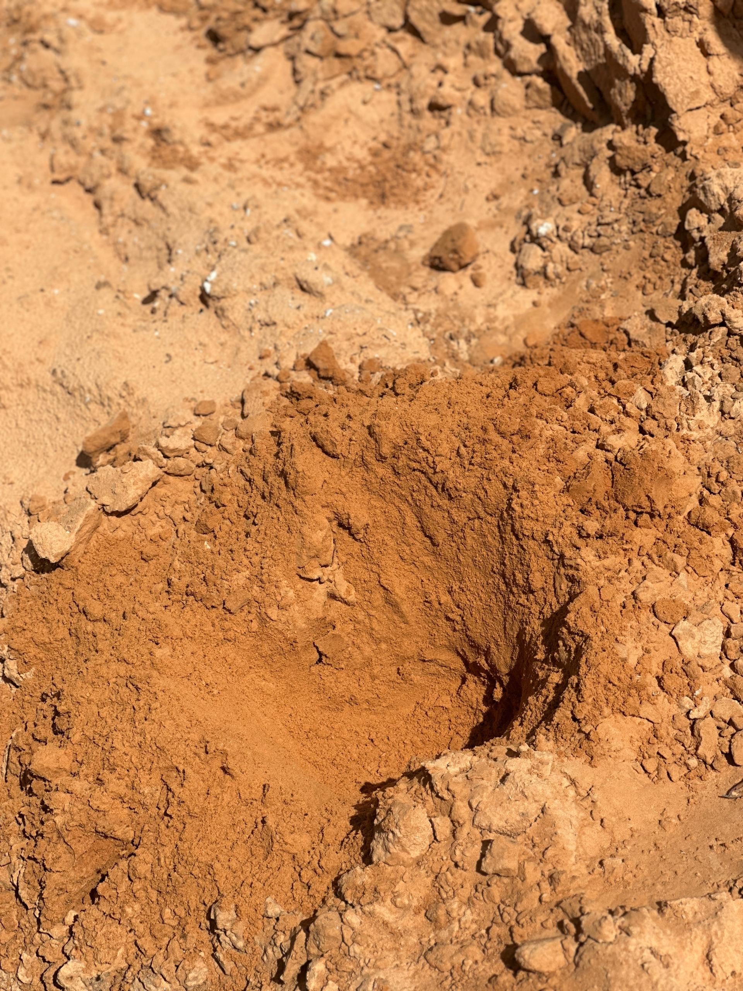
SITE WORKS

Slide 17
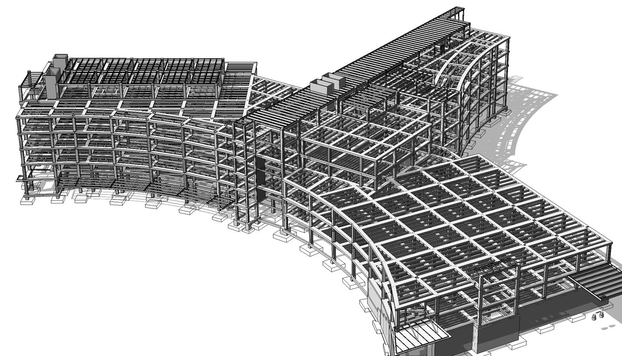
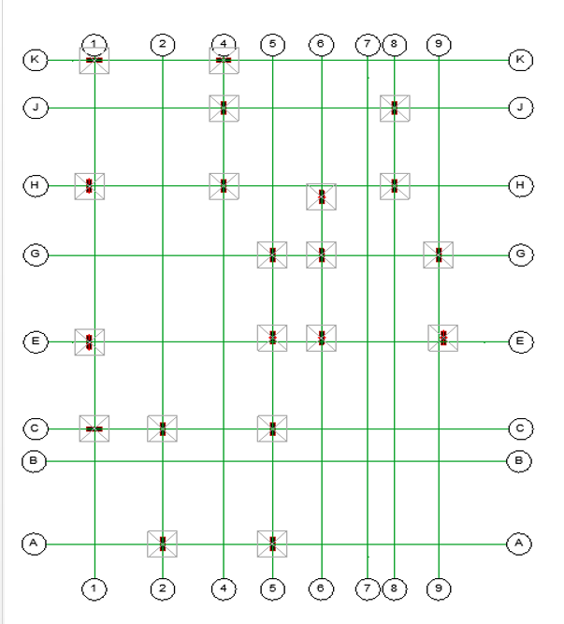
STRUCTURAL DESIGN
INTODUCTION
Structural design is the process of determining the size, shape, and materials of structural elements so that a building can safely support all expected loads? It ensures that components such as beams, columns, slabs, and foundations remain strong, stable, and durable throughout the life of the structure.
Foundation design is the engineering process of selecting and designing a suitable foundation system to support a building and transfer its loads safely into the ground. It ensures that the structure remains stable and minimizes excessive settlement or movement.

Slide 18
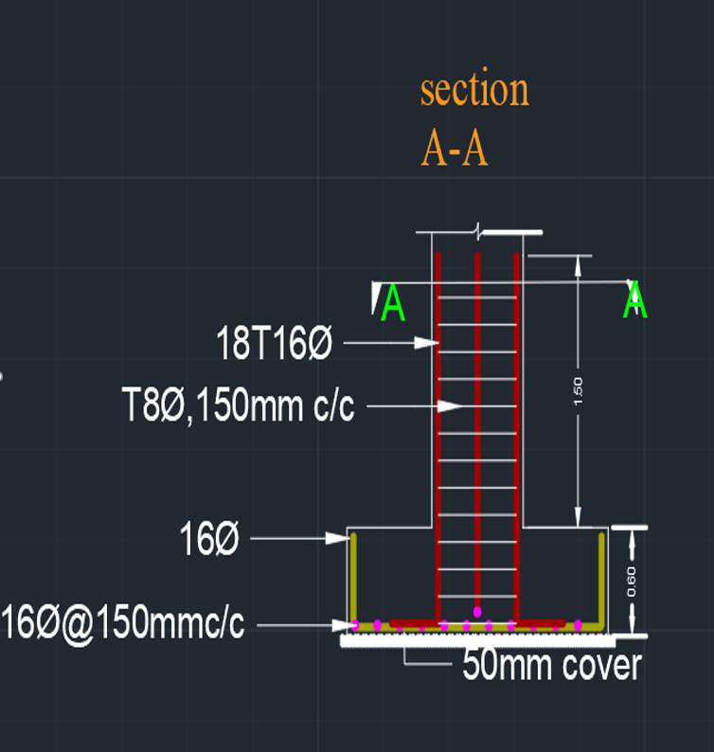
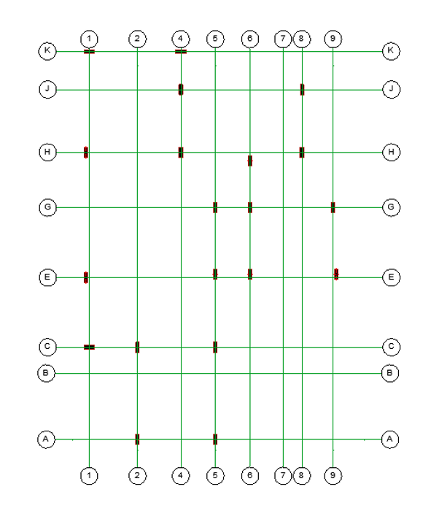
Column Design
Column design is the process of designing structural columns with suitable dimensions and reinforcement to safely carry building loads and transfer them to the foundation. It ensures that the columns have adequate strength, stability, and durability under different loading conditions.

Slide 19
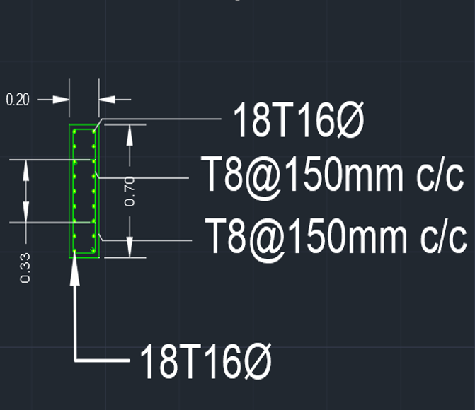
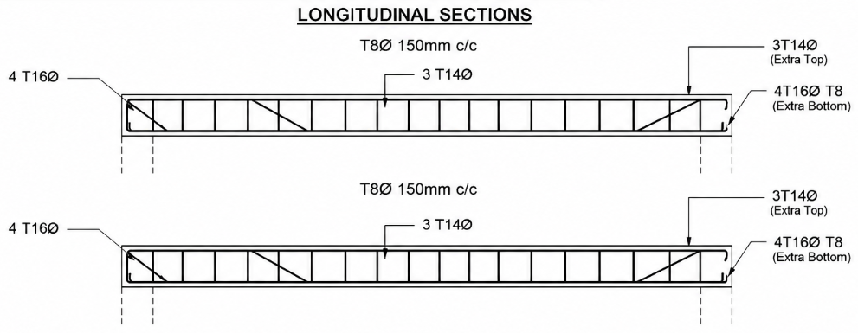
Beam Designs
Beam design is the engineering process of determining the suitable size, dimensions, and reinforcement of a beam to safely carry applied loads and transfer them to columns or supporting walls. It ensures adequate strength, stability, and resistance to bending and shear.

Slide 20
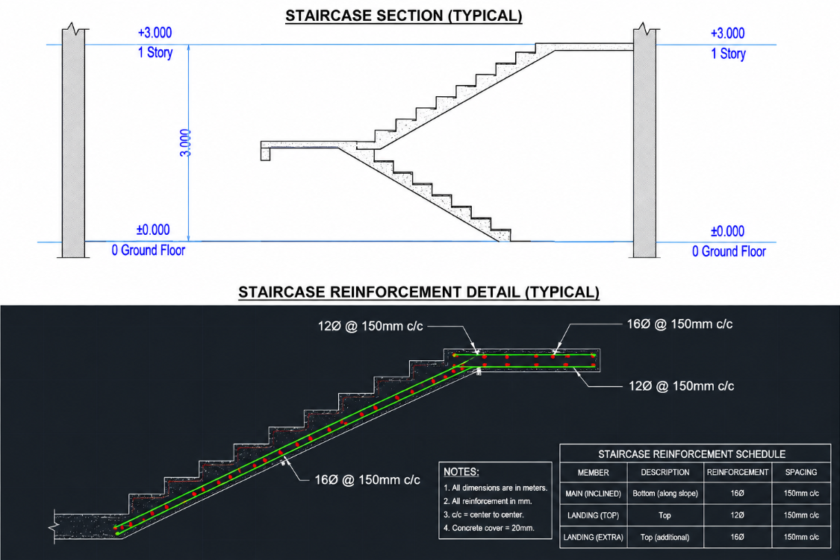
Staircase Design
Staircase design is the process of planning and designing stairs with suitable dimensions, materials, and reinforcement to provide safe and comfortable movement between different floors of a building. It ensures adequate strength, stability, and durability during use.

Slide 21
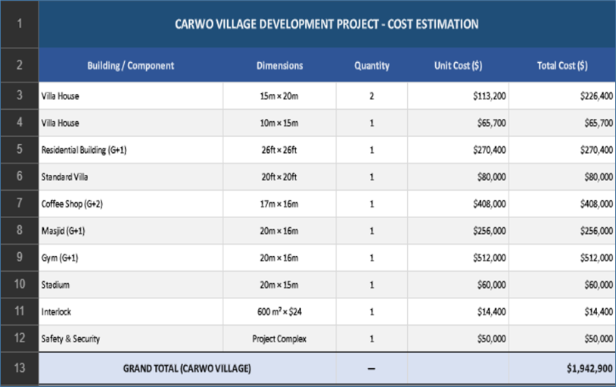
Cost Estimation
Cost estimation is the process of calculating the approximate cost of materials, labor, equipment, and other construction activities required to complete a project. It helps in preparing a proper budget, controlling expenses, and planning the project effectively.

Slide 22

Conclusion
The proposed Carwo Village Development provides a well-planned residential and community environment in Carwo Taleex.
The project integrates residential buildings, commercial facilities, recreational areas, access roads, and supporting infrastructure.
The design considers site conditions, accessibility, geotechnical characteristics, structural requirements, and preliminary cost estimation.
Overall, the project aims to create a safe, functional, durable, and sustainable residential community.

Slide 23


