Slide 1

CIVIL ENGINEERING • GIS • ARCGIS 10.8
Applications of GIS in Civil Engineering Using ArcGIS 10.8
A GIS-based approach to spatial mapping, terrain analysis, infrastructure planning, and flood-risk assessment
N
Academic Presentation | 2026
MAPPING TERRAIN — PLANNING SAFER COMMUNITIES

Slide 2

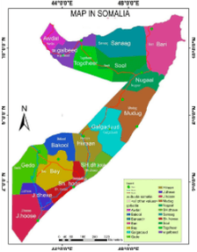
01 / OBJECTIVE
01
Understand the study areas and their locations within Somalia.
Study Objectives and GIS Focus
02
Identify boundaries, roads, buildings, and essential facilities.
GIS maps bring together location, boundaries, terrain, and risk in one clear view.
03
Turn geographic information into practical insight for flood-risk planning.
VISUAL DATA · SOMALIA REGIONS

Slide 3

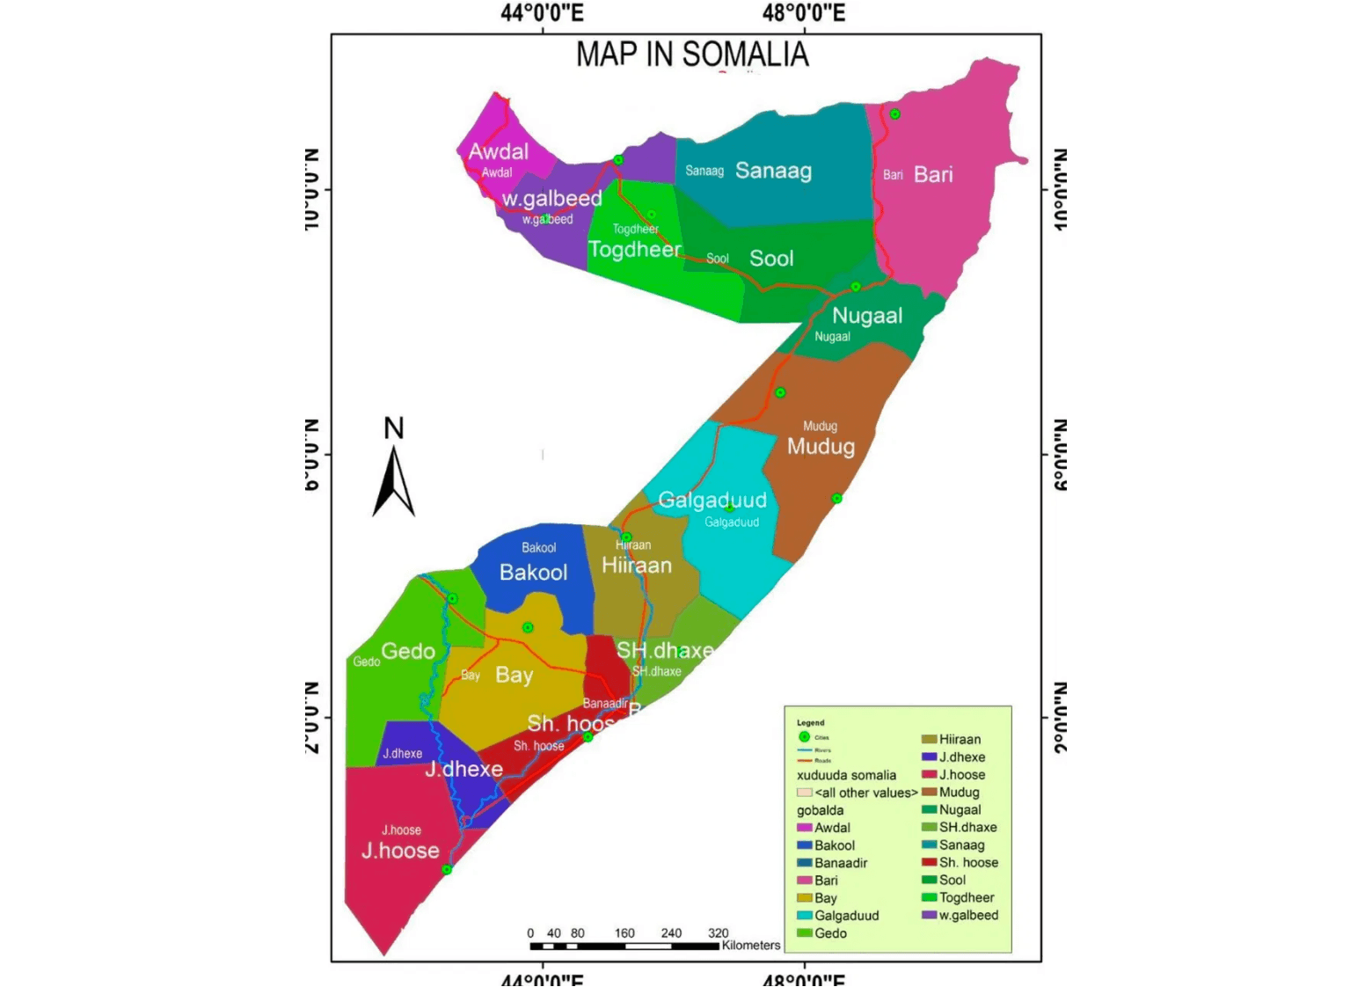
Somalia’s Regional Geographic Context
02 / REGIONAL CONTEXT
The map establishes the national context for the study areas.
REGIONS
Colors distinguish the
administrative regions shown on
the map.
CONNECTIVITY
City markers, rivers, and roads
help explain relationships
between locations.
ORIENTATION
This overview prepares the
audience for the district-level
maps that follow.

Slide 4

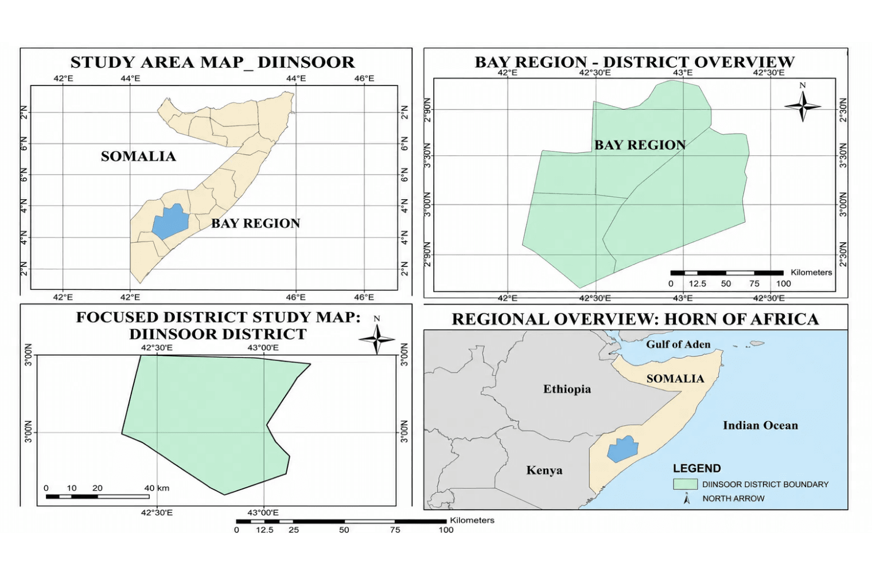
Diinsoor Study Area and Regional Setting
03 / STUDY LOCATION
The map moves from national context to district focus.
01
SOMALIA
The national view places the study area within Somalia.
02
BAY REGION
The regional view shows Diinsoor within Bay Region.
03
DIINSOOR DISTRICT
The district view defines the focused study boundary.
→
GEOGRAPHIC ZOOM
Three scales make the local context easier to interpret.
DIINSOOR DISTRICT · BAY REGION · SOMALIA

Slide 5

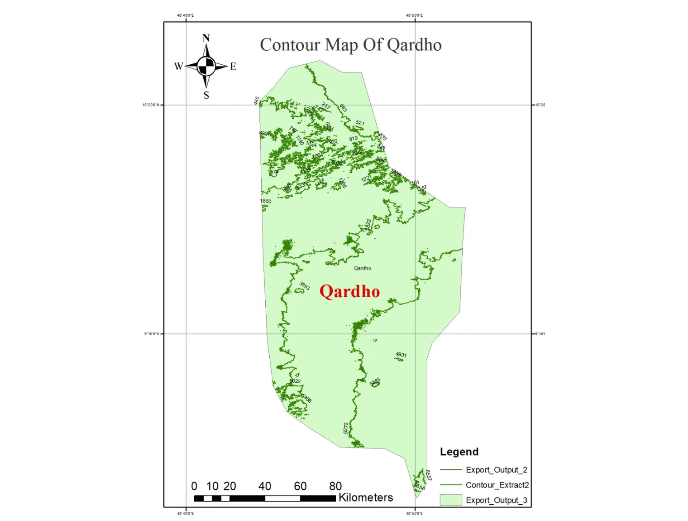
Qardho Terrain and Elevation Patterns
04 / TERRAIN STRUCTURE
Contours turn terrain form into readable geographic information.
CONTOUR LINES
The contour lines show the shape
and variation of the land
surface.
ELEVATION
Elevation labels help distinguish
higher areas from lower areas.
WATER FLOW
Understanding slope and low-lying
areas is important for assessing
how water may move.
QARDHO CONTOUR MAP · SUPPLIED MAP DATA

Slide 6

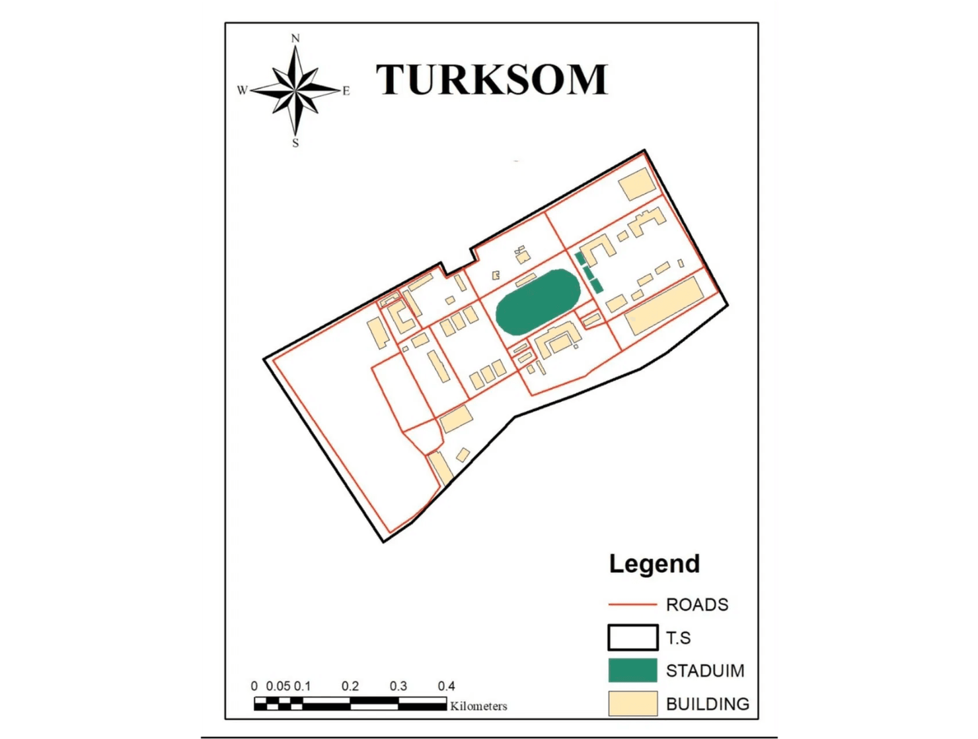
TurkSom Site Structure and Land Use
05 / SITE STRUCTURE
The map separates the main functional layers of the site.
SITE BOUNDARY
The black line defines the overall
extent of TurkSom.
ROADS
The terracotta lines show internal
circulation routes.
BUILDINGS
The yellow shapes identify
buildings distributed across the
site.
STADIUM
The green area at the center is the
visible stadium feature.
TURKSOM STUDY SITE
SITE MAP · GIS

Slide 7

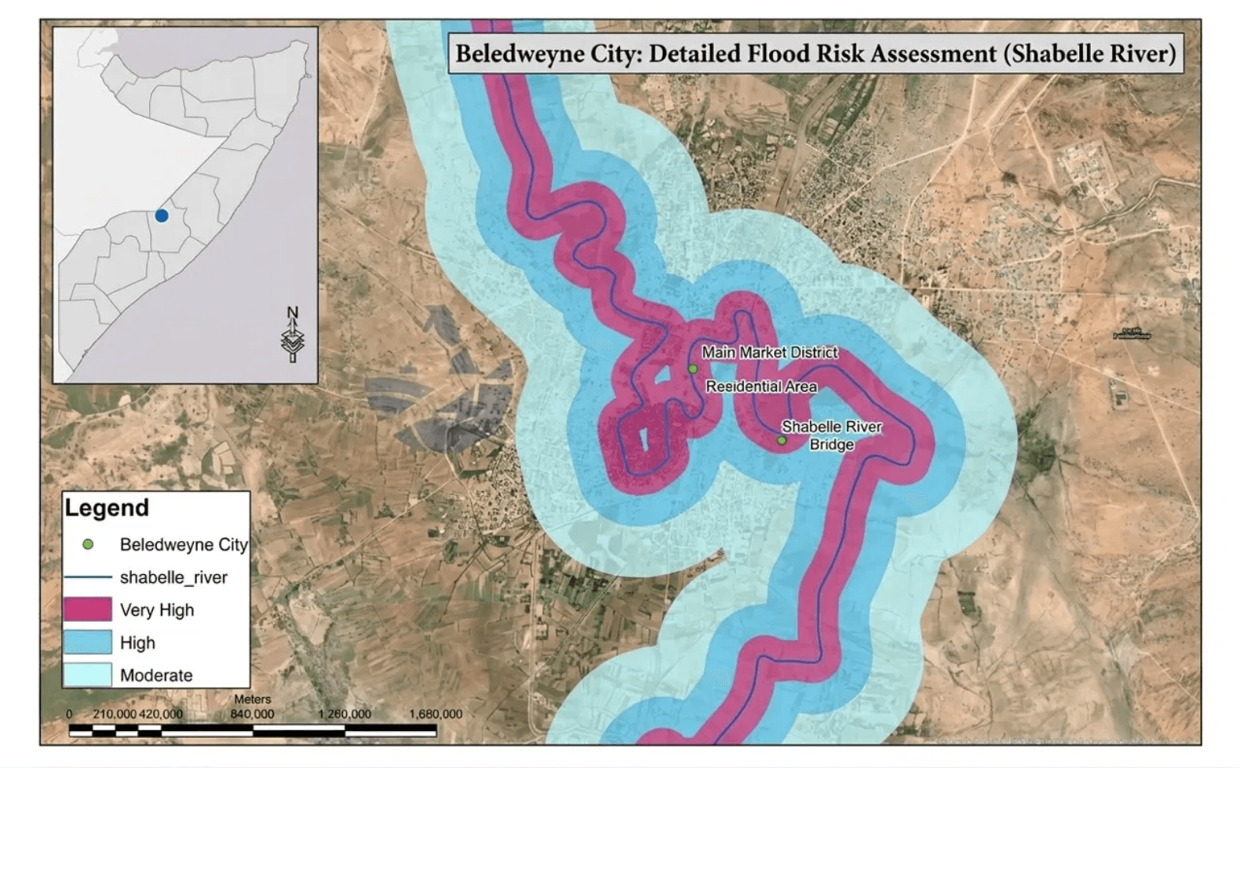
Beledweyne Flood-Risk Exposure
06 / FLOOD RISK
The Shabelle River is the key line for reading the city's flood exposure.
RIVER CORRIDOR
The map shows the river channel and the surrounding areas.
RISK LEVELS
Zones are classified as Very High, High, and Moderate.
KEY LANDMARKS
Main Market District, Residential Area, and Shabelle River Bridge require careful planning.
FLOOD-RISK GRADIENT
VERY HIGH
HIGH
MODERATE

Slide 8

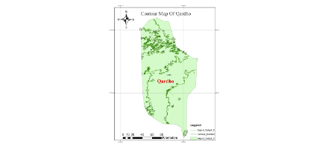
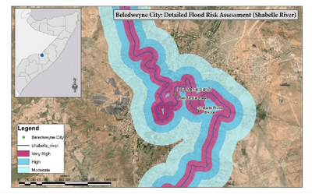
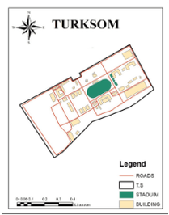
How Maps Turn Data into Planning Insight
07 / GIS MESSAGE
When different layers are combined, the map becomes a tool for understanding risk and priority.
01
02
03
Elevation and slope
Rivers and water flow
Land use and infrastructure
Contours and terrain variation help explain where water may flow and where low-lying areas may be vulnerable.
The river corridor helps identify where flooding may directly affect people and essential services.
Settlements, roads, buildings, and key facilities show what requires protection and planning.
BELEDWEYNE · SHABELLE
QARDHO · CONTOUR
TURKSOM · DIINSOOR
VISUAL EVIDENCE ACROSS THE STUDY AREAS
ELEVATION · WATER · LAND USE / ONE PLANNING VIEW
Notes:
map somali, somaliland map add slide

Slide 9

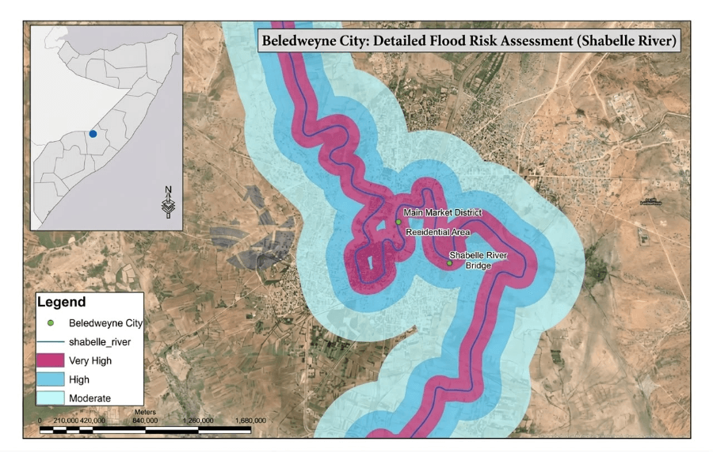
From Mapping to Action
08 / NEXT STEPS
Maps create value when their information is converted into an actionable plan.
01
02
03
Update the data
Plan evacuation
Strengthen coordination
Regularly update river, elevation, settlement, boundary, and infrastructure information.
Define evacuation routes, safe locations, and warning signs based on mapped risk zones.
Local authorities, communities, and technical institutions should share GIS information.
DATA · ELEVATION · BOUNDARY
WARNING · ROUTES · SAFETY
GOVERNMENT · COMMUNITY · GIS
EXAMPLE: FLOOD-RISK MAP · BELEDWEYNE
Expected outcome: Better preparation before floods, faster response during emergencies, and stronger community resilience.
DATA-DRIVEN ACTION / PLANNING BEFORE RISK

Slide 10

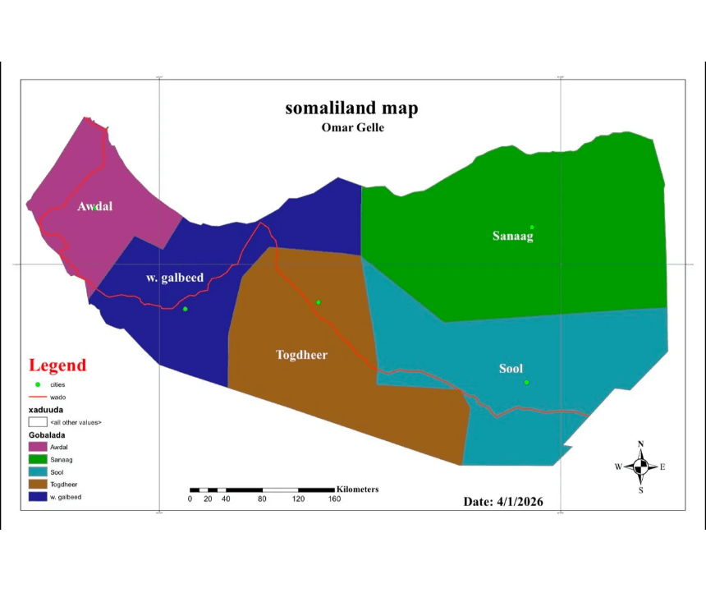
One Geographic Story, Better Decisions
09 / CONCLUSION
Geographic information becomes protection when it is used for sound planning.
Together, the maps of Somalia, Somaliland, Diinsoor, Qardho, TurkSom, and Beledweyne provide a connected view of location, terrain, infrastructure, and risk.
01
MAP
02
DATA
03
PLANNING
Shows where a place is located and how it is structured.
Explains elevation, rivers, roads, and land use.
Guides warning, evacuation, and community resilience.
REGIONAL MAP · SOMALILAND
SOMALIA · SOMALILAND · DIINSOOR · QARDHO · TURKSOM · BELEDWEYNE
ACCURATE MAPS — RESILIENT COMMUNITIES

Slide 11

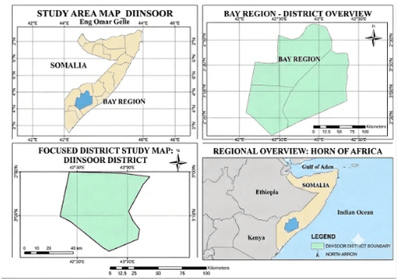
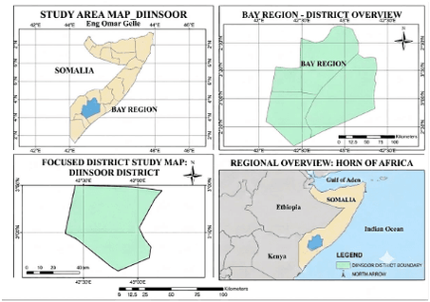
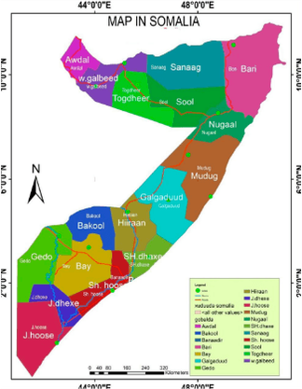
10 / CLOSING
Thank You
Questions and Discussion
QARDHO · DIINSOOR · TURKSOM · BELEDWEYNE
GIS / 2026
STUDY AREAS · MAPPING AND PLANNING

