Slide 1
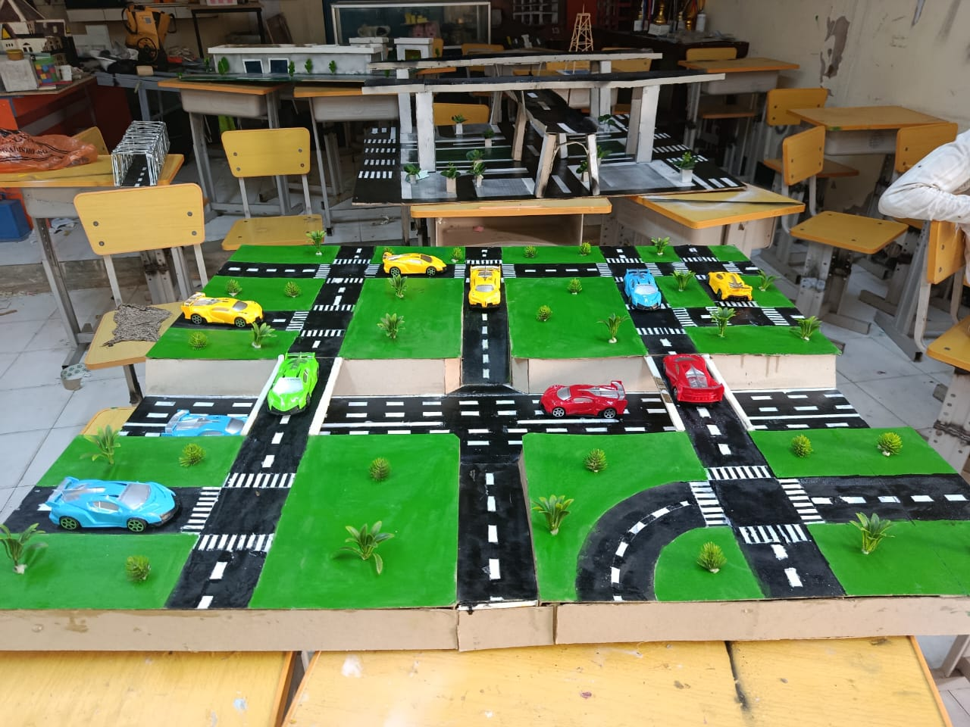
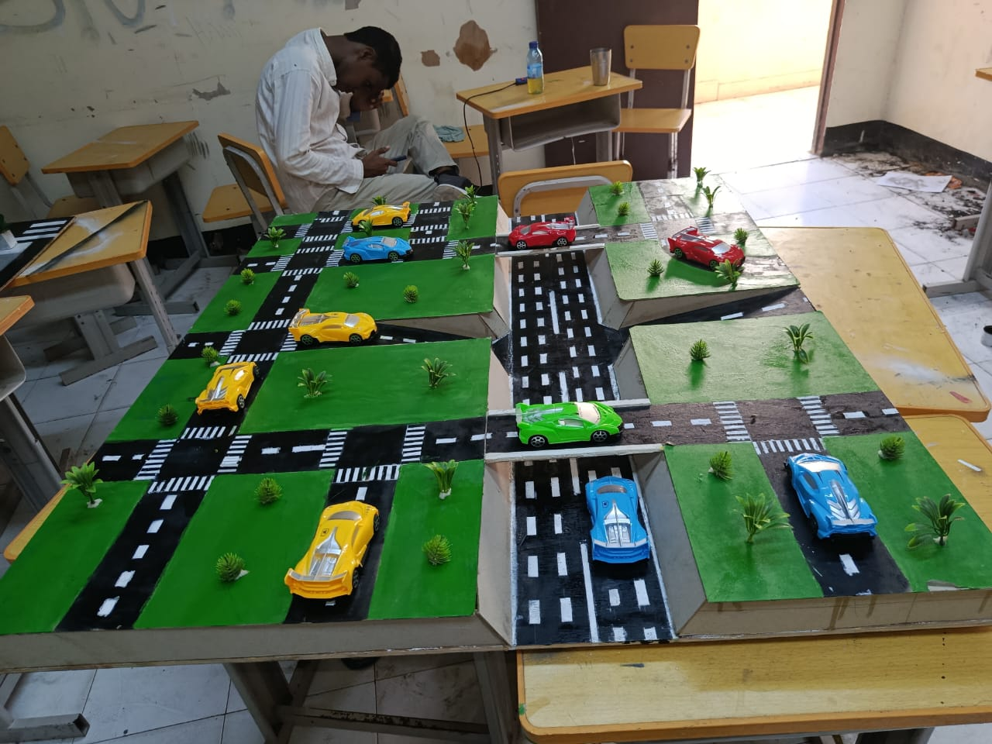
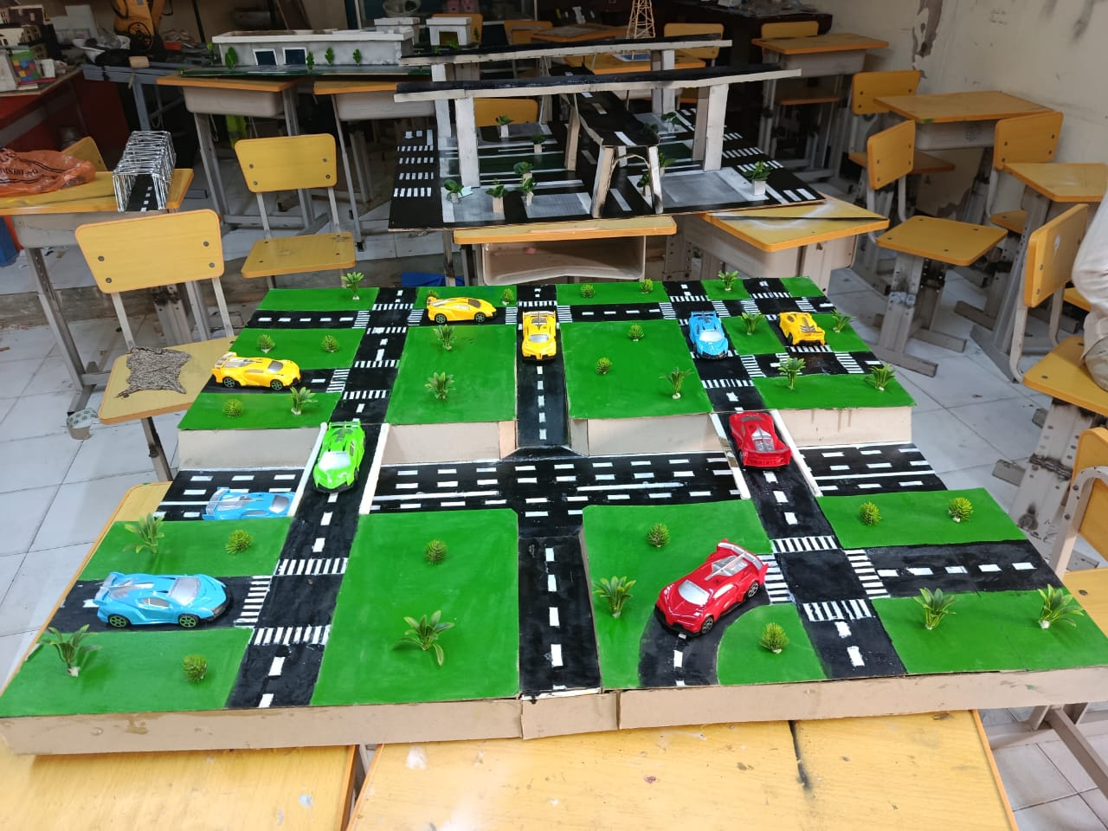
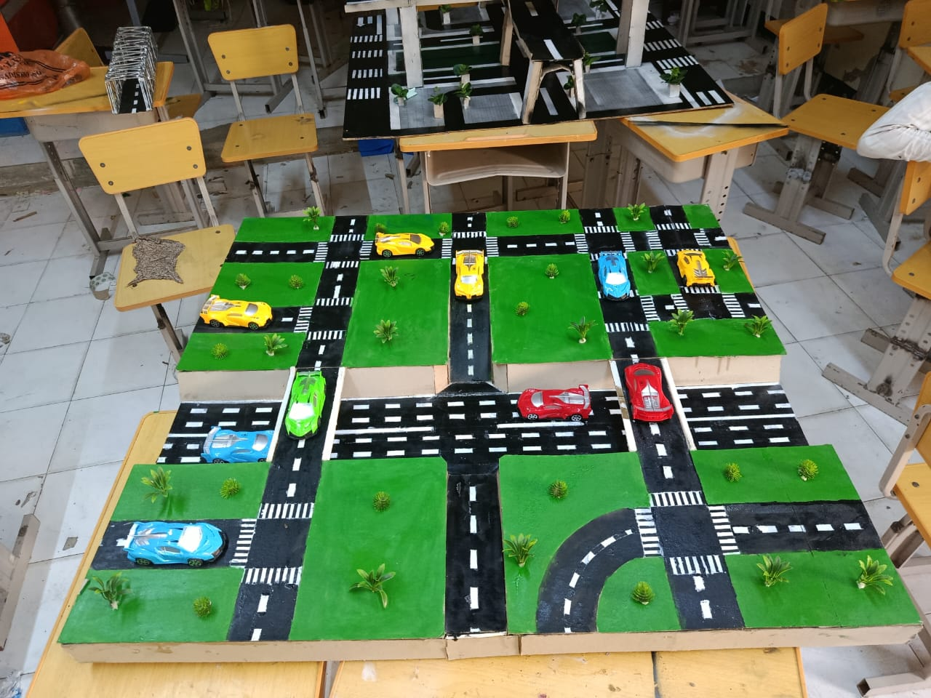
DESIGN OF A GRADE-SEPARATED INTERSECTION
Final Transportation Engineering Project Presentation
Course: Transportation Engineering
Instructor: Eng Osman Kulane
Presenter: Abdullahi Mohamed Sayidali
Prepared by:
Abdullahi Mohamed Sayidali
Abdisamed Hashi Abdulle
Abdishakur Mowlid Ibrahim
Abdiwahid Mohamed Farah
Aadan Cabdi Saiid
Abdiqaadir Abdullahi Mohamud

Slide 2
INTRODUCTION & BACKGROUND
A grade-separated intersection is a road intersection where different traffic movements are separated vertically using structures such as overpasses and underpasses.
This project focuses on the conceptual design and physical model of a grade-separated intersection.
Background
As urban areas develop, traffic demand increases and existing intersections may experience:-
Traffic congestion
Long queues and delays
Conflicting vehicle movements
Increased accident risk
Fuel wastage
Inefficient use of road capacity
The project therefore considers vertical separation of traffic movements as a possible solution to improve intersection performance.

Slide 3
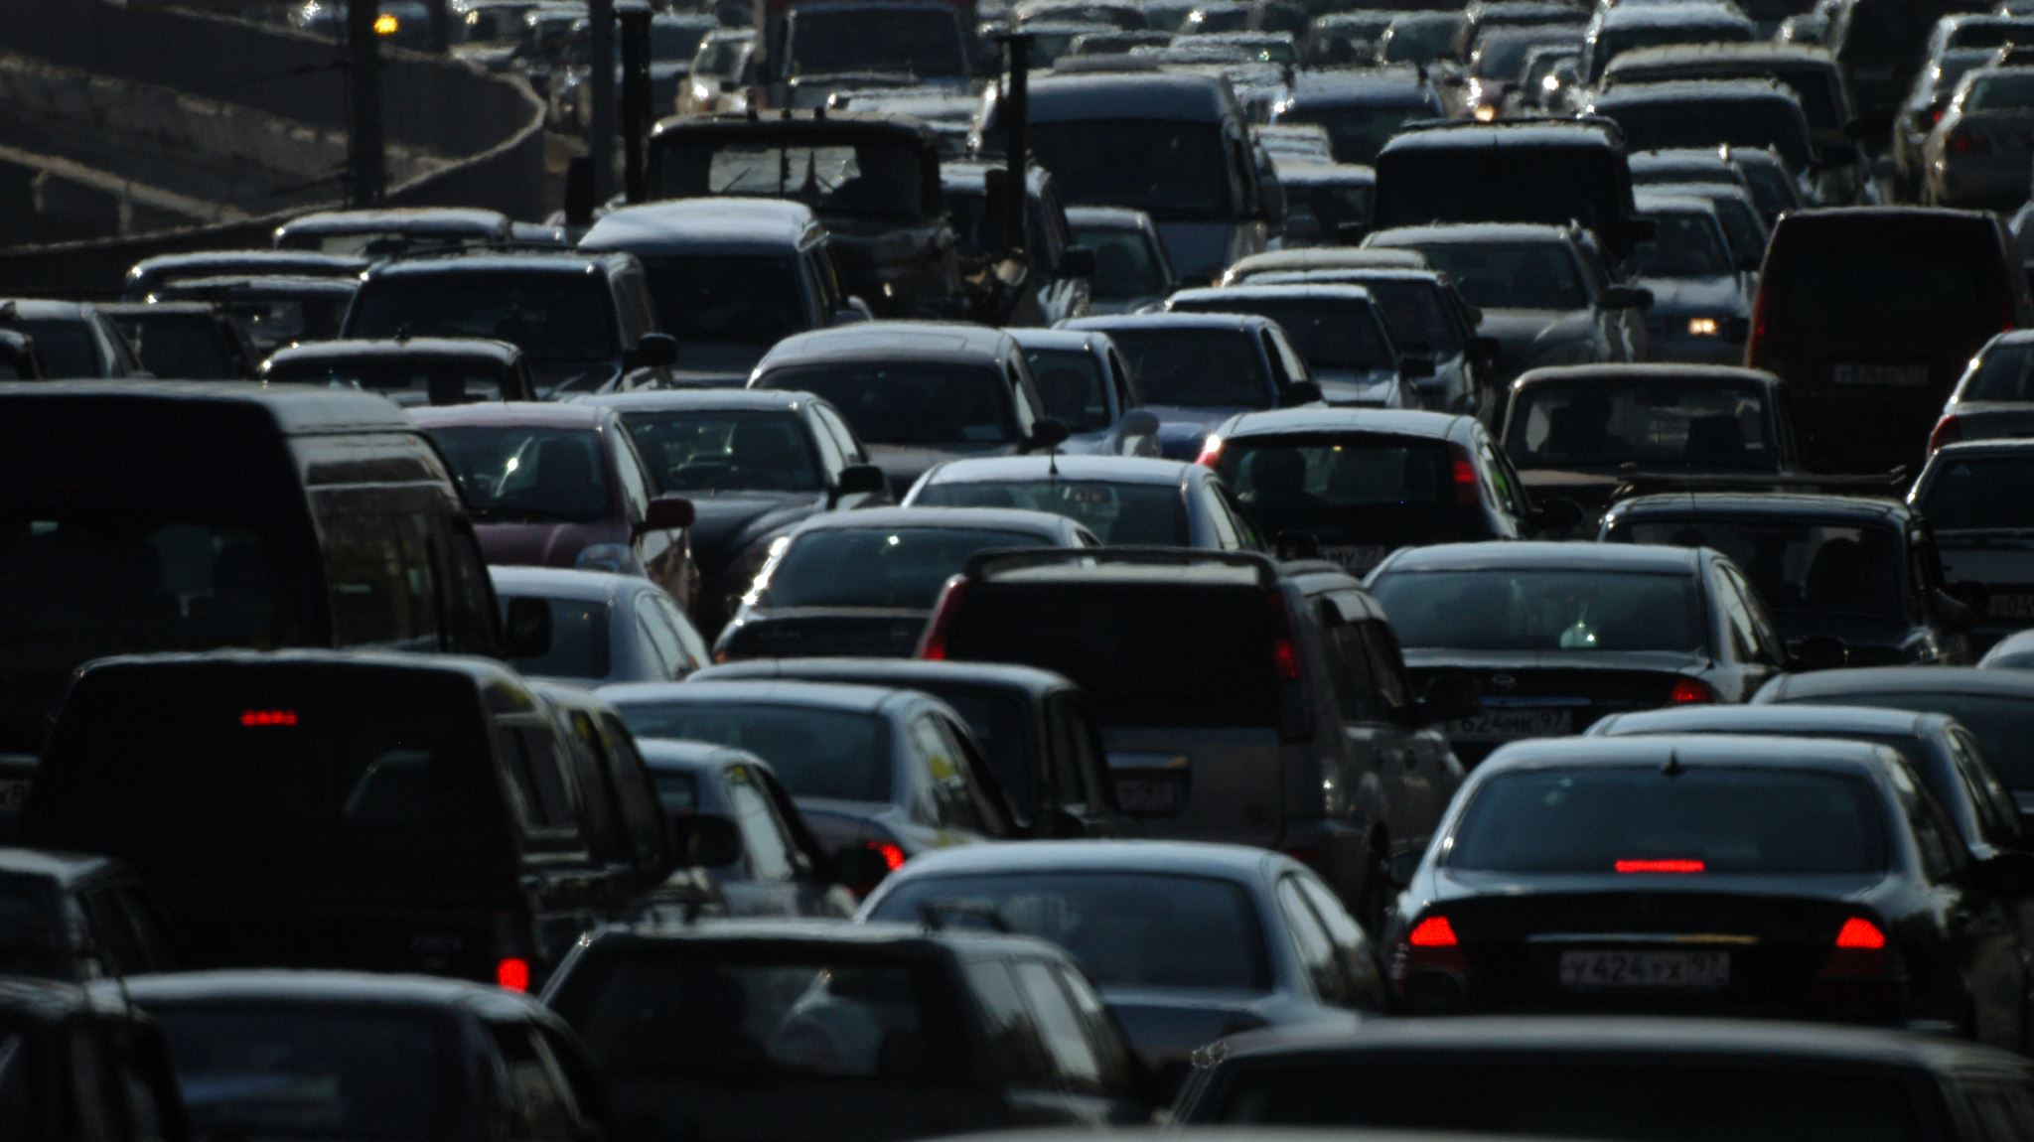
PROBLEM STATEMENT
Urban intersections can experience several transportation problems:
Traffic Congestion
High traffic volumes can exceed the capacity of conventional intersections.
Traffic Conflicts
Vehicles moving in different directions may cross each other's paths.
Safety Problems
Multiple conflicting movements can create safety challenges.
Travel Delays
Vehicles may spend considerable time waiting at intersections.
Fuel Wastage
Frequent stopping and idling can result in unnecessary fuel consumption.
Poor Traffic Organization
Inadequate intersection arrangements can reduce the efficiency of the road network.
Project Problem
How can traffic movements be separated and organized to improve the efficiency and safety of a congested intersection?

Slide 4
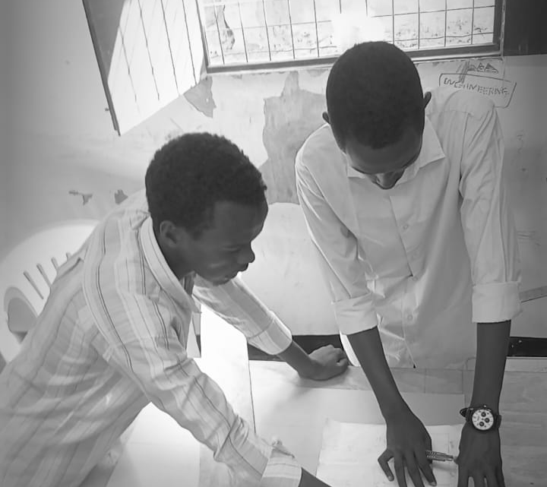
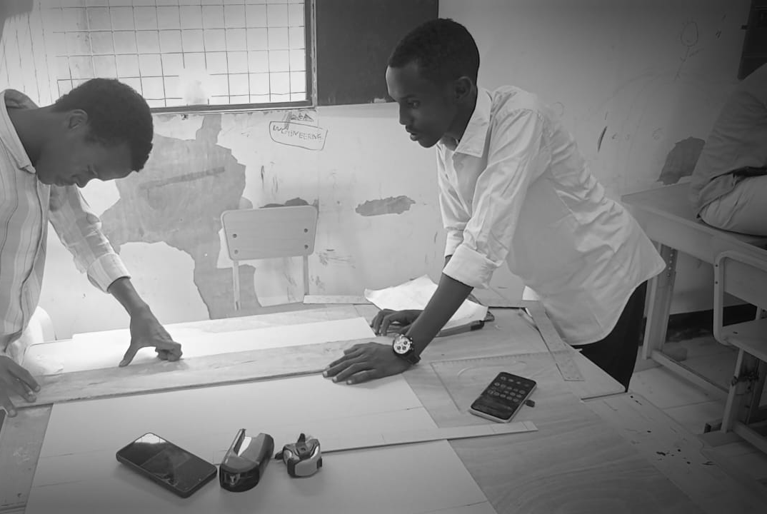
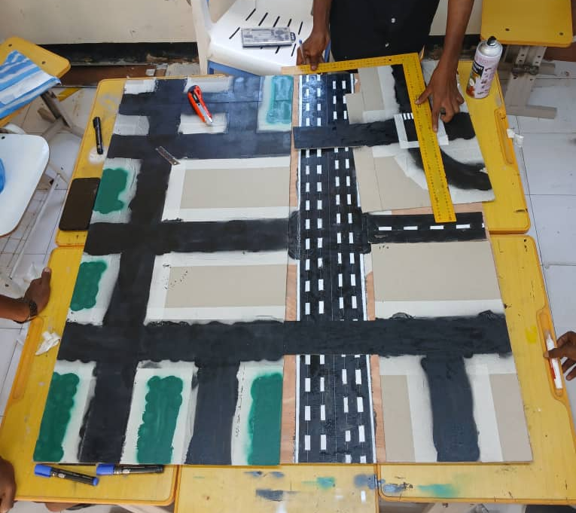
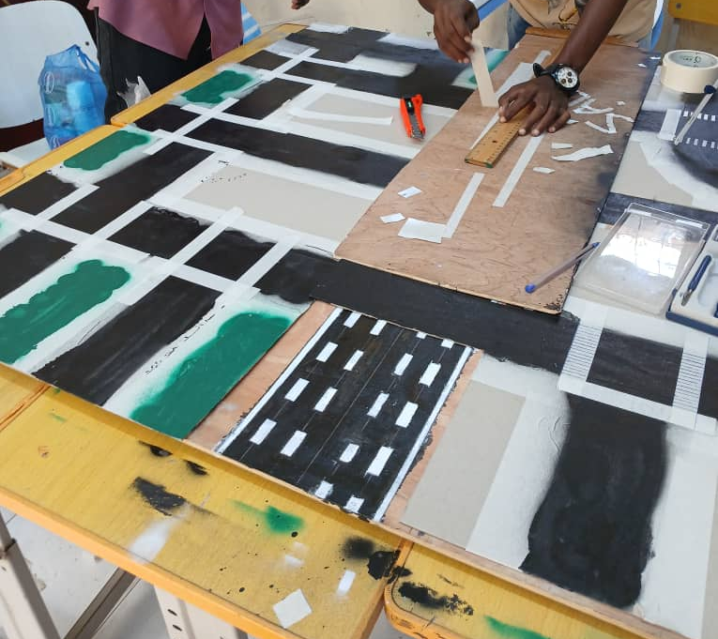
PROJECT AIM & OBJECTIVES
General Aim
To develop a conceptual grade-separated intersection design that improves traffic movement, reduces traffic conflicts, and contributes to safer and more efficient transportation.
Specific Objectives
To separate traffic flows at different levels
To reduce direct crossing conflicts
To improve road safety
To improve traffic flow
To reduce travel time
To provide a more organized road layout

Slide 5
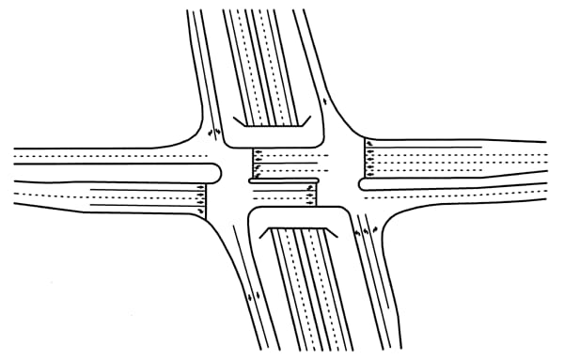
GRADE SEPARATION CONCEPT
What is Grade Separation?
Grade separation means arranging roads at different vertical levels so that selected traffic movements can pass without directly crossing each other at the same level.
Overpass
A roadway passes above another roadway.
Underpass
A roadway passes below another roadway.
Key Concept
Vertical separation allows selected traffic movements to continue with fewer direct crossing conflicts.
Suggested visual:
Use one clear engineering diagram showing an overpass and underpass with traffic arrows.

Slide 6
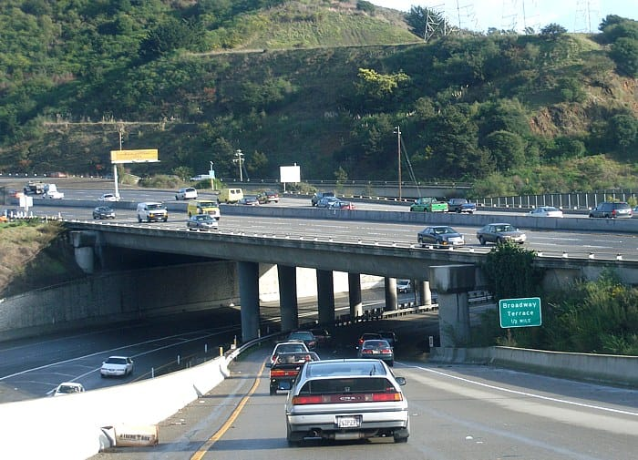
PROPOSED INTERSECTION DESIGN
The proposed intersection consists of:-
Main roadway
Underpass
Elevated overpass
Side roads
Road connections
Lane markings
Traffic-control features
Design Concept
The proposed arrangement separates selected traffic movements vertically while maintaining connections between the surrounding roads.
The main purpose is to create a more organized movement of traffic through the intersection.

Slide 7
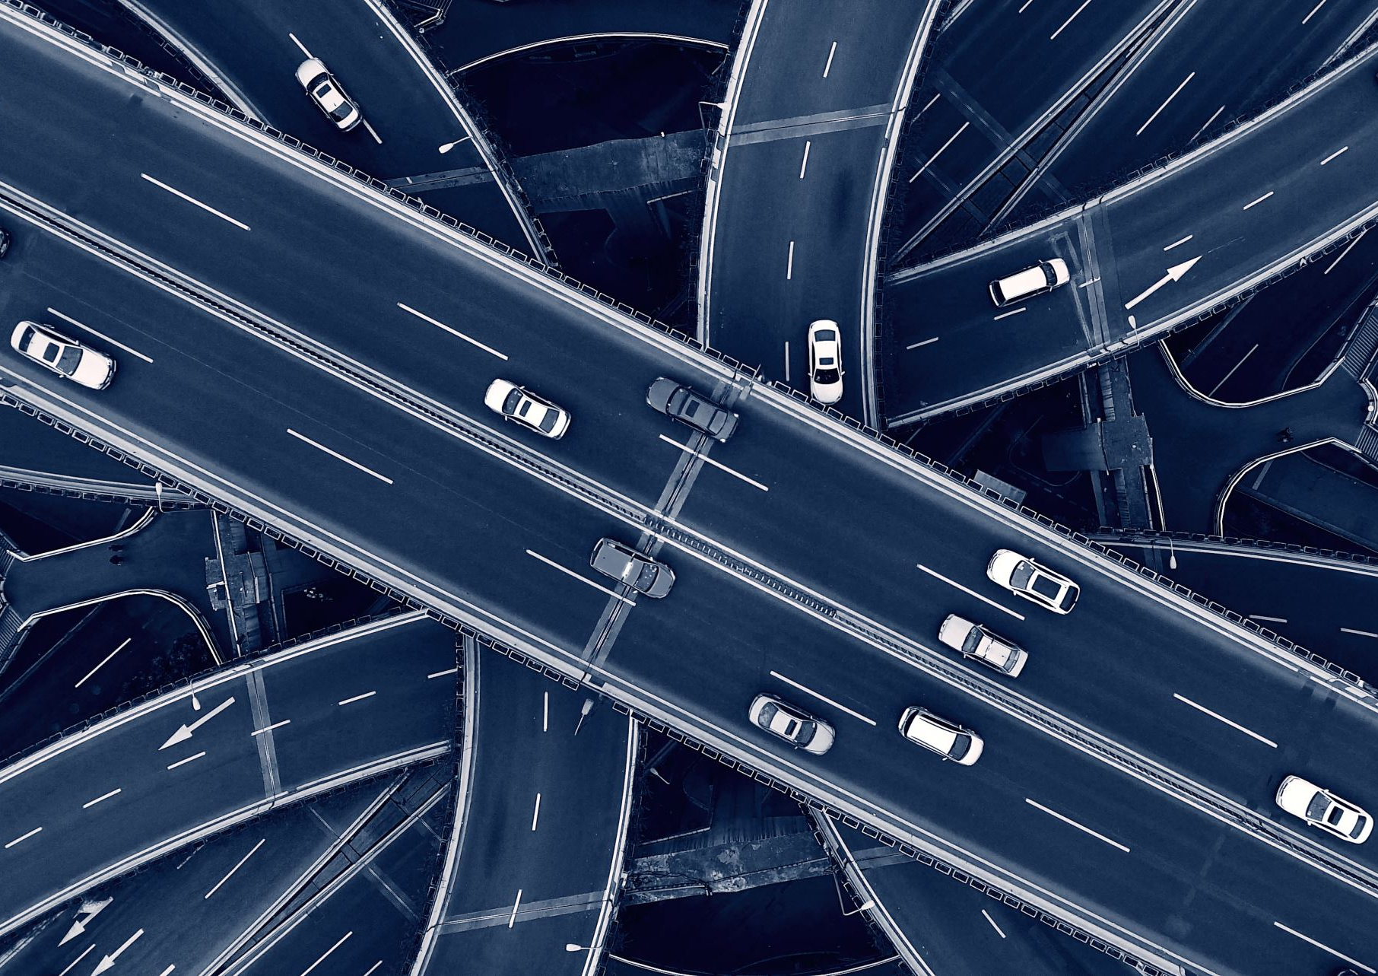
TRAFFIC FLOW & SAFETY
Traffic Flow
The proposed design separates traffic movements vertically:-
Some traffic passes through the underpass.
Other traffic uses the overpass.
Side roads provide connections.
Lane markings guide vehicle movement.
Traffic movements become more organized.
Safety Considerations
The design aims to improve safety through:-
Separation of traffic movements
Clear lane markings
Organized road connections
Reduced direct crossing conflicts
Better organization of vehicle movement
Appropriate traffic-control features
Expected Effect
Better traffic continuity + fewer direct conflicts + more organized movement

Slide 8
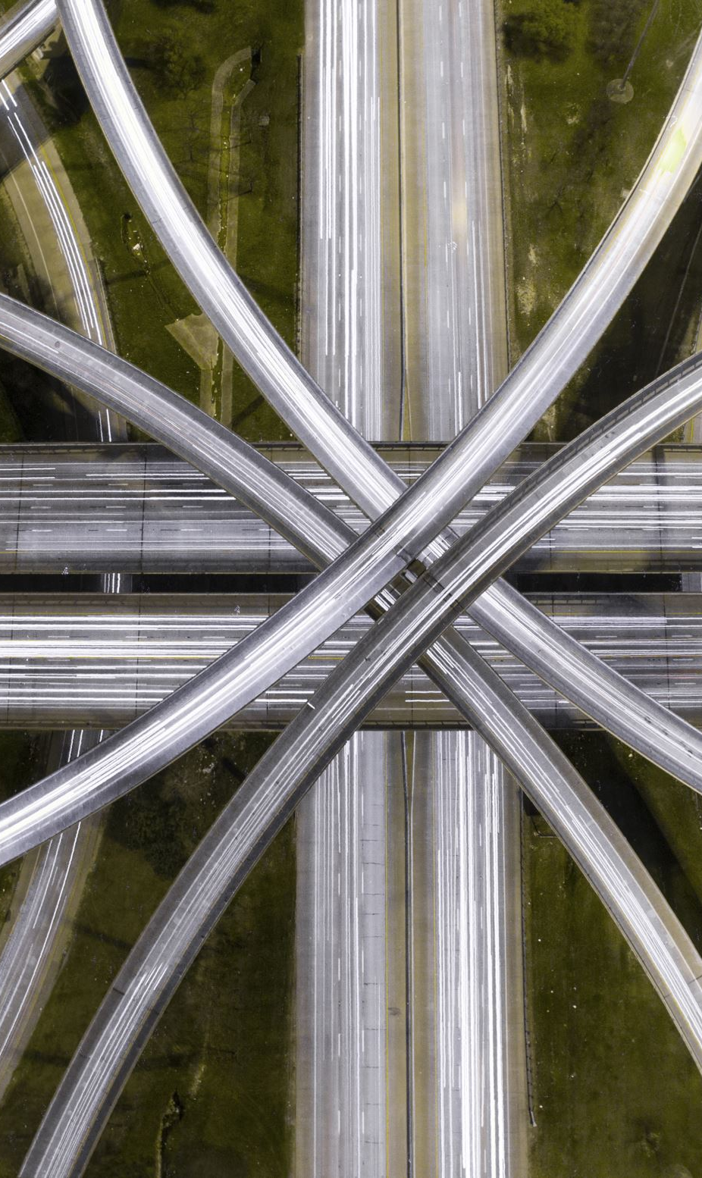
LOCATION
& IMPORTANCE
Location Suitability
The proposed design is suitable for:-
High-traffic intersections
Busy urban roads
Congested intersections
Areas experiencing significant traffic delays
Importance
The proposed design can potentially:-
Improve traffic flow
Reduce direct traffic conflicts
Reduce intersection delays
Improve road safety
Save travel time and fuel
Support urban transportation development
These benefits are consistent with the original project presentation.

Slide 9
FINAL PROJECT MODEL
FINAL PROJECT MODEL
The completed model demonstrates:-
A separated road system
An overpass
An underpass
Side-road connections
Organized traffic movement
Lane markings and road features

Slide 10
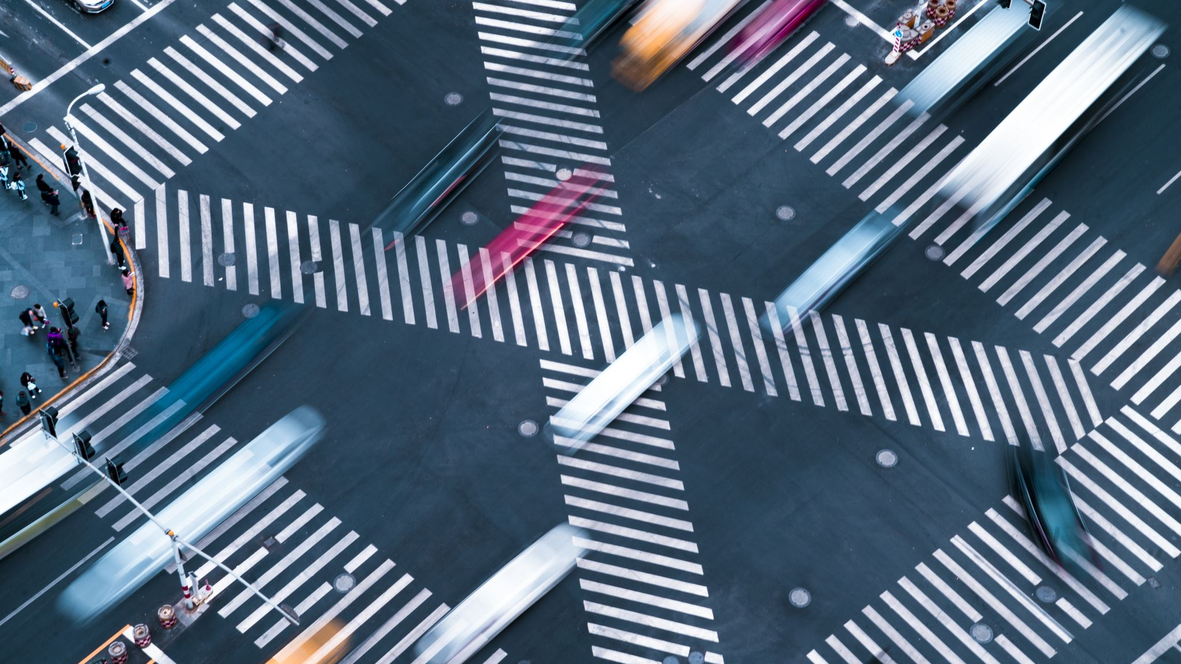
RESULTS
The final model demonstrates:-
Smooth and organized traffic movement
Reduced direct crossing conflicts
Separation of selected traffic movements
A modern grade-separated intersection concept

Slide 11
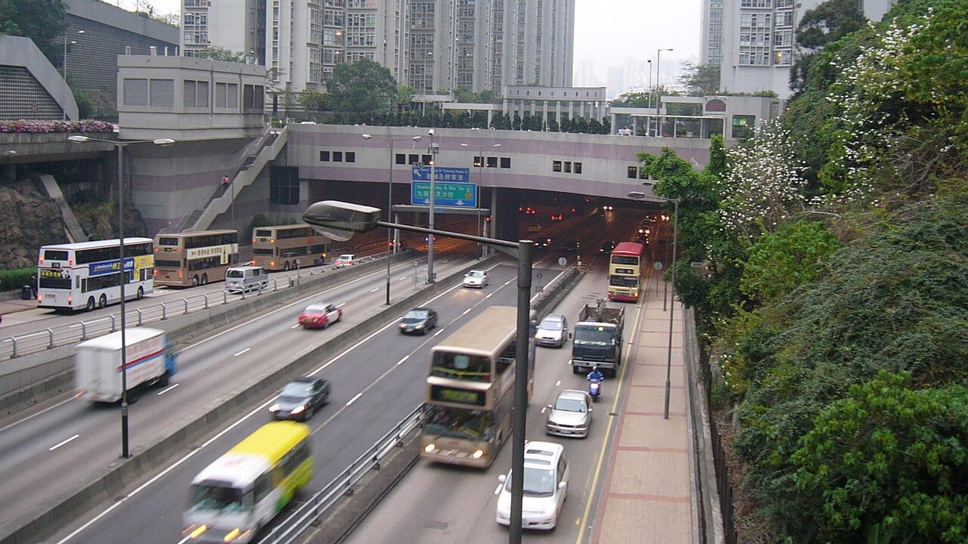
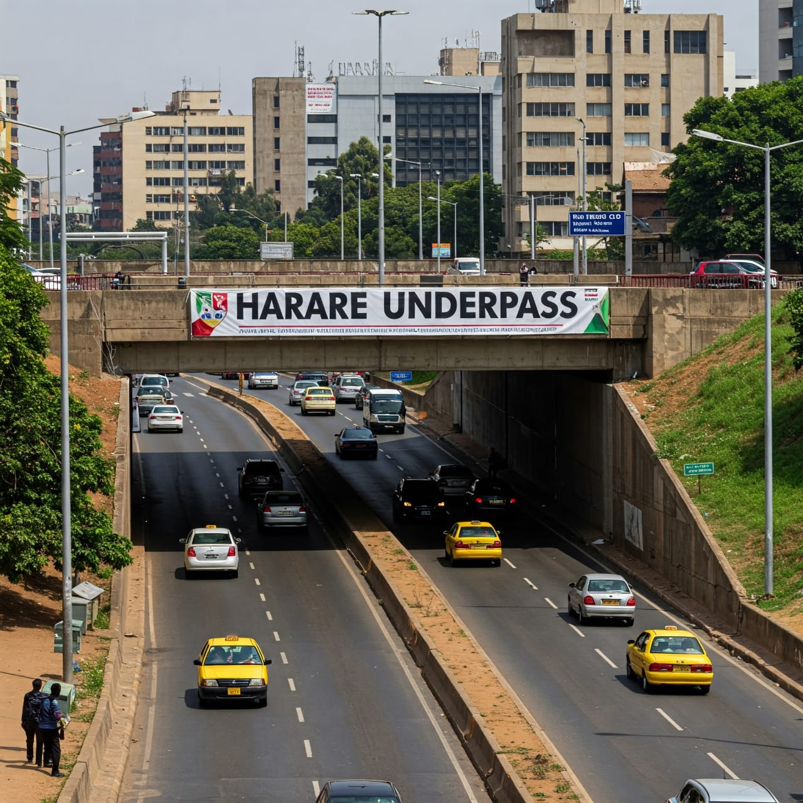
CONCLUSION
This project demonstrates the concept of a grade-separated intersection using an overpass and an underpass.
The proposed design aims to:-
Improve traffic flow
Reduce direct traffic conflicts
Reduce congestion
Improve road safety
Reduce travel delays
Provide a more organized transportation system
Grade separation provides a conceptual approach for organizing traffic movements at congested urban intersections.
The original project concludes that proper intersection design can help address traffic problems and that grade-separated intersections can be effective in modern cities.

Slide 12
THANK YOU FOR YOUR ATTENTION
QUESTIONS & DISCUSSION
Transportation Engineering Project
Design of a Grade-Separated Intersection

